Slide 1
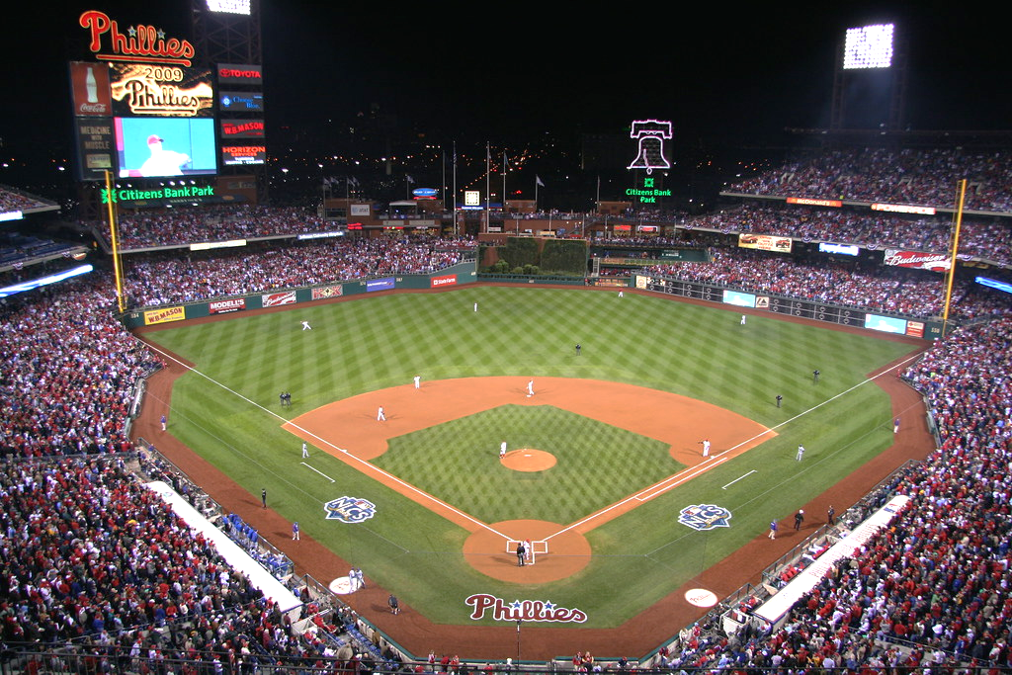
ChargeItSpot Partnership
Pitched by: Jimmy Lambert, Jacob Thomas, Matt Root, and Lukas Stauffer

Slide 2
The Bullpen
1
Who we are...
3
Value during Covid-19
2
4
Our inventory/value creation
Example Activations/Summary

Slide 3
Who are the Phillies?
Have won seven NL pennants and two World Series titles
Oldest continuously run, single-name, single-city team in American professional sports
Organization looking to mirror the technological strides of the world
Notes:
We are the philadelphia phillies and we were founded in 1883. In our long history we have won seven National League pennants and two world series titles. We are currently the oldest continuously run, single name, single city team in American Professional sports. Along with the recent technological advancements in our country and the world we find it extremely important as an organization to mirror those advancements in our players, management, front offices, and partnerships.

Slide 4
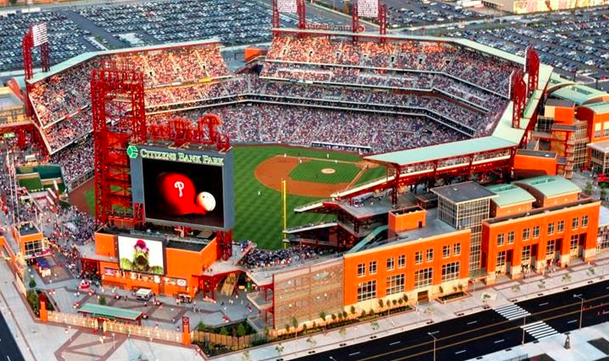
We will help you...
Achieve your primary goal of greater brand awareness amongst consumers
Continue the local surge into Philadelphia professional sports teams
Achieve your secondary goal of using this first major partnership opportunity to drive B2B sales in other sports and entertainment venues
Notes:
How will we help you at Charge it spot. We will help you achieve your primary goal of greater brand awareness amongst consumers. As an emerging company it is important to be seen in a location where business is happening. With the continued growth in social media, sports betting and the overall use of technology during these games phone batteries will continue to lose their battery bring more and more need for your product. We are also the final piece to helping you get into every professional sports stadium in the city of Philadelphia. Lastly we want to help you achieve your secondary goal of using what will be your first major partnership to help drive your business to business sales on other sports and entertainment venues. This first major partnership is huge for your company and will propel you forward into many other venues. We want you to charge the Phillies.

Slide 5
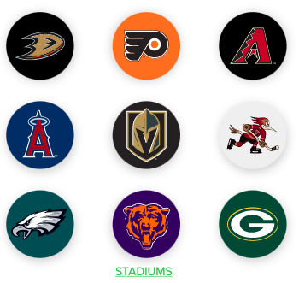
Why you fit in with us
Local Businesses
Big Brand Partnerships
Congruence and Sponsorship Alignment
Notes:
We are both Philly born businesses and you have product in all other professional sports venues in Philadelphia. we both value dedication and paying attention to every detail of our business, which is essential in a successful partnership. We are partners with some of the biggest brands in the United states because we place a great deal of emphasis on sponsorship congruence and alignment. But at the same time the sponsorship has to be eye-catching and stand out.

Slide 6
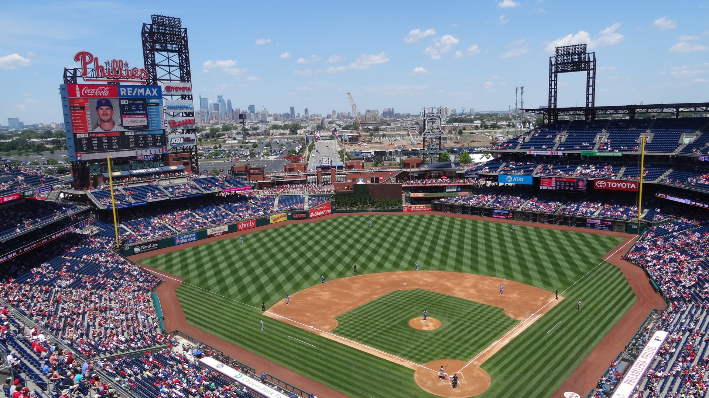
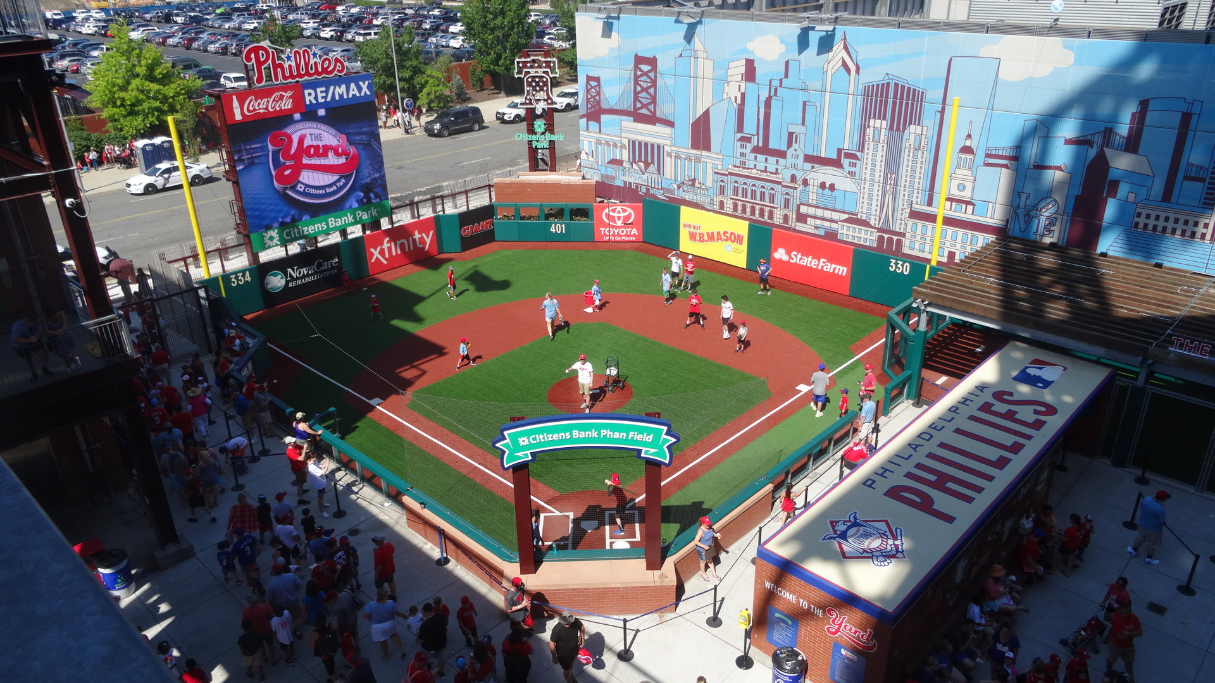
Citizens Bank Park Sponsorship Inventory
Add signage throughout ball park
Access to suites and suite holders
Product giveaways / Event naming
Social media campaigns
Activation space in social / Concession area

Slide 7
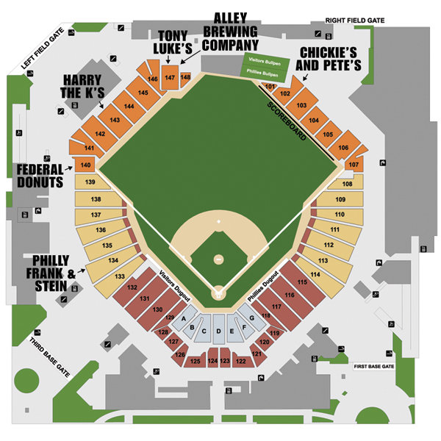
= ChargeItSpot Station

Slide 8
Delivering Value During COVID-19
Social Media
On-site Activation
Virtual Opportunities

Slide 9
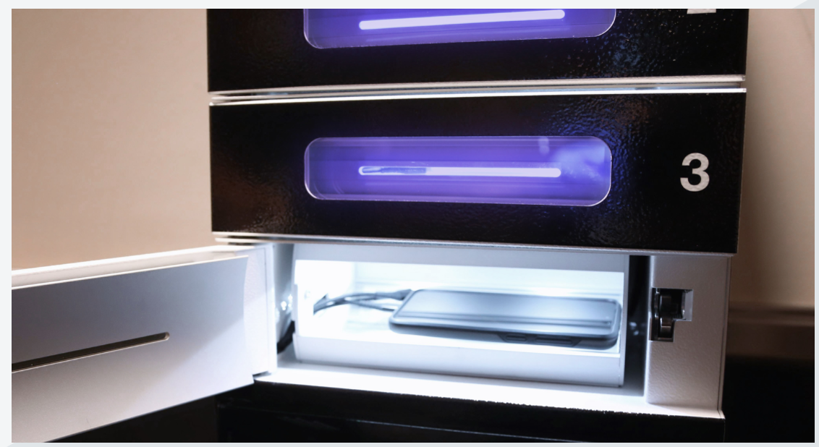
Delivering Value On-Site
Be a part of the solution and eliminate COVID-19
Charge It Spot has UV-C technology that offers a way for guest to eliminate up to 99.9% of select viruses and bacteria while their phone charges
Mutually beneficial partnership
Although fans are limited at the game, the kiosk still generates direct brand exposure/awareness
Notes:
Teams are looking for a way to prevent the spread of covid-19 and look for alternatives to these existing partnerships. This new sponsorship allows us to have both
We see this partnership creating value for both sides in covid world and non covid world, that's why we think this is such a neat opportunity for both parties.
Optimistic that fan attendance will increase
On April 4th, capacity increased to 25% which means 11,000 fans can attend the game

Slide 10
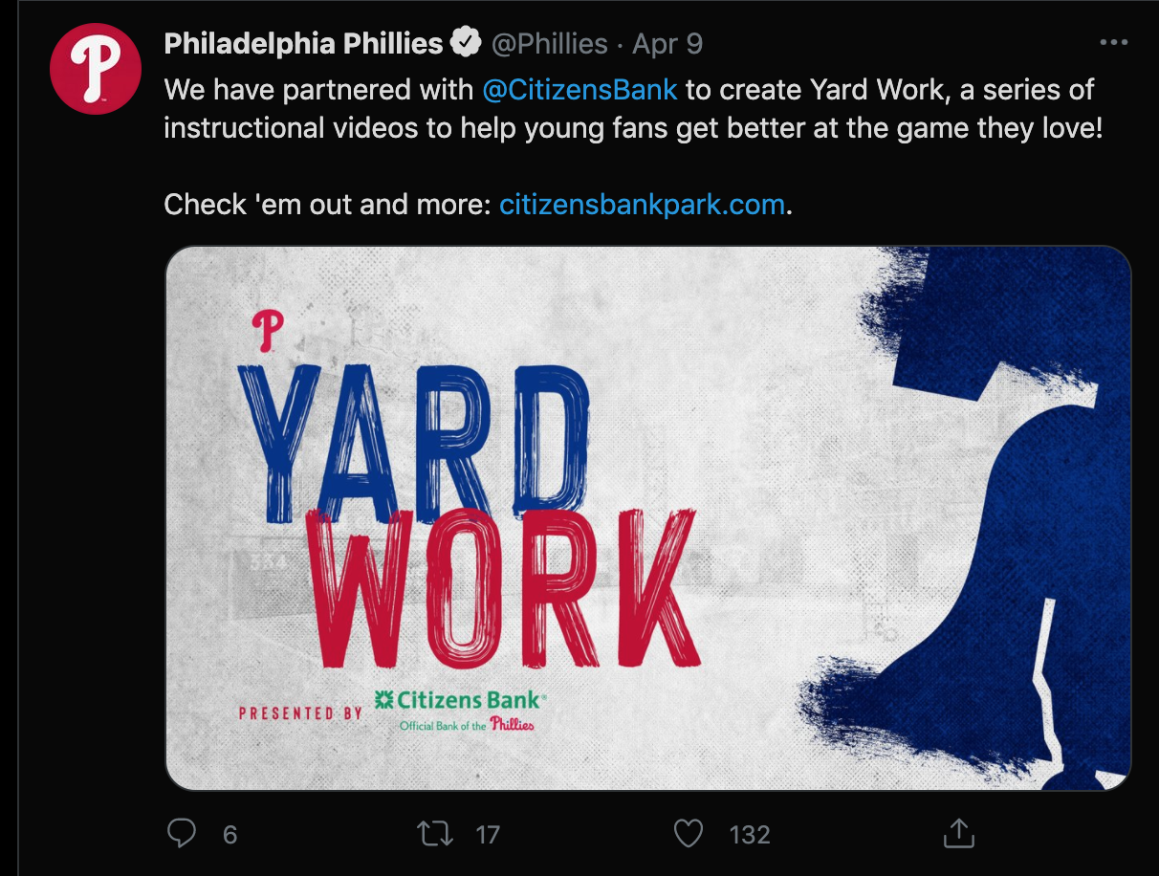
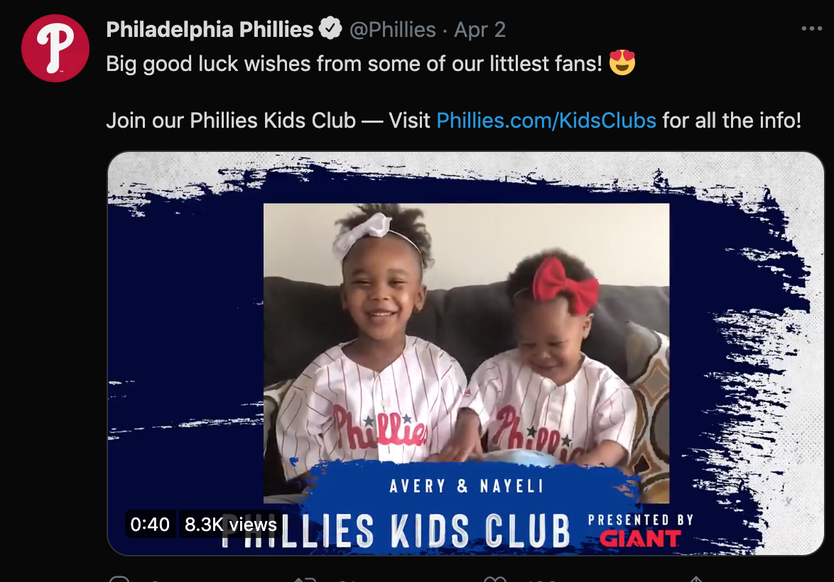
Promising Value Through Social Media
Notes:
Main point- showcase how creative our social media activations have been
-relatable to the younger generation
1.8 million followers on twitter
761k f followers on instagram

Slide 11
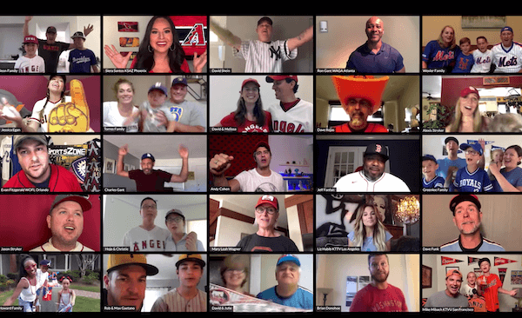
Virtual Post-Game Fan Interview
When you use a ChargeItSpot station and enter your contact information you will be entered to win a chance to ask the player of the game an interview question of your choice (pre-approved)
“The ChargeItSpot virtual fan question of the night comes from ______”

Slide 12
Present:
The Charge Forward Campaign

Slide 13
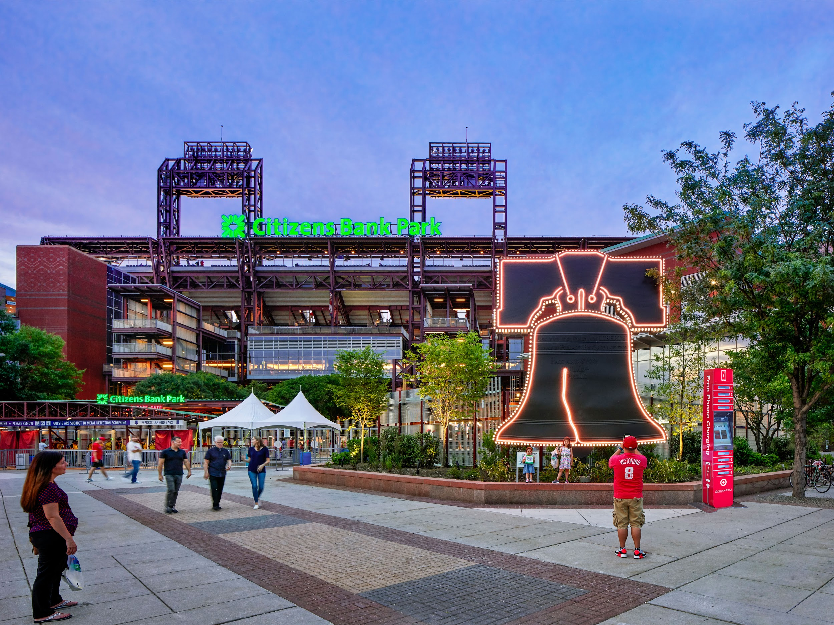
On-site activation
Notes:
A visualization of consumers interacting with the partnership through placement of the kiosks in plazas and other highly trafficked areas like Matt mentioned earlier
ChargeItSpot Activation Video(just in case)

Slide 14
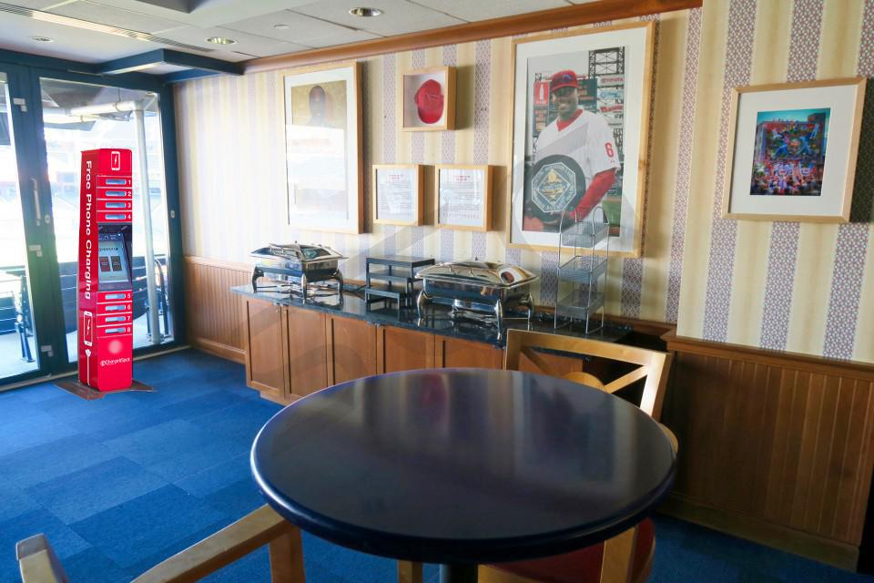
On-site activation
Notes:
Placement in suites, many of which are leased by corporations during game-days. Great space for business gatherings and exchanging contact information, which exacerbates the need to have a charged phone.
B2B corporate sweepstakes: Every corporate suit holder who uses the station (over the season) and opts-in to put their business contact information into the charging station will be entered to win a free custom-branded charging station to be delivered to their corporate offices or factory.
Help to drive new leads among b2b sales

Slide 15
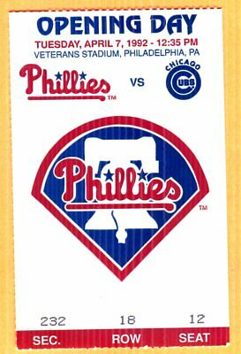
Local Community Activation
Negative situation Positive situation
Premise: Every time a Phillies player is hit by a pitch, we will donate to a local charity of that players choice
All fans that entered their contact information on the charging stations will also be eligible to receive 2 tickets to Phillies opening day next season
Notes:
We want to use this partnership to support Philadelphia. First, we have a unique donation opportunity through hit batters. And we also will help to Incentivize the usage of the stations through an opening day ticket giveaway.
Allows you to gain valuable customer insights and analytics. This forges a positive image for both organizations through the implementation of CSR through the on-field action.

Slide 16
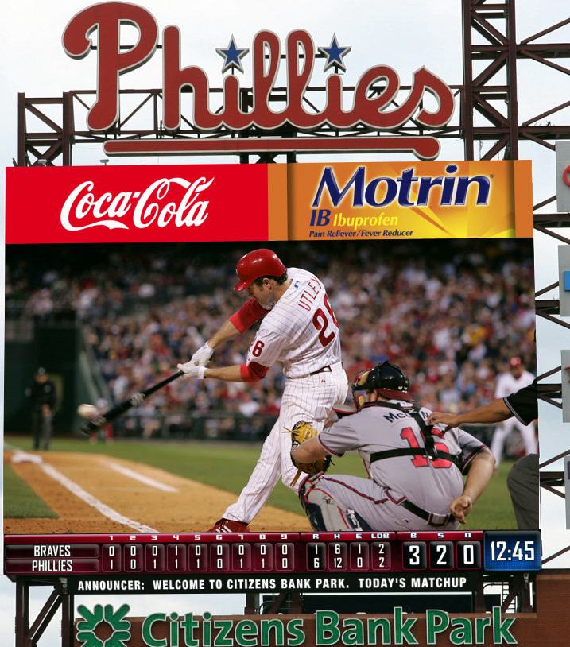
Naming Activation
7th Inning stretch
A time for fans to “charge-up” for the last 2 innings
Unique engagement through jumbotron
Notes:
Unique naming activation for the 7th inning stretch that creates new value through mass exposure. Here is an example of a mock PA announcement.
On screen, fans can use their phones to take a photo of their party to be featured on the video board during the ChargedUp 7th inning stretch. Also, because this is the Largest video board in the National League it provides the greatest exposure of brand placement due to everyone looking at the board for themselves to be featured

Slide 17
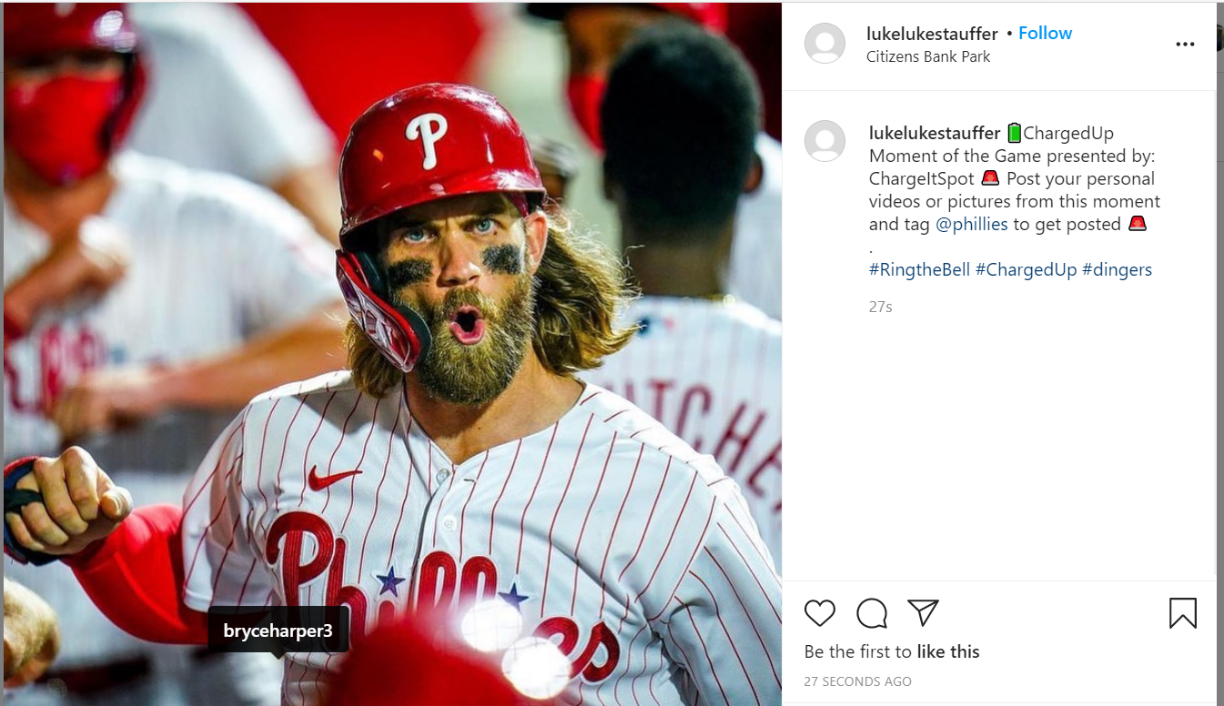
Social Media Activation
Notes:
Charged up moment of the game
By tagging Bryce Harper its allows for greater engagement (82% more engagement than posts without players tagged)
Allow for fan-centered content through tagging and reposting which is the most authentic engagement on social media
Provides great execution on brand awareness for their target of younger audiences
Pass it off to Matt to summarize how we can help you achieve your goals and propel Chargeitspot to new heights

Slide 18
The Closer
Goal 1: Greater brand awareness amongst consumers
Inventory: On-site placement, Community engagement, social media, naming rights
Activations: Kiosk placements, ChargedUp Moment of the Game, 7th inning stretch presented by ChargeItSpot
Goal 2: Drive B2B sales in other sports and entertainment venues
Inventory: Suite placement
Activations: Kiosk giveaway and interaction with corporations

Slide 19
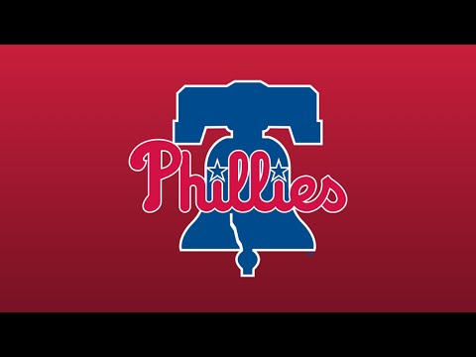
Notes:
Come be apart of our Phillies family and together we can knock this partnership out of the park

