Slide 1
SM 440 Take Home Exam 1
Sidney Johnson, Lukas Stauffer, Lucas Vargas

Slide 2
Question #1 Proposal for New Arena in Downtown Richmond, VA
You work for a development team that is proposing to build a new arena in downtown Richmond, Virginia. The venue would host a few minor league and niche sport teams. The venue would be the anchor for a mixed-use development that would include hundreds of new residential units, other entertainment amenities, and commercial spaces for businesses. You have been tasked with writing the PowerPoint presentation (other presentation software) that will be used to explain to the City Council why this project is important for the city’s future. The presentation (using data and theories) must explain what has changed for Richmond and why projects of this type have the potential to reverse or retard unfavorable economic or demographic trends. Your presentation must address the following for points:

Slide 3
Question #1a: Demographics, Employment Data, Regional Comparison, Decentralization Trends
Using demographic and employment data explain the changes taking place in Richmond compared to its region. Explain the factors that sustain decentralization trends that you have observed.

Slide 4
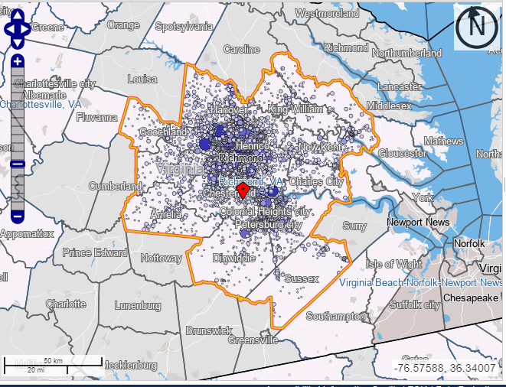
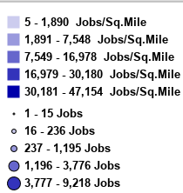
Notes:
The map shown above covers a roughly 40 square mile area centered by downtown. The darker areas represent job concentrations. The graphic shows that the Richmond, VA area is decentralized with job concentrations in select areas 10 miles away from the proposed arena site in downtown Richmond. Property tax revenues in downtown Richmond could be increased with the addition of the new arena and the accompanying real estate, commercial and retail development project.

Slide 5
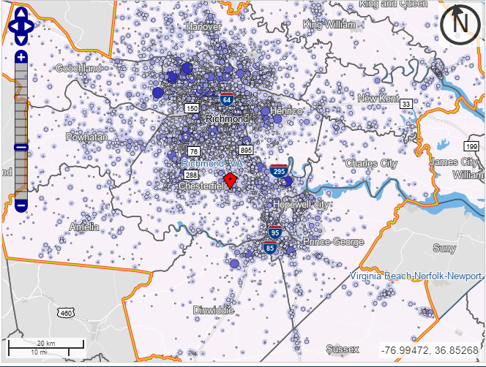
Notes:
A closer look at the job dispersion in the region surrounding Richmond.

Slide 6
Demographic Characteristics, Richmond VA (Region)
Metropolitan/Micropolitan Areas (CBSA)

Slide 7
Downtown Area Demographics
Notes:
A larger percentage of high income jobs are located in the Richmond downtown area relative to the region. This is good indicator for commercial property tax revenue inflow. Year-over-Year the rate of growth has been _________.

Slide 8
College Educated Populace
Notes:
There is a high level of entrepreneurial capital in the region. Two A-10 Schools near Richmond (VA Commonwealth and Richmond).

Slide 9
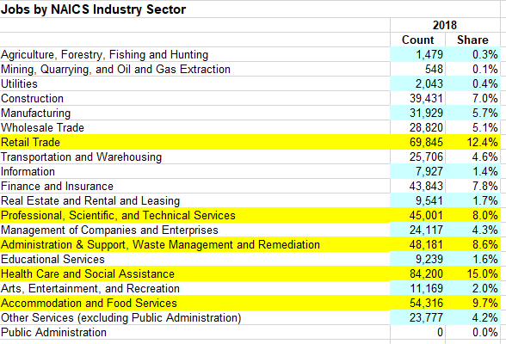
Health Care and Retail Trade Dominate
Metropolitan/Micropolitan Areas (CBSA)
Notes:
The Richmond Job Market is dominated by Health Care Jobs ranging from higher-paying (Doctors, Hospital Adminstration) to lower-paying (Nursing Aide, Home Health Care Aid). Many health care jobs are technology driven, so the number of humans involved in the process could be reduced as a consequence of increased productivity and return on capital provided by machines (higher volume, lower error, faster, more complicated analysis). Retail Trade jobs tend to be lower-paying, volatile and subject to downturns in the economy.

Slide 10
Location Quotients for Richmond Regional Area
Health Care and Social Assistance
15.0%/15.9% = 0.943
Retail Trade
12.4%/12.5% = 0.992
Accommodation and Food Services
9.7%/11.0% = 0.882
Waste Management & Remediation
8.6%/7.4% = 1.16
Professional, Scientific and Technical Services
8.0%/7.7% = 1.039
Notes:
Location Quotients- ratios that compare an area’s distribution of employees by industry(sector) to a) the national distribution, or b) the distribution in a given grouping of markets/regions
Location Quotients are shown above for the top 5 job classes by percentage share of Richmond’s regional job market . The quotients essentially show how fast the region is growing compared to other economies.
If LQ>1, the area has a greater concentration of employment in that industry/sector compared to the nation or the grouping of areas/regions
If LQ<1, the area/market has a lesser concentration of employment in that industry/sector compared to the nation or the grouping of market areas/regions.
Richmond’s top 3 sectors (Health Care, Retail Trade, Accommodation/Food Services) are lagging behind the national average, while Waste Management and Professional/Scientific/Technical Services are growth areas. Amenities such as the proposed sports district can attract talent to these growth areas--particularly in high-technology areas that will drive the future direction of the economy.

Slide 11
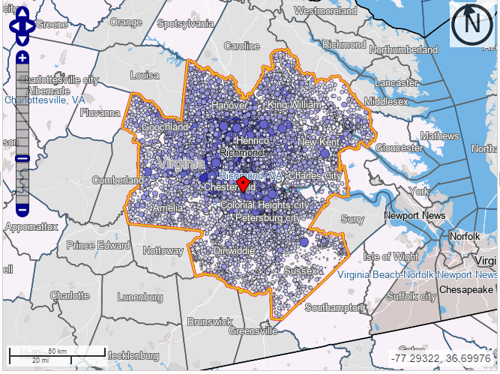
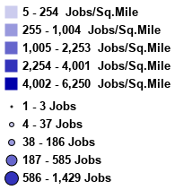
Notes:
This map shows area where workers in the Richmond region actually LIVE (reside). Decentralization: sustained shift from monocentric to polycentric income concentration, more efficient travel and suburbanization. Individuals are spread throughout the region with a concentration on cities and towns outside of Richmond. As a result, residential property taxes in Richmond city are reduced as workers move elsewhere.

Slide 12
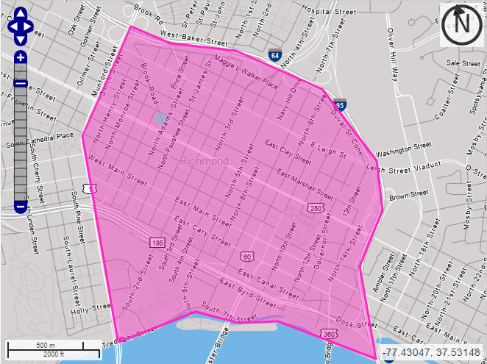
Notes:
Downtown Richmond anchored by I-95 to the North and East, Belvedere Street on the West and the James River to the South.
A Richmond downtown arena would be centrally located with respect to the region. Minimized transportation costs for suburban customers attending the events are an attractive feature associated with higher Demand and higher Revenues.

Slide 13
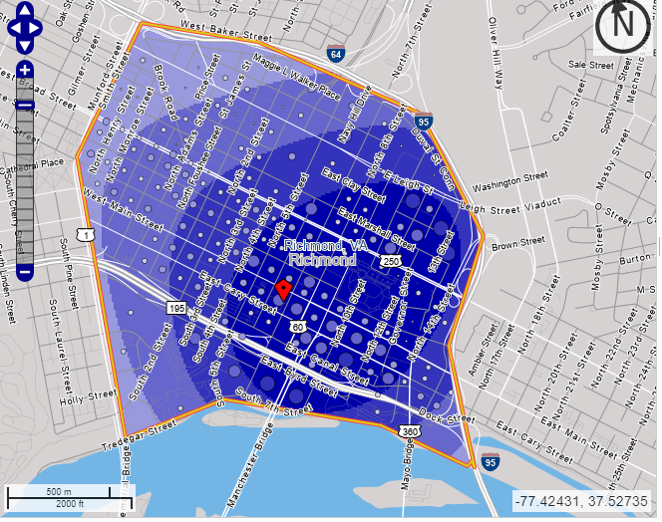
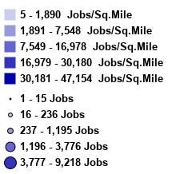
Notes:
Job concentration in Downtown Area

Slide 14
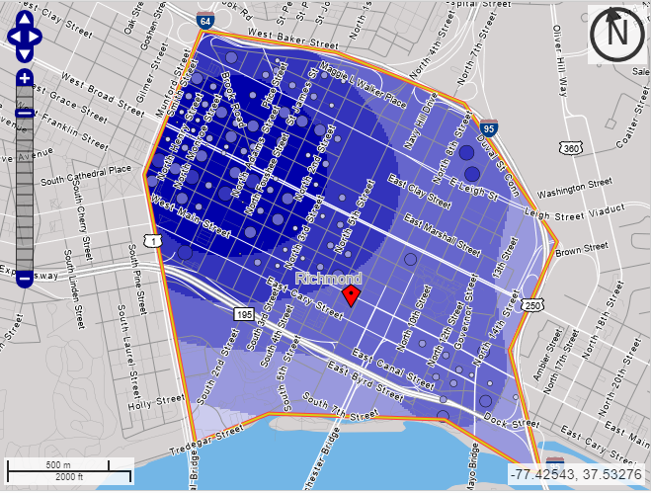
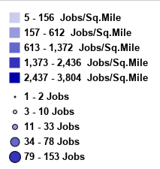
Notes:
Residential Analysis: With the exception of the NorthWest corner of downtown, very few workers at downtown firms actually live in the area (approximately 7.1% per onthemap census.gov data). The residential income base in downtown Richmond is lower than in surrounding areas. The arena project could restore income circulation and a residential property tax base to Richmond city proper and Downtown. 16.1% of downtown workers aged 29 or younger also live downtown, so it may be valued added to cater the sports district housing to young professionals.

Slide 15
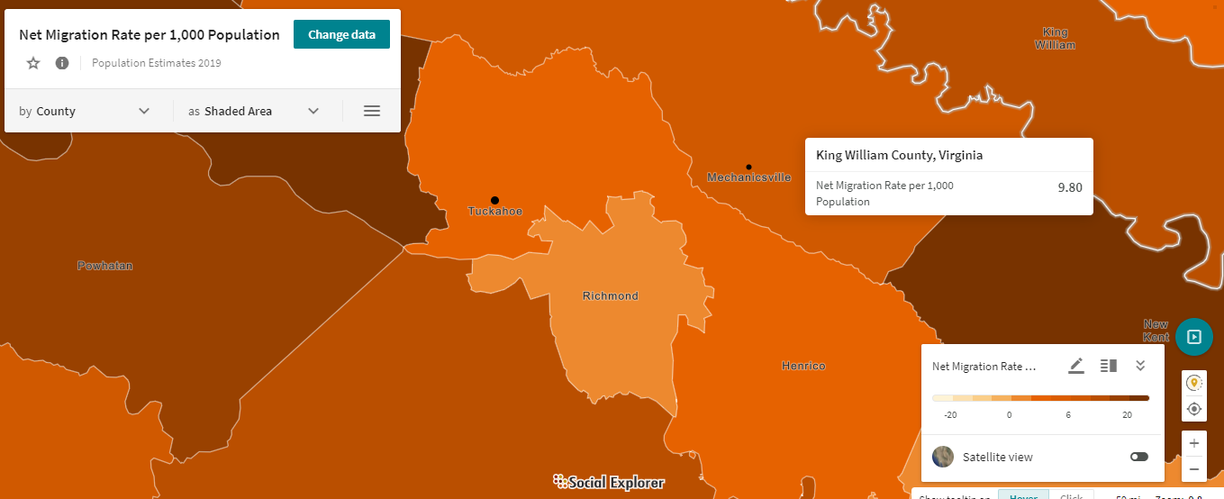
Notes:
The net migration rate for a given period of time is the difference between how many people come from other regions to live in the region being discussed. A positive net migration rate means that more people are moving into an area than are leaving it. A negative trend that must be reversed is that the net migration rate is much higher for counties surrounding Richmond city proper. Net migration is a proxy for entrepreneurial talent and idea generation, which have both been positively correlated with future revenue generation. The arena and real estate project proposed by this firm will help to entice young professionals to live, work and exchange ideas in the Richmond area.
https://study.com/academy/lesson/net-migration-rate-definition-formula-statistics.html

Slide 16
Question#1b: Declining Value of Comparative Advantages, Increasing Focus on Competitive Advantages
Discuss the shifting patterns resulting from the declining value of comparative advantages and why it is necessary to focus on attracting and retaining human capital for competitive advantages. Define what is a competitive advantage and the factors that led to it becoming a central element in economic development. Provide examples of both comparative and competitive advantages to illustrate your points.

Slide 17
Shift from Comparative Advantage to Competitive Advantage
Comparative Advantage: Goods/services that area can produce most efficiently, access to natural resources, local talent of workers
Comparative Advantage was historically used as the decision basis for acquisition/distribution of productive resources and final goods/services.
Ex. Hollywood was originated in California, because the comparative advantage of good weather allowed the location to make movies almost every day year-round.
Competitive Advantage: Attracting and Retaining Human Capital drives innovation in the economy.
Fastest growth by companies that invest in shift to competitive advantage of human capital.
Ex. Apple computers destroys its products yearly & uses new ideas to create new products that satisfy Demand requirements from clientele. Apple maintains high price and Sales Revenue.
‘Creative destruction’ allows companies to thrive when natural resources go down in value. The incentive to innovate is greatest when this occurs.
Notes:
Until the 1950s, when interstate highway systems were developed, heavy machinery could most easily be moved via waterways. This spurred the establishment of cities and industries along waterways. Natural resource (comparative) advantages such as proximity to water determined success for entities.
Increases in technology have allowed a shift in the decision making process. Technology and Idea Generation can overcome the lower production costs of competitors because specialized labor is hard to replicate.

Slide 18
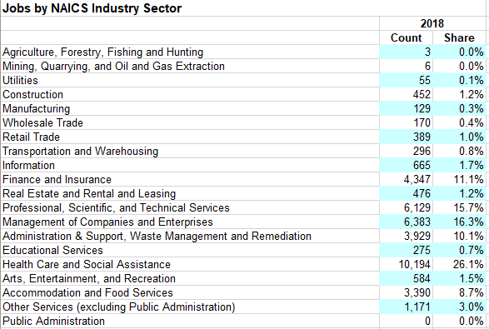
Richmond Downtown Area Jobs
Notes:
Downtown Richmond has a much higher concentration of Finance and Insurance jobs relative to the region. These tech-savvy jobs lean on competitive advantage (innovation, creativity, first-mover advantage) rather than comparative advantage (costing strategies). Jobs focusing on competitive advantage tend to have a higher level of survivability when shifting resource advantages put a strain on the local economy. Emphasis on competitive advantage also lends itself to improved job creation

Slide 19
Question #1c: Trade Value Dissipation
Discuss and describe why and how the trade value from a comparative advantage dissipates and why the advantages from competitive advantages are less likely to dissipate.

Slide 20
Trade Value, Supply and Human Capital
In a Comparative Advantage scenario, trade value dissipates
Eventually, other locations can also produce the certain good or service.
Increases in Supply capacity lead to falling prices
The focus of one’s business becomes reducing Average Production Costs
In the Long Run, Profits are ‘competed away’.
With Competitive Advantage, trade value is less likely to dissipate
Human capital drives innovation, positive disruption, new ideas, job creation
Economist Alfred Marshall: Our economy is run by “ideas in the air”
Notes:
There is no theoretical Profit to be had in perfectly competitive industries (comparative advantage scenario) because the number of firms in the industry will grow or reduce to satisfy all Demand for the product at the lowest possible Price.

Slide 21
Question#1d: Sport and Entertainment District Potential
Explain why a sport and entertainment district has the potential to enhance Richmond’s attractiveness as a place for people and businesses.

Slide 22
Sports and Entertainment as an Amenity
Richmond can use a sports district as a catalyst to attract human capital
Sports is an amenity that leverages human capital
The proposed district can make downtown Richmond a place to live, work, play
Richmond could also benefit from the property, sales and income tax of a district
“...elaborate, single-sport facility that features numerous new revenue opportunities: luxury suites, club boxes, elaborate concessions, catering, signage, advertising, theme activities, and even bars, restaurants, and apartments with a view of the field. A new facility now can add $30 million annually to a team’s revenues for a few years after the stadium opens.”
Public Good or “Externality” Benefit
Consumers who follow sports regardless of whether they help pay for it.
Individuals want to be a part of communities with amenities such as these
Notes:
“Sports, Jobs, & Taxes: Are New Stadiums Worth the Cost? (brookings.edu)
:

Slide 23
Sports and Entertainment as an Amenity (cont.)
Old View:
“First, building the facility creates construction jobs. Second, people who attend games or work for the team generate new spending in the community, expanding local employment. Third, a team attracts tourists and companies to the host city, further increasing local spending and jobs. Finally, all this new spending has a “multiplier effect” as increased local income causes still more new spending and job creation.”
“A stadium can spur economic growth if sports is a significant export industry—that is, if it attracts outsiders to buy the local product and if it results in the sale of certain rights (broadcasting, product licensing) to national firms.”
New Paradigm for Venue Development:
Professional Sports Districts bring individuals together to exchange ideas, create synergies for future project collaborations and develop internal feedback loops that drive economic growth within the district.
Notes:
“Sports, Jobs, & Taxes: Are New Stadiums Worth the Cost? (brookings.edu)

Slide 24
Comparable Cities with Minor League Venues
Job Growth 2008-2018
Fort Wayne, IN Mad Ants (Indiana Pacers G-League) 11% job increase
Allen County War Memorial Coliseum Seats 13,000 Built 2007
Greensboro, NC Swarm (Charlotte Hornets G-League) 9% job decrease Greensboro Coliseum Fieldhouse Seats 2,500 Built 2016
Ontario, CA Reign (Los Angeles Kings AHL) 26% job increase
Toyota Center Seats 9,700 Built 2008
Notes:
G-League -- National Basketball Association’s primary developmental league
AHL -- National Hockey League’s primary developmental league

Slide 25
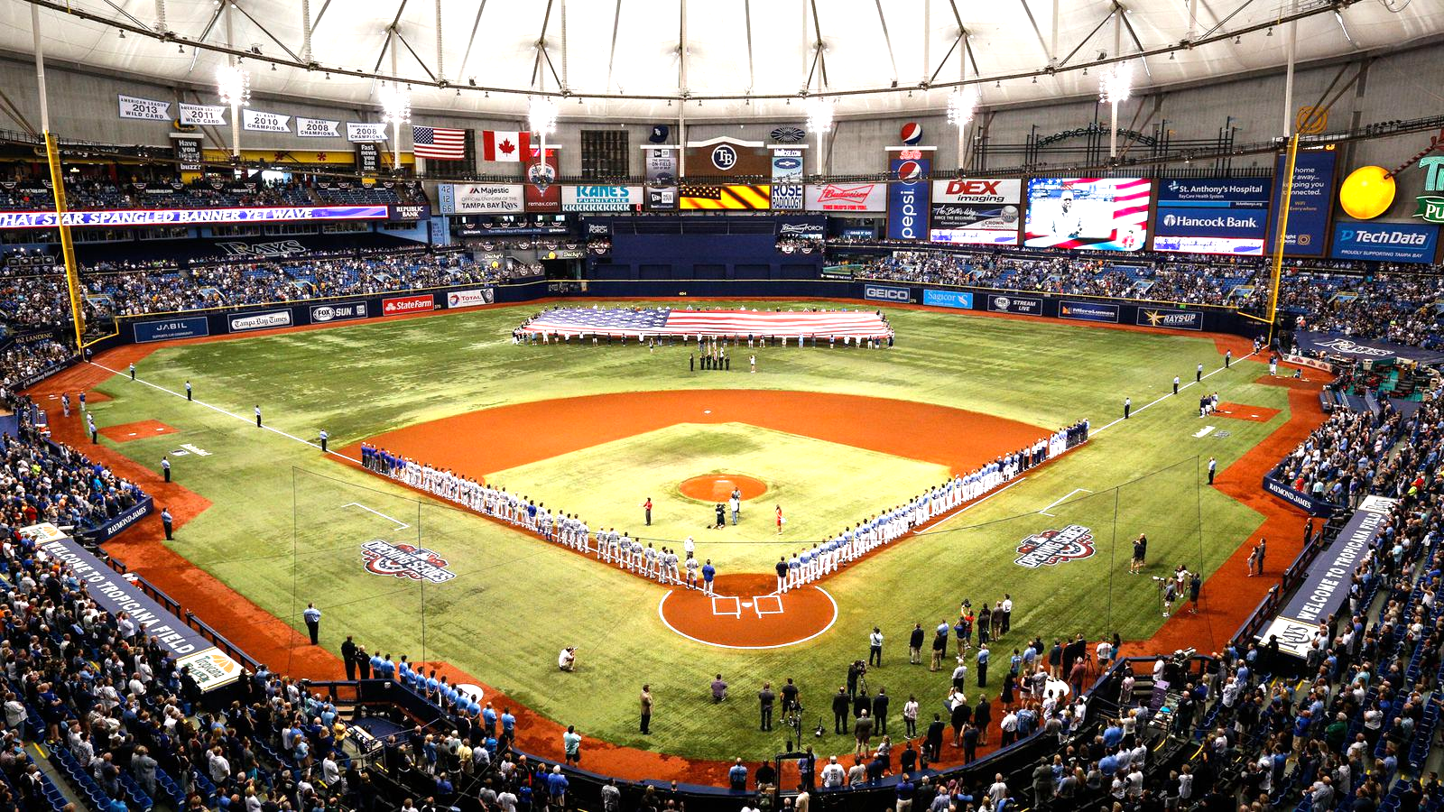
Question 2:
Is there an advantage for the Tampa Bay Rays to relocate?

Slide 26
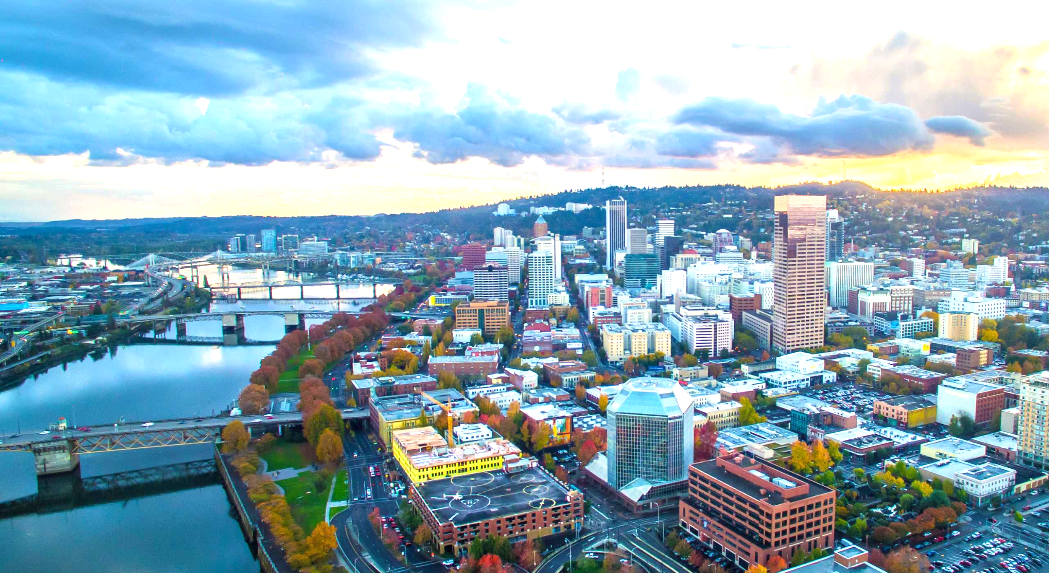
Competing Markets
Charlotte, NC
Nashville, TN
Portland, OR
San Antonio, TX

Slide 27
Primary Concern:
What does the Tampa-St.Petersburg-Clearwater, FL MSA look like compared to the other 4 MSA’s demographics and economy?

Slide 28
Market Comparison
Demographic Analysis
Total Population/Growth
Population in Targeted Age Range
Percentage of population w/ at least a Bachelor's Degree
Median Household Income
Percentage of High Earners

Slide 29
Total Population and Growth (ACS, 2010, 2019)
Charlotte-Concord-Gastonia, NC-SC MSA
Tampa Bay-St.Pete-Clearwater, FL MSA
2010: 1,764,313
2019: 2,636,883 (+872,570)
Total Growth Rate: 49.49%, AAGR: 4.95%
2010: 2,789,116
2019: 3,194,831 (+405,715)
Total Growth Rate: 14.55%, AAGR: 1.45%
Nashville-Davidson-Murfreesboro-Franklin, TN MSA
4.95%
Charlotte MSA AAGR
Highest AAGR
2010: 1,593,050
2019: 1,933,860 (+340,810)
Total Growth Rate: 21.39%, AAGR: 2.14%
2.14%
Nashville MSA AAGR
Portland-Vancouver-Hillsboro, OR-WA MSA
1.82%
San Antonio MSA AAGR
2010: 2,232,496
2019: 2,493,221 (+260,725)
Total Growth Rate: 11.68%, AAGR: 1.17%
1.45%
Tampa Bay MSA AAGR
San Antonio-New Braunfels, TX MSA
2010: 2,157,897
2019: 2,550,960 (+393,063)
Total Growth Rate: 18.22%, AAGR: 1.82%
Lowest AAGR
1.17%
Portland MSA AAGR
Notes:
Critical Keys: The Charlotte MSA grew at the fastest rates (4.95% AAGR) and also had the largest population growth (872,570). Nashville MSA followed with a strong growth in population as well. It is noteworthy that
Importance: Population is a great indicator of market size and the ability to sustain an MLB franchise.

Slide 30
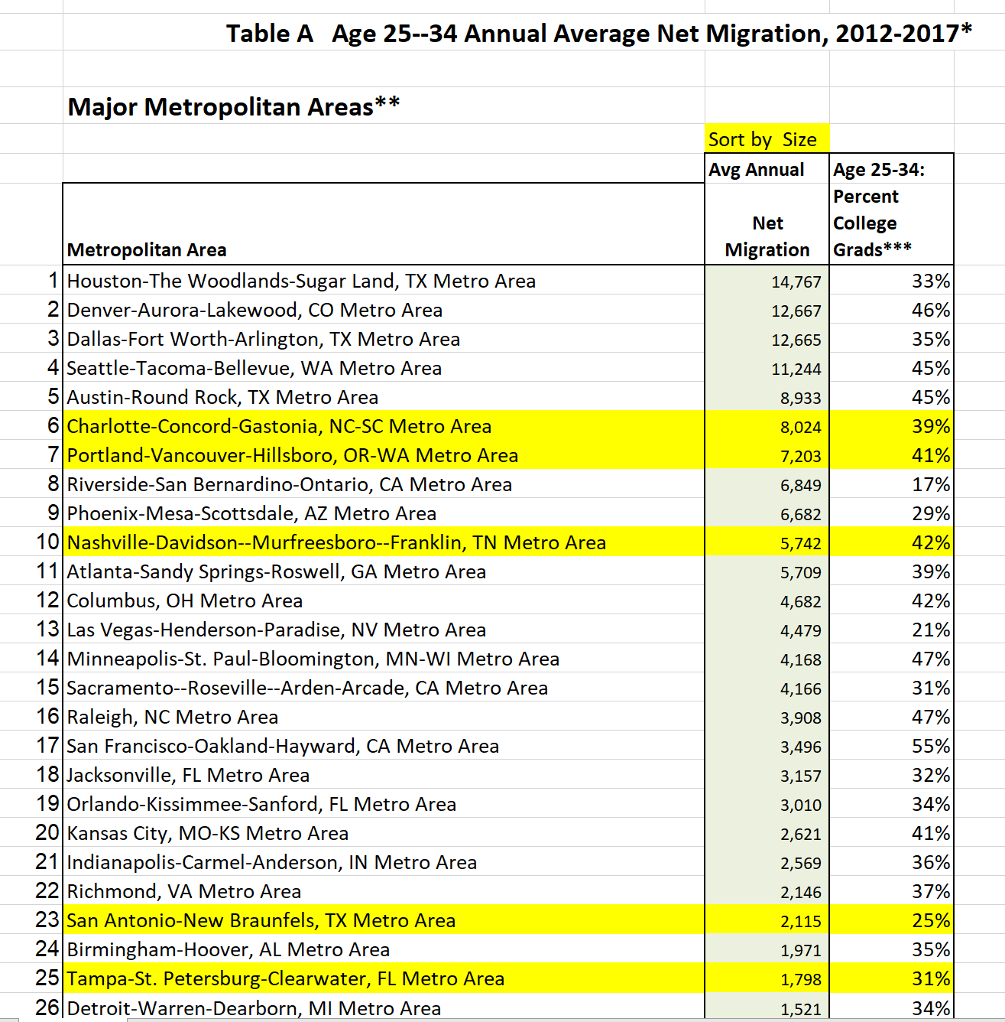
Percent Population in 18-44 Range (ACS, 2012-2017, 2019)
San Antonio MSA
38.6%
38.6%
Highest PCT
Nashville MSA
38.4%
Portland MSA
36.6 %
Charlotte MSA
33.5%
Tampa Bay MSA
Lowest PCT
Notes:
Critical Points: San Antonio MSA and Nashville MSA had the largest percentage of their population (38.6%) in the 18-44 range. Tampa Bay MSA fall dead last with only 33.5%. For the annual average net migration, Charlotte, Portland, and Nashville have a large percentage of college grads moving into the MSA’s (39%-42%). Once again, Tampa Bay has the lowest migration of college graduates incoming (1,798 and 31%).
Importance: Millennials have a large propensity to consume, because they have time to recover from their losses and many of the don’t have families so they are more likely to participate in the amenity of sports. By looking at this data, it can help determine if the growth of human capital and skilled/educated workers is enough for the market to sustain a franchise.

Slide 31
Educated Population/Growth (ACS, 2010, 2019) *At least a Bachelor's Degree
Charlotte-Concord-Gastonia, NC-SC MSA
Tampa Bay-St.Pete-Clearwater, FL MSA
2010: 32.2 %
2019: 36.2 % (+4%)
Total Growth Rate: 12.42%, AAGR: 1.24%
2010: 26.2%
2019: 31.6% (+5.4%)
Total Growth Rate: 20.61%, AAGR: 2.06%
Nashville-Davidson-Murfreesboro-Franklin, TN MSA
2.96%
Nashville MSA AAGR
Highest AAGR
2010: 29.7%
2019: 38.5% (+8.8%)
Total Growth Rate: 29.639%, AAGR: 2.96%
2.21%
Portland MSA AAGR
Portland-Vancouver-Hillsboro, OR-WA MSA
2.06%
Tampa Bay MSA AAGR
2010: 33%
2019: 40.3% (+7.3%)
Total Growth Rate: 22.12%, AAGR: 2.21%
San Antonio-New Braunfels, TX MSA
1.34%
San Antonio MSA AAGR
2010: 25.4%
2019: 28.8% (+3.4%)
Total Growth Rate: 13.39%, AAGR: 1.34%
Lowest AAGR
1.24%
Charlotte MSA AAGR
Notes:
Critical Points: The Nashville MSA had the largest growth (2.96% AAGR) since 2010 for percent population with at least a Bachelor’s Degree. Portland MSA had the highest total percentage with 40.3%. Notably, Tampa Bay was in the middle of the pack in both growth (2.06% AAGR) and percentage of population w/ at least a Bachelors Degree (31.6%).
Importance: This variable is critical to understanding the growth of human capital within a market. Human capital is marked by creative destroyers who have skilled labor, and these people are mostly educated individuals who start new ideas. They help to promote economic growth for a franchise to succeed.

Slide 32
Median Household Income/Growth (ACS, 2010, 2019)
Charlotte-Concord-Gastonia, NC-SC MSA
Tampa Bay-St.Pete-Clearwater, FL MSA
2010: $59,282
2019: $66,399 (+7,117)
Total Growth Rate: 12.01%, AAGR: 1.20%
2010: $51,752
2019: $57,061 (+6,734)
Total Growth Rate: 13.16%, AAGR: 1.32%
Nashville-Davidson-Murfreesboro-Franklin, TN MSA
2.58%
Portland MSA AAGR
Highest AAGR
2010: $56,375
2019: $70,262 (+13,877)
Total Growth Rate: 24.63%, AAGR: 2..46%
2.46%
Nashville MSA AAGR
Portland-Vancouver-Hillsboro, OR-WA MSA
1.32%
Tampa Bay MSA AAGR
2010: $62,372
2019: $78,439 (+16,067)
Total Growth Rate: 25.76%, AAGR: 2.58%
1.20%
Charlotte MSA AAGR
San Antonio-New Braunfels, TX MSA
2010: $59,019
2019: $62,355 (+3,336)
Total Growth Rate: 5.65%, AAGR: 0.57%
Lowest AAGR
0.57%
San Antonio MSA AAGR
Notes:
Critical Points: Portland MSA experienced the most growth in median household income (2.58% AAGR). They also had the highest median income at $78,439 with the next highest number at $70,262 in the Nashville MSA. Notably, San Antonio had a very low AAGR of .57% compared to the rest. Tampa Bay while having average growth, had the lowest median income of all the different MSA’s ($57, 061).
Importance: This variable is key in understanding how an area can financially support a team and new venue because of income taxes.

Slide 33
PCT of High Earners/Growth (ACS, 2010, 2019) *At least $75,000 annual
Charlotte-Concord-Gastonia, NC-SC MSA
Tampa Bay-St.Pete-Clearwater, FL MSA
2010: 39.3%
2019: 44.4% (+5.1%)
Total Growth Rate: 12.98%, AAGR: 1.30%
2010: 32.7%
2019: 38.7% (+6%)
Total Growth Rate: 18.35%, AAGR: 1.83%
Nashville-Davidson-Murfreesboro-Franklin, TN MSA
2.46%
Portland MSA AAGR
Highest AAGR
2010: 37.6%
2019: 46.8% (+9.2%)
Total Growth Rate: 24.47%, AAGR: 2.45%
2.45%
Nashville MSA AAGR
Portland-Vancouver-Hillsboro, OR-WA MSA
1.83%
Tampa Bay MSA AAGR
2010: 41.9%
2019: 52.2% (+10.3)
Total Growth Rate: 24.58%, AAGR: 2.46%
1.30%
Charlotte MSA AAGR
San Antonio-New Braunfels, TX MSA
2010: 38.6%
2019: 41.6% (+3%)
Total Growth Rate: 7.77%, AAGR: 0.78%
Lowest AAGR
0.78%
San Antonio MSA AAGR
Notes:
Critical Points: Much like the median household income, Portland and Nashville MSA’s had the largest growth in high income earners (2.46% AAGR and 2.25% respectively). Tampa Bay had a growth rate of 1.83%, but was once again lowest in total percentage of high earners (38.7%).

Slide 34
Market Comparison
Location Quotient Assessment
Primary Job Growth
Industry Sectors Analysis

Slide 35
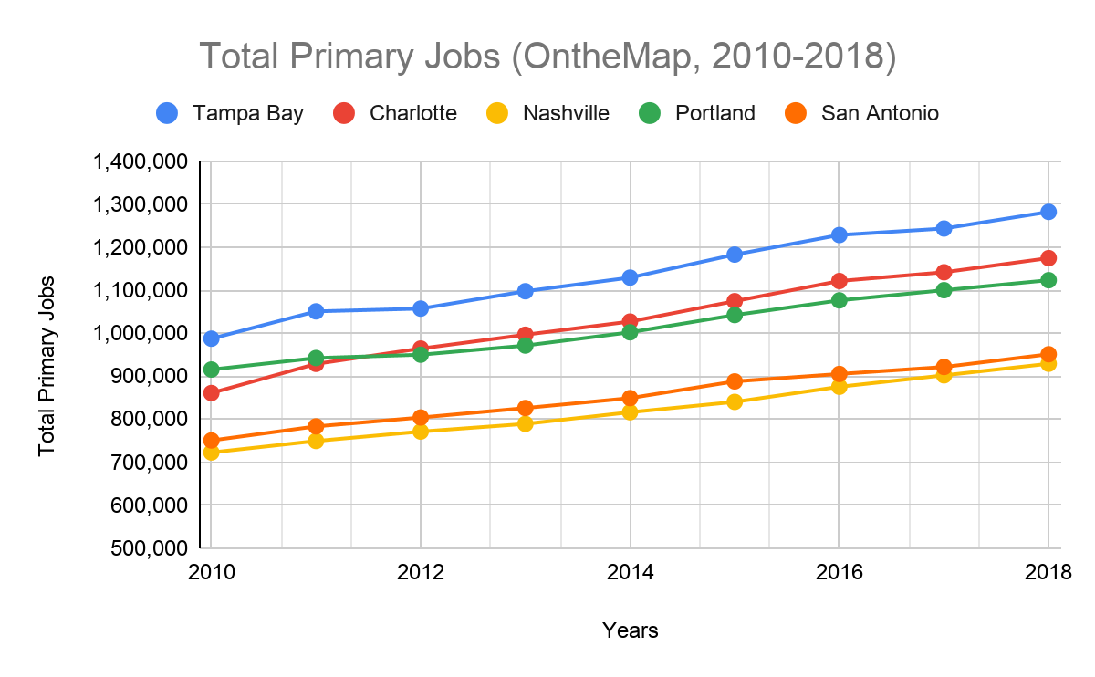
Total Primary Jobs/Growth (OntheMap, 2010-2018)
Charlotte-Concord-Gastonia, NC-SC MSA
Tampa Bay-St.Pete-Clearwater, FL MSA
2010: 860,975
2019: 1,174,578 (+313,603)
Total Growth Rate: 36.42%, AAGR: 4.04%
2010: 987,291
2019: 3,194,831 (+294,737)
Total Growth Rate: 29.85%, AAGR: 3.49%
Nashville-Davidson-Murfreesboro-Franklin, TN MSA
4.95%
Charlotte MSA AAGR
Highest AAGR
2010: 722,805
2019: 929,050(+206,245)
Total Growth Rate: 28.53%, AAGR: 3.16%
2.14%
Nashville MSA AAGR
Portland-Vancouver-Hillsboro, OR-WA MSA
1.82%
San Antonio MSA AAGR
2010: 915,584
2019: 1,123,215 (+207,631)
Total Growth Rate: 22.68%, AAGR: 2.75%
1.45%
Tampa Bay MSA AAGR
San Antonio-New Braunfels, TX MSA
2010: 750,699
2019: 951,118 (+200,419)
Total Growth Rate: 26.70%, AAGR: 3.18%
Lowest AAGR
1.17%
Portland MSA AAGR
Notes:
Critical Points: All of the markets had good growth rates for total primary jobs. Charlotte MSA had the most growth with 313,603 new jobs and an AAGR of 4.04%. Notably, Tampa Bay MSA had the second highest growth rate (3.49% AAGR) and also had the most primary jobs (roughly 3.2 million) which is two times larger than any of the other MSA’s.
Importance: This variable helps to predict economic growth in the various MSA’s. This has a direct impact on the competitive advantages that markets have. The more competitive clusters with a large number of firms and jobs, the more confident labor is in the jobs, and thus helps to retain human capital and drives economic growth.

Slide 36
LQ Assessment: Chosen Sectors
(OntheMap, 2018, and BLS, 2020)
Retail Trade
Professional, Scientific, and Technical Services
Management of Companies/Enterprises*
Educational Services*
Health Care/ Social Assistance
Notes:
*Combined data between OntheMap and BLS.gov

Slide 37
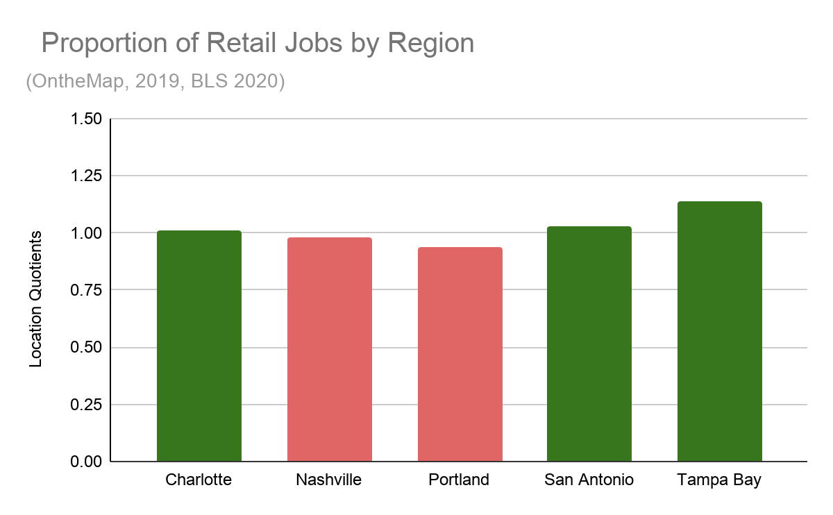
Proportion and LQ’s of Retail Jobs (OntheMap, 2019)
Charlotte-Concord-Gastonia, NC-SC MSA
10.8 % of jobs
LQ= 1.01
Nashville-Davidson-Murfreesboro-Franklin, TN MSA
10.5% of jobs
LQ= 0.98
Portland-Vancouver-Hillsboro, OR-WA MSA
10.10% of jobs
LQ= 0.94
San Antonio-New Braunfels, TX MSA
11.10% of jobs
LQ= 1.03
Tampa Bay-St.Pete-Clearwater, FL MSA
12.20% of jobs
LQ= 1.14
Green = above US sector growth (>1.00)
Red = below US sector growth
Notes:
Critical Points: Tampa Bay MSA had the largest LQ, followed by San Antonio MSA and Charlotte MSA. Nashville and Portland MSA’s were lacking below the US average.
Importance: We chose Retail Jobs sector because retail activity is key to building a new venue in a market or retaining a venue. Importantly, all 5 MSA’s had more than 10% of their jobs in this sector which makes it a solid predictor of the direction of each of their market economies.

Slide 38
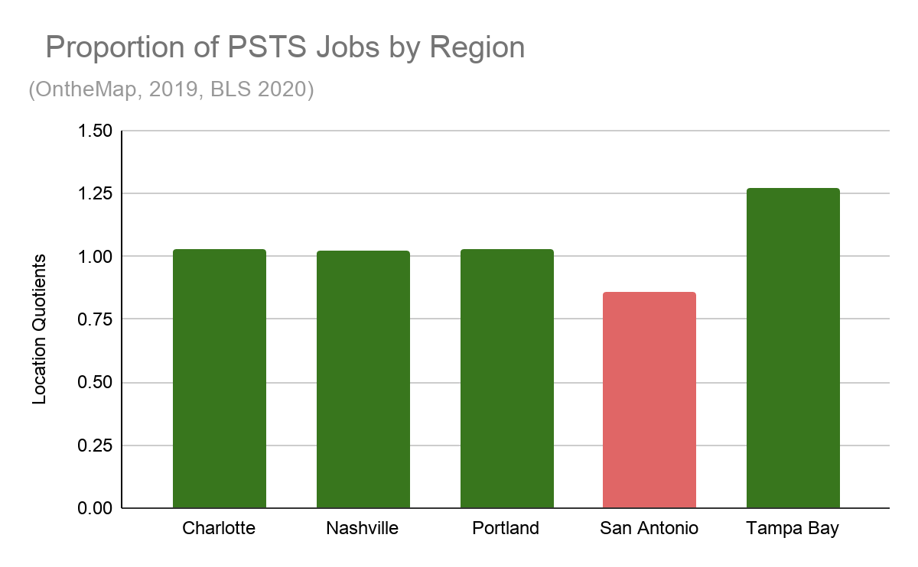
Proportion and LQ’s of PSTS Jobs (OntheMap, 2019)
Charlotte-Concord-Gastonia, NC-SC MSA
7.0% of jobs
LQ= 1.03
Nashville-Davidson-Murfreesboro-Franklin, TN MSA
6.90% of jobs
LQ= 1.02
Portland-Vancouver-Hillsboro, OR-WA MSA
7.0% of jobs
LQ= 1.03
San Antonio-New Braunfels, TX MSA
5.80% of jobs
LQ= 0.86
Tampa Bay-St.Pete-Clearwater, FL MSA
8.6% of jobs
LQ= 1.27
Green = above US sector growth (>1.00)
Red = below US sector growth
Notes:
Critical Points: Tampa Bay MSA had the largest growth due to having the highest LQ (1.27). PSTS jobs also comprised more of the local job market than any of the other markets. It is also notable that all of the MSA’s had greater growth than the US, other than San Antonio MSA.
Importance: PSTS is a key industry sector that exhibits creative destruction and human capital within a market. This sector, because of its skilled labor and knowledge helps to predict growth trends.

Slide 39
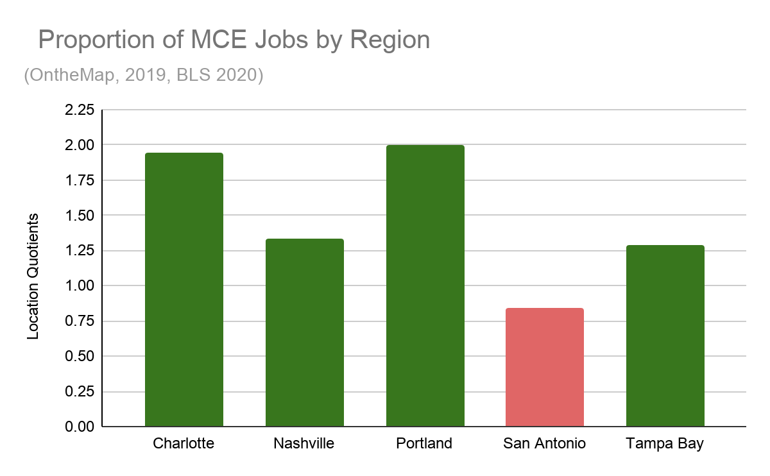
Proportion and LQ’s of MCE Jobs (OntheMap, 2019)
(Management of Companies/Enterprises)
Charlotte-Concord-Gastonia, NC-SC MSA
3.50% of jobs
LQ= 1.94
Nashville-Davidson-Murfreesboro-Franklin, TN MSA
2.40% of jobs
LQ= 1.33
Portland-Vancouver-Hillsboro, OR-WA MSA
3.60% of jobs
LQ= 2.0
San Antonio-New Braunfels, TX MSA
1.50% of jobs
LQ= 0.84
Tampa Bay-St.Pete-Clearwater, FL MSA
2.30% of jobs
LQ= 1.29
Green = above US sector growth (>1.00)
Red = below US sector growth
Notes:
Critical Points: All of the MSA’s other than San Antonio had huge growth in the MCE sector of their job economy. Portland had the highest, which doubled the US growth (2 LQ). Tampa Bay was in the middle of the pack but still was showing great growth with a 1.29 LQ.
Importance: This sector captures the growth of business and entrepreneurship which once again directly ties to disruption within the free marketplace.

Slide 40
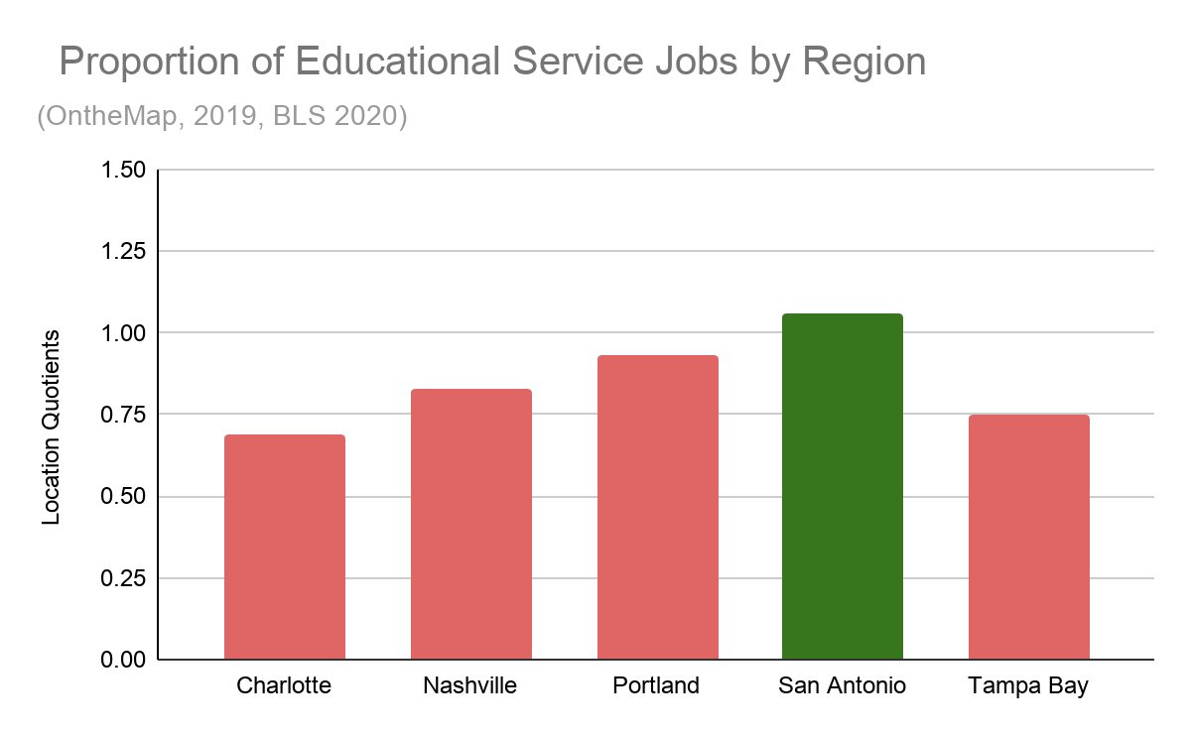
Proportion and LQ’s of Educational Services Jobs (OntheMap, 2019)
Charlotte-Concord-Gastonia, NC-SC MSA
6.30% of jobs
LQ= 0.69
Nashville-Davidson-Murfreesboro-Franklin, TN MSA
7.50% of jobs
LQ= 0.83
Portland-Vancouver-Hillsboro, OR-WA MSA
8.40% of jobs
LQ= 0.93
San Antonio-New Braunfels, TX MSA
9.70% of jobs
LQ= 1.06
Tampa Bay-St.Pete-Clearwater, FL MSA
6.9% of jobs
LQ= 0.75
Green = above US sector growth (>1.00)
Red = below US sector growth
Notes:
Critical Points: All of the MSA’s were below the US average, except for San Antonio MSA. San Antonio MSA had the highest LQ (1.06). Notably, Tampa Bay was second to last with an LQ of .75. Charlotte brought up the rear (0.69 LQ).
Importance: This sector is important to include because it helps to show the educational infrastructure in the different MSA’s. For example, the more educational service growth there is, the more ideas there normally are, which helps to create a competitive advantage for that particular MSA.

Slide 41
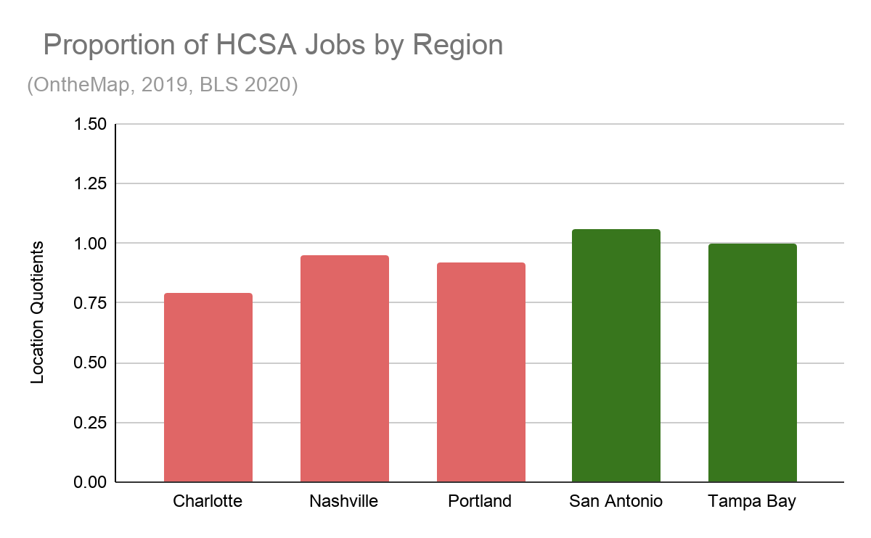
Proportion and LQ’s of HCSA Jobs (OntheMap, 2019)
(Health Care/ Social Assistance)
Charlotte-Concord-Gastonia, NC-SC MSA
11.40% of jobs
LQ= 0.79
Nashville-Davidson-Murfreesboro-Franklin, TN MSA
13.80% of jobs
LQ= 0.95
Portland-Vancouver-Hillsboro, OR-WA MSA
13.40% of jobs
LQ= 0.92
San Antonio-New Braunfels, TX MSA
15.40% of jobs
LQ= 1.06
Tampa Bay-St.Pete-Clearwater, FL MSA
14.5% of jobs
LQ= 1.00
Green = above US sector growth (>1.00)
Red = below US sector growth
Notes:
Critical Points: San Antonio MSA was the only one above the US (1.06 LQ). Tampa Bay MSA was even with the US average (1.0 LQ). All of the other fell below the US average. Notably, this sector had the highest proportion of their job markets filled with jobs in HCSA.
Importance: This sector is important to include because it has a high proportion of jobs for all the MSA’s, which means its very indicative of the local economy and its direction. Also, health care jobs are high wage, so they are important to asses in order to ascertain how the markets can maintain human capital and help an MLB franchise to be successful.

Slide 42
Market Comparison
Additional Factors
Nielsen DMA Rankings
U.S. Patent Filing Growth

Slide 43
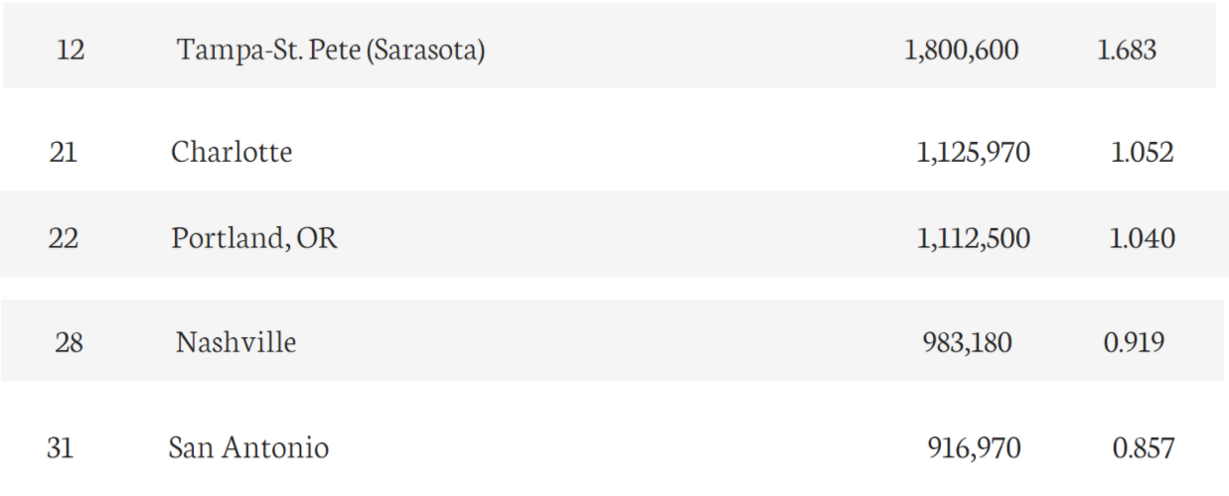
Nielsen DMA Rankings
DMA Rank Number of TV Homes PCT of U.S.
Notes:
Critical Notes: Tampa Bay had the best DMA ranking and consequently, the largest number of TV homes and PCT of the U.S. Then, there is a decent gap, followed by Charlotte and Portland.
Importance: DMA rankings help us determine the size of the TV market and thus, the magnitude of the TV contracts that a franchise in that market would be able to obtain.

Slide 44
U.S. Patents Filed 2011-2015
Charlotte-Concord-Gastonia, NC-SC MSA
Tampa Bay-St.Pete-Clearwater, FL MSA
Total over 5 years: 2,971, AAGR: 0.07%
Total over 5 years: 2,076, AAGR: .14%
Nashville-Davidson-Murfreesboro-Franklin, TN MSA
Highest AAGR
.14%
Charlotte MSA AAGR
Total over 5 years: 1,1133, AAGR: .01%
Portland-Vancouver-Hillsboro, OR-WA MSA
.07%
.07%
Tampa Bay MSA AAGR
San Antonio MSA AAGR
Total over 5 years: 9,829, AAGR: .05%
.05%
Portland MSA AAGR
San Antonio-New Braunfels, TX MSA
Total over 5 years: 2,061, AAGR: 0.07%
Lowest AAGR
0.01%
Nashville MSA AAGR
Notes:
Critical Points: Charlotte MSA had the most growth of patents filed (.14% AAGR). Tampa Bay and San Antonio MSA’s followed with .07% AAGR. It is notable to note that TB MSA had the second highest number of patents filed (2,971), while Portland MSA was leaps and bounds above everyone with 9,829 patents filed over 5 years.

Slide 45
Evidence Reasoning
MSA Income Comparison
Tampa Bay MSA while having average growth in comparison (1.32% AAGR), had the lowest median income of all the different MSA’s ($57, 061)
They also had an AAGR of 1.83% for percentage of high earners which fell in the middle of the other markets, but was once again lowest in total percentage of high earners in their market (38.7%)
Job and Population Growth
Tampa Bay MSA had the second lowest population growth rate at 1.45% AAGR, but had the second largest population increase (405,715) and the largest population of all the markets at 3.19 million.
Tampa Bay MSA falls dead last with only 33.5% population in the 18-44 year age range. They also had average growth in the percentage of population w/ at least a Bachelor’s Degree (2.06% AAGR)
Tampa Bay MSA had the second highest primary job growth rate (3.49% AAGR) and also had the most primary jobs (roughly 3.2 million) which is two times larger than any of the other MSA’s.
LQ Assessment
Tampa Bay MSA has LQ’s above 1 for every sector except one and outpaces the comparison markets in these sectors: PSTS and Retail
DMA Market and Patents
Tampa Bay had the highest DMA ranking and also the second highest number of patents filed (2,971)

Slide 46
Conclusion: Is there an advantage for the Rays to relocate?
While other markets have advantages in certain areas over Tampa Bay/ St, Petersburg MSA, overall Tampa Bay is growing enough (in the variables we examined) to keep the franchise in this market
No clear advantage
Clear advantage

Slide 47
Question #3

Slide 48
Question #3
The two least valuable franchises in the National Hockey League are the Florida Panthers ($310m) and the Arizona Coyotes ($300m). This seems unlikely given the population of the Miami-Ft. Lauderdale region is 6.2 million and the Phoenix region has almost 5 million residents. By way of a contrast, the Penguins are worth $665m but play in a region with less than 3 million residents. The Golden Knights are valued at $580m and the team is in a region with less than 2.5 million residents.
Your firm – Best Sport Market Evaluators – has organized a staff training session at which you are being asked to present your ideas regarding how it is possible for smaller regions to have teams with higher values than those of franchises in far larger markets.

Slide 49
Demographics (Social Explorer, ACS 2019)
Phoenix-Mesa-Chandler, Arizona MSA
Population: 4,948,203
49.7 % Male, 50.3 % Female
Percentage of Population Age 18-44: 36.6%
Percentage of Population With At Least a Bachelor’s Degree: 31.4%
Percentage of Households Earning At Least $75,000: 45.6%

Slide 50
Demographics (Social Explorer, ACS 2019)
Miami-Fort Lauderdale-Pompano Beach, Florida MSA
Population 6,166,488
48.6% Male, 51.4% Female
Percentage of Population Age 18-44: 34.2%
Percentage of Population With At Least a Bachelor’s Degree: 33.1%
Percentage of Households Earning At Least $75,000: 40.4

Slide 51
Demographics (Social Explorer, ACS 2019)
Las Vegas-Henderson-Paradise, Nevada MSA
Population 2,266,715
49.9% Male, 50.1% Female
Percentage of Population Age 18-44: 36.9%
Percentage of Population With At Least a Bachelor’s Degree: 25.6%
Percentage of Households Earning At Least $75,000: 41.3%

Slide 52
Demographics (Social Explorer, ACS 2019)
Pittsburgh, Pennsylvania MSA
Population 2,317,600
48.7% Male, 51.3% Female
Percentage of Population Age 18-44: 33.4%
Percentage of Population With At Least a Bachelor’s Degree: 36%
Percentage of Households Earning At Least $75,000: 42.2%

Slide 53
Demographics
Phoenix (4,948,203) and Miami (6,166,488) are two of the largest MSAs in the United States especially compared to Las Vegas (2,266,715) and Pittsburgh (2,317,600). These 4 MSAs have comparable percentages (within 5%) of populations between ages 18-44, with at least a bachelor’s degree, and earning above $75,000 except Las Vegas which falls behind in education.
So what other factors contribute to the difference in NHL franchise values between different sized markets?

Slide 54
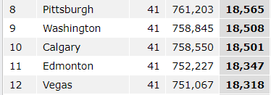
NHL Attendance
2018-2019 Attendance
2019-2020 Attendance
Notes:
In the last two seasons to have attendance, Pittsburgh and Las Vegas each drew over 18,000 fans per game while Arizona and Florida were near the bottom of league attendance. Las Vegas drew almost 180,000 more fans in 2018-2019 and 190,000 more fans in 2019-2020 than Arizona did. Arizona and Florida joined Pittsburgh and Las Vegas as part of the NHL expanded playoffs when play was resumed showing that all four of the franchises were competitive in the 2019-2020 season.
NHL Attendance: https://www.espn.com/nhl/attendance/_/year/2019

Slide 55
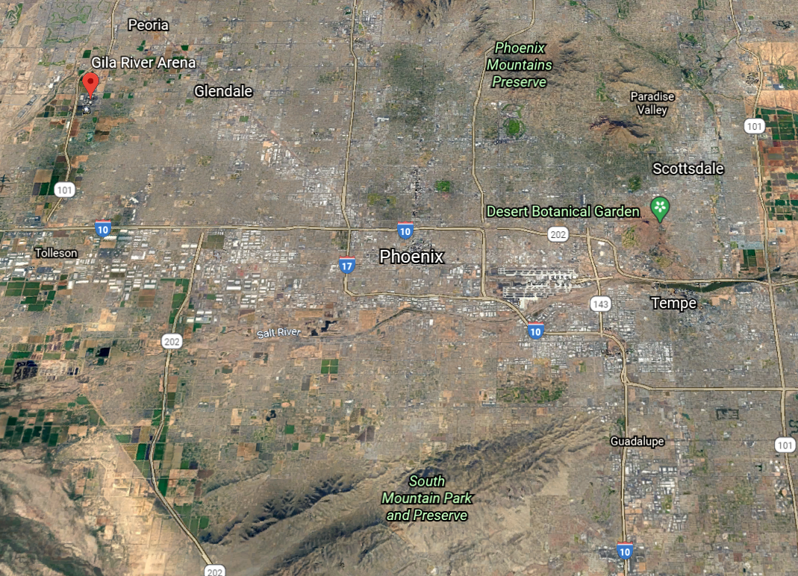
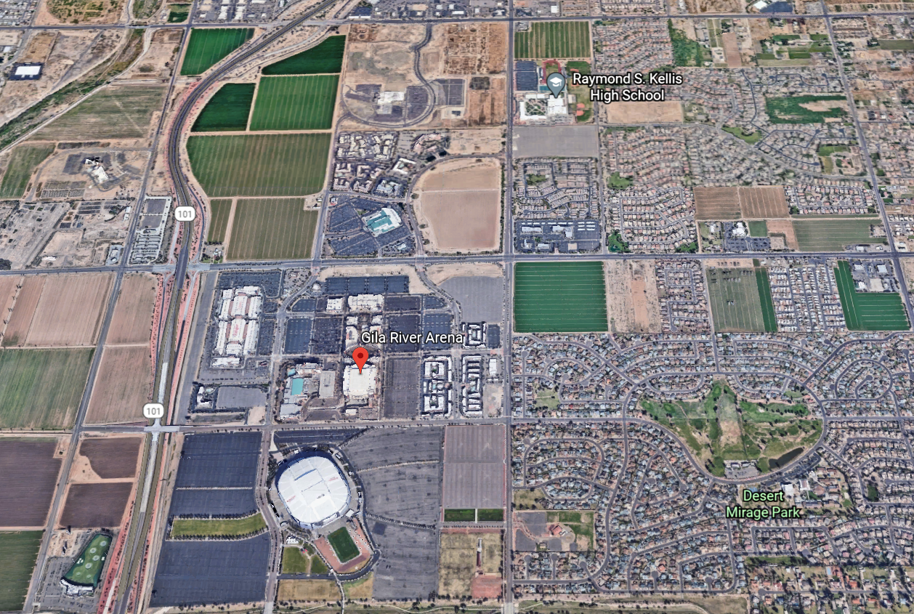
Phoenix
Notes:
The Arizona Coyotes play their home games at Gila River Arena in Glendale, Arizona. Gila River Arena opened in 2003 and seats 17,125 fans for hockey games. On average, there were 2,500 empty seats per game in the 2019-2020 season. Gila River Arena is located northwest of Phoenix, apart from major urban development.
Google Earth

Slide 56
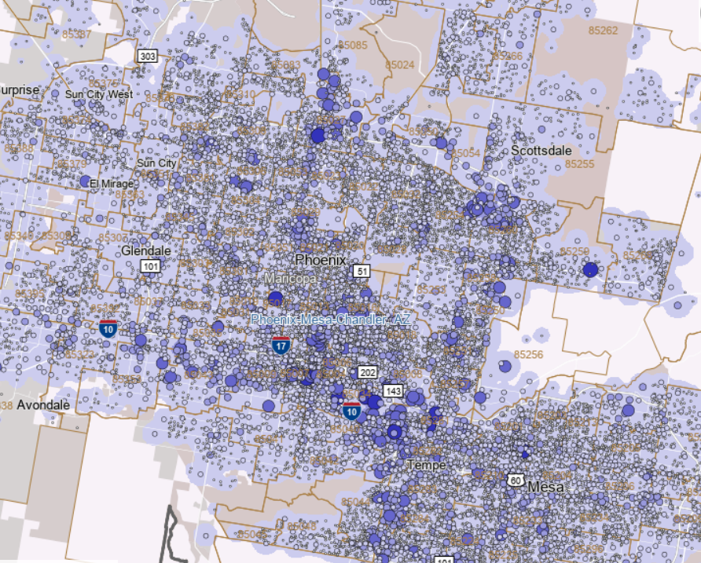
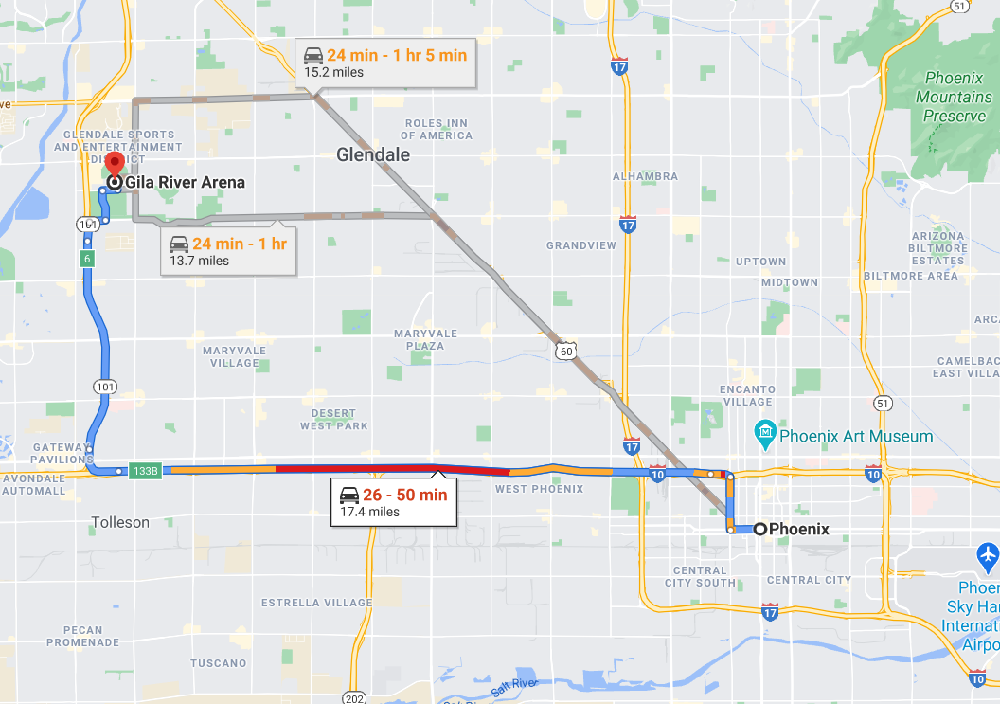
Phoenix
Notes:
Most of the jobs in the Phoenix MSA are concentrated around the city or southwest towards Tempe and Mesa. Driving from the city center in rush hour at 5:05 PM on a Wednesday evening, it would take 26-50 minutes to travel the 17.4 miles to Gila river Arena. The arena is located away from the job concentration center and attendance requires fans to travel across the MSA for games on weeknights. The location away from the job centers and travel challenges could relate to the low attendance.
OnTheMap, Google Maps

Slide 57
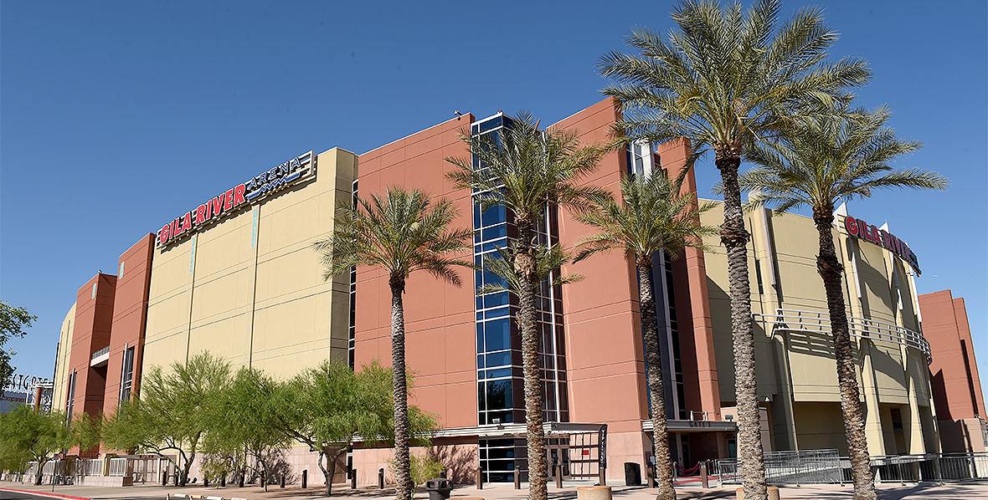
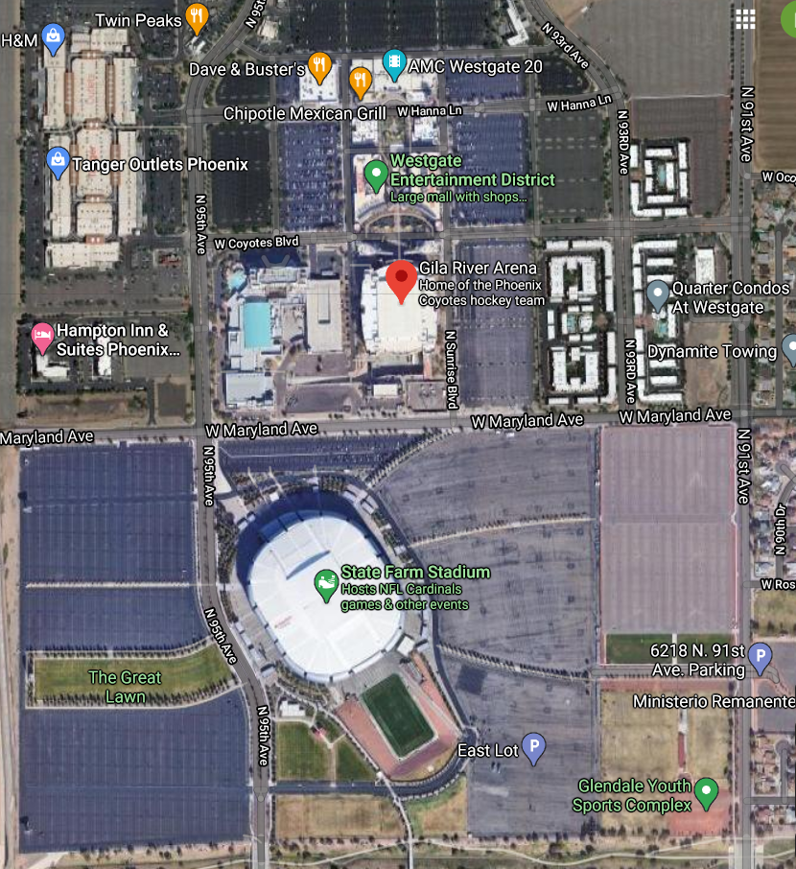
Phoenix
Notes:
Gila River has a standard arena construction with desert colors that are uniform all the way around. It sits alongside State Farm Stadium where the Arizona Cardinals play and is surrounded by parking lots, a shopping mall, and suburban neighborhood housing. There are no unique attractions surrounding the arena to keep fans on the footprint before or after games and no real estate to develop housing or apartment projects. The most convenient access is to the fans that live in the surrounding neighborhood that would likely arrive just as the game starts and go home immediately afterwards.
Google Maps

Slide 58
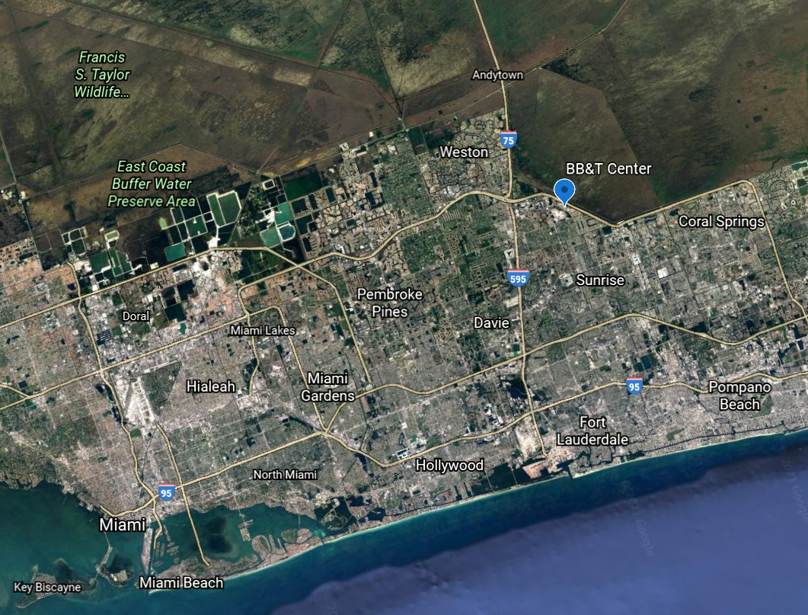
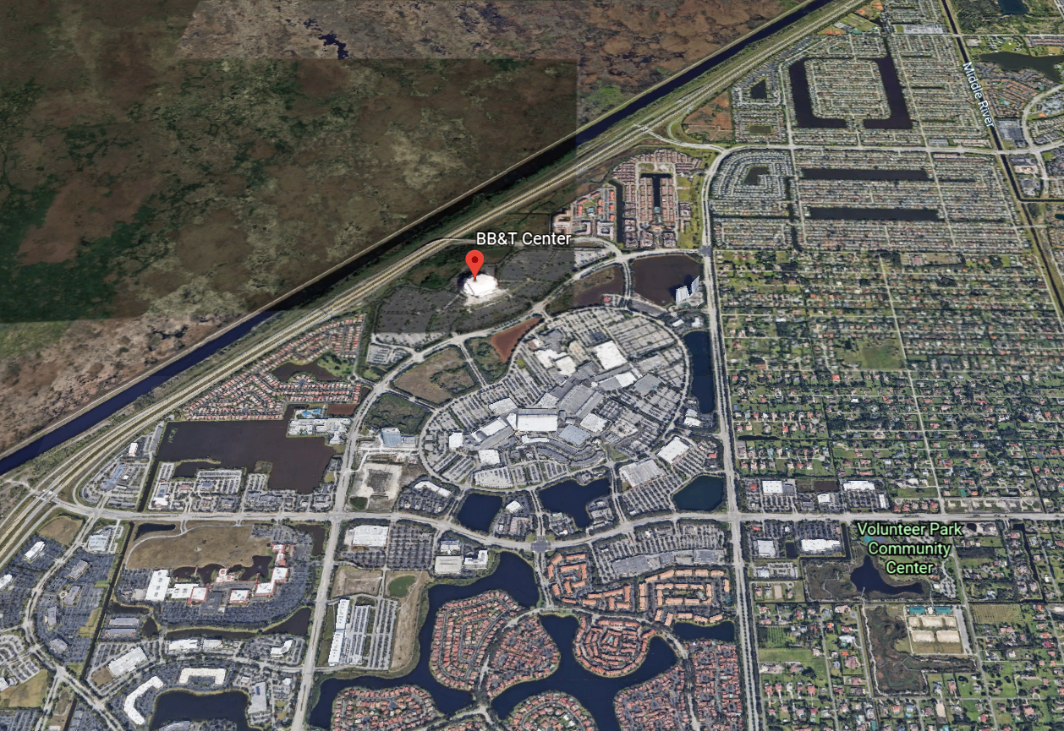
Florida
Notes:
The Florida Panthers play their home games at the BB&T Center in Sunrise, Florida. The BB&T Center opened in 1998 and seats 19,250 fans for ice hockey. On average there were 5,100 empty seats per game in the 2019-2020 season. The BB&T Center is located North of Miami and borders the Florida Everglades. The City of Sunrise, Florida has a population of 94,060 people.
Google Earth

Slide 59
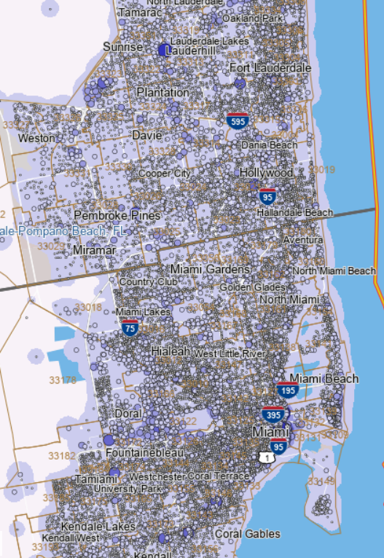
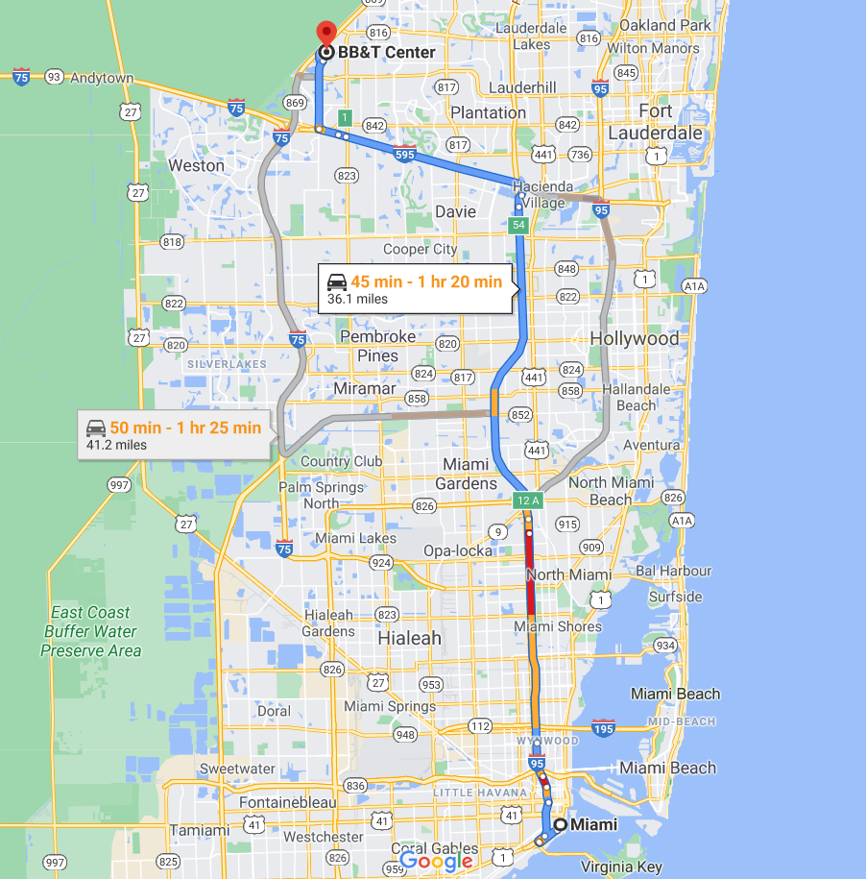
Florida
Notes:
The jobs in the Miami-Fort Lauderdale MSA are located along the coast and particularly in the southeast area of the region towards Miami. The job concentration thins as you move northwest towards the Everglades. The BB&T Center in Sunrise can be 45 minutes to 1 hour and 20 minutes away from the center of Miami during rush hour on a weekday. A trip of 36 miles is a long drive for fans to make on a weeknight, especially in a city such as Miami with so many other entertainment options including something as simple as the beach.
OnTheMap, Google Maps

Slide 60
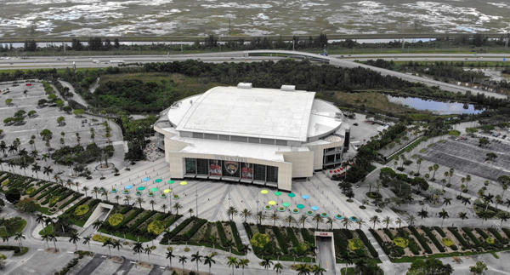
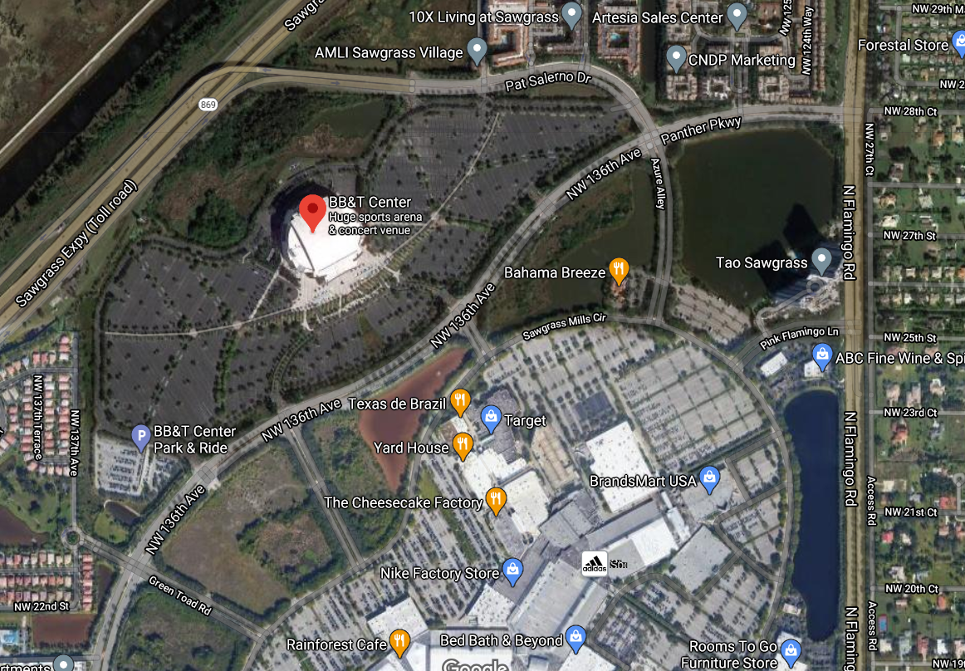
Florida
Notes:
The BB&T Center sits along the Everglades and is surrounded by immediate parking lots on all sides. There is a shopping mall and residential area in the vicinity but no unique attraction or economic development on the footprint to attract fans. The arena is located on the edge of development in southeastern Florida and the isolation dissuades fans from making the trip and results in a lack of convenience.
Google Maps

Slide 61
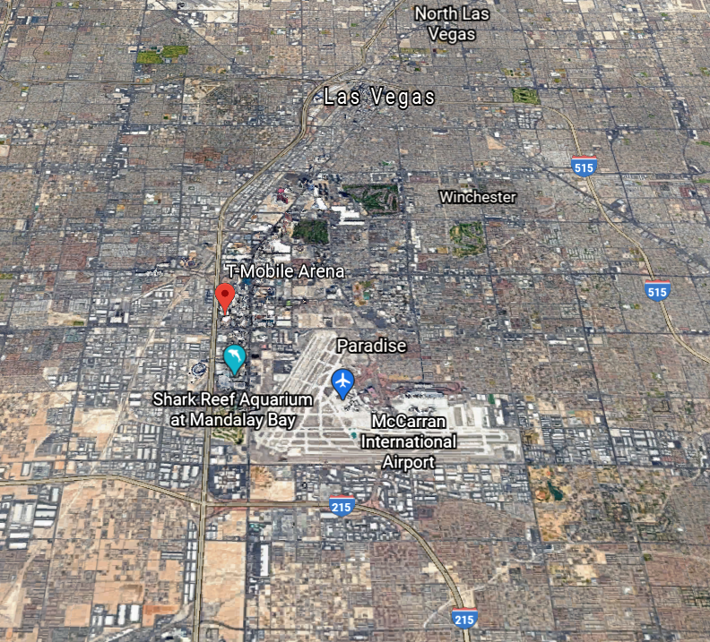
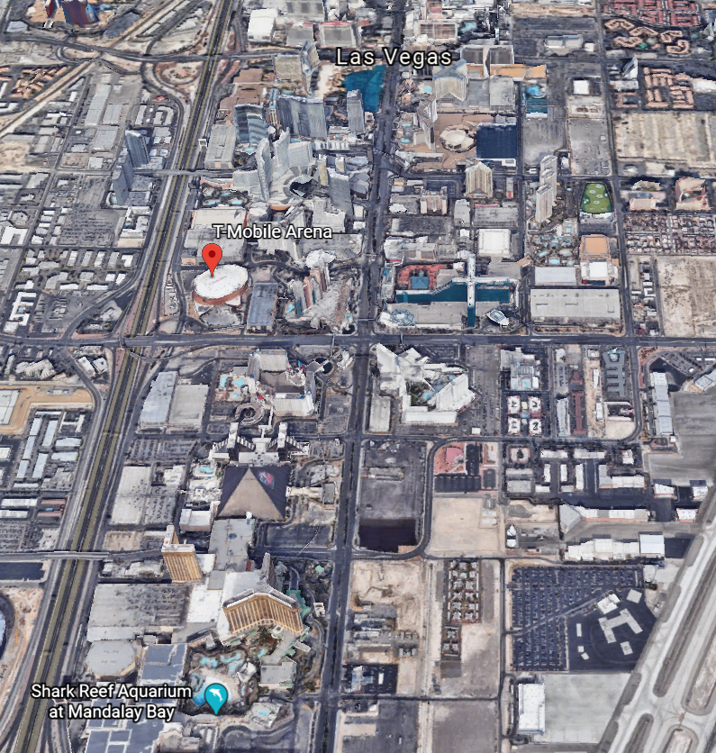
Las Vegas
Notes:
The Vegas Golden Knights play their home games at T-Mobile Arena in Las Vegas, Nevada. T-Mobile Arena opened in 2016 and seats 17,500 for ice hockey. The Golden Knights reported an average attendance of 18,310 fans in the 2018-2019 and 2019-2020 seasons meaning that they are selling out games and are seating over capacity crowds at their games on a nightly basis. T-Mobile Arena is located on The Las Vegas Strip among the casino and entertainment attractions in Las Vegas.
Google Earth

Slide 62
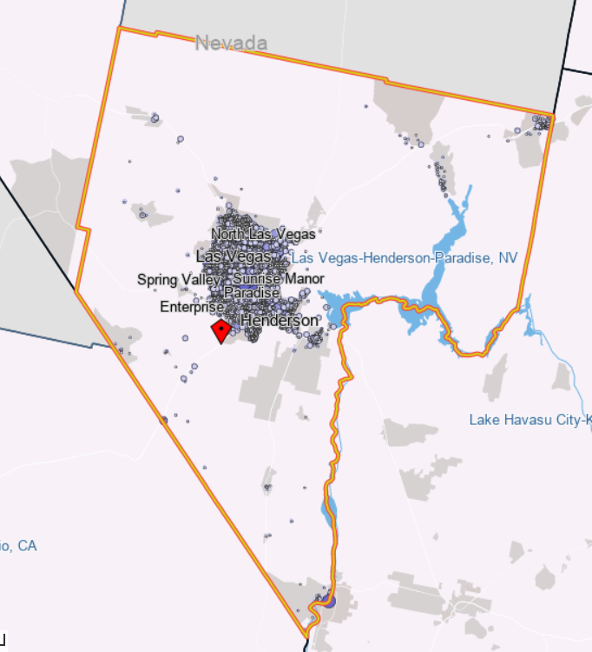
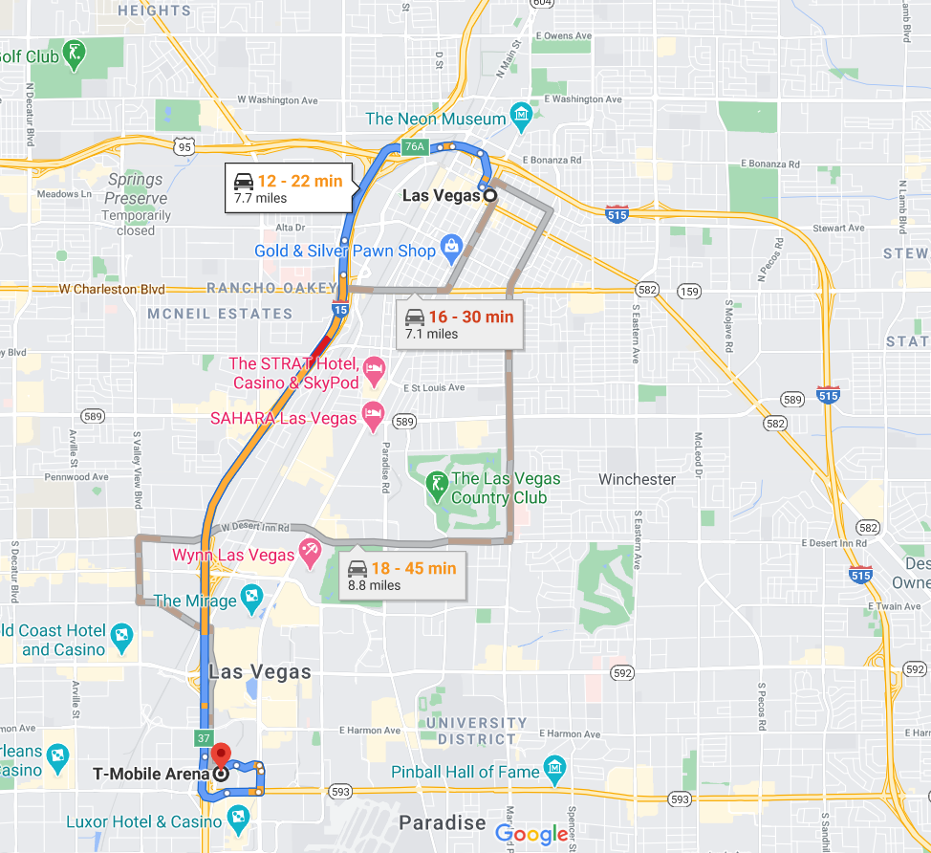
Las Vegas
Notes:
The jobs in the Las Vegas MSA are centered around the city and T-Mobile Arena is located in the middle of that job concentration. Located near downtown, the arena is accessible and convenient to those working on weekdays in Las Vegas.
OnTheMap, Google Maps

Slide 63
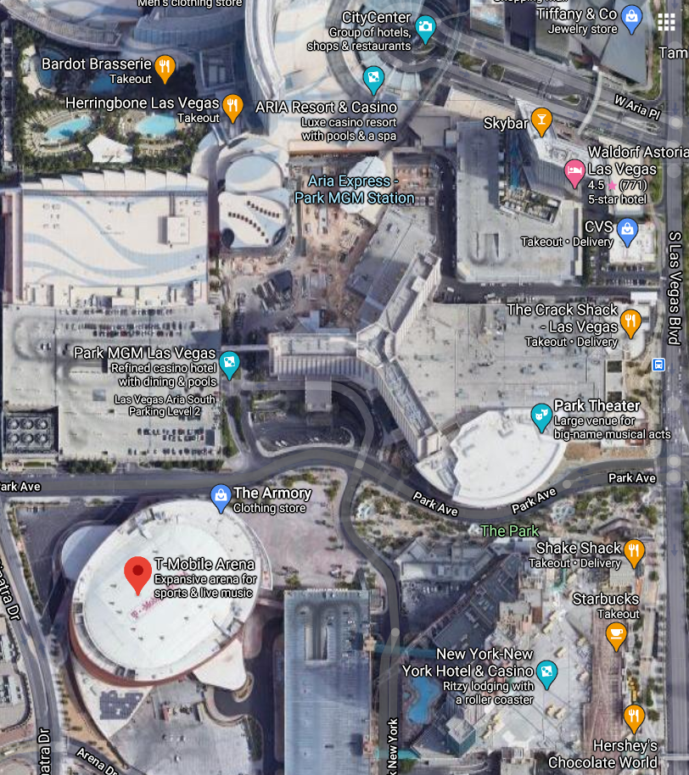
Game Presentation
Notes:
The Las Vegas Golden Knights must compete with the other entertainment options in the city. They present the game as an entertainment event that includes a pre-game show put together by Cirque du Soleil. Surrounding T-Mobile Arena 3 hours before hockey games, the Knights host pre-game tailgate parties at The Park that includes a DJ, live music, food and drinks, and a drumline march from the Brooklyn Bridge to the Arena. T-Mobile Arena is surrounded by casinos, theaters, restaurants, and other entertainment attractions that attract fans to the downtown area before and after games. The city has immersed the Golden Knights into the scene on The Strip.
Golden Knights Intro: https://www.youtube.com/watch?v=h1TbT05ZS5o
Google Maps

Slide 64
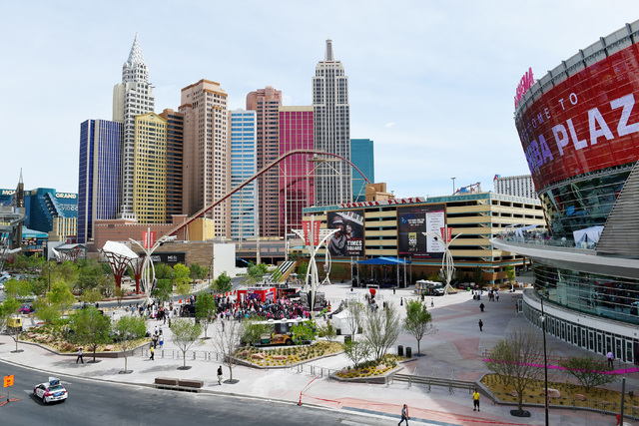
T-Mobile Arena,Toshiba Plaza, & The Park
Notes:
T-Mobile Arena has a unique design with lights and a screen. The arena is not uniformly constructed all the way around. The Park and Toshiba Plaza present opportunities for fans to gather before, during, and after the game or a stop as a tourist destination in Las Vegas. The entertainment district is designed to give fans the opportunity to walk around and take in the art of the outdoor space at all times of the year. The screen and Plaza can combine for watch parties outside the arena as another way to bring people to the footprint. People spend more than just game time in downtown Las Vegas when they attend a Golden Knights’ game.

Slide 65
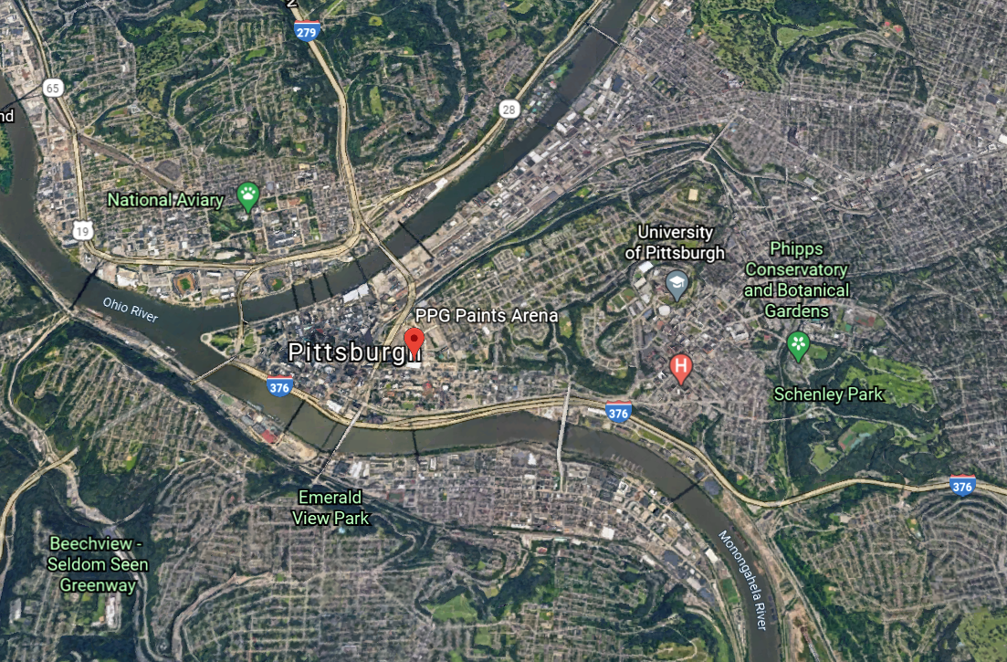
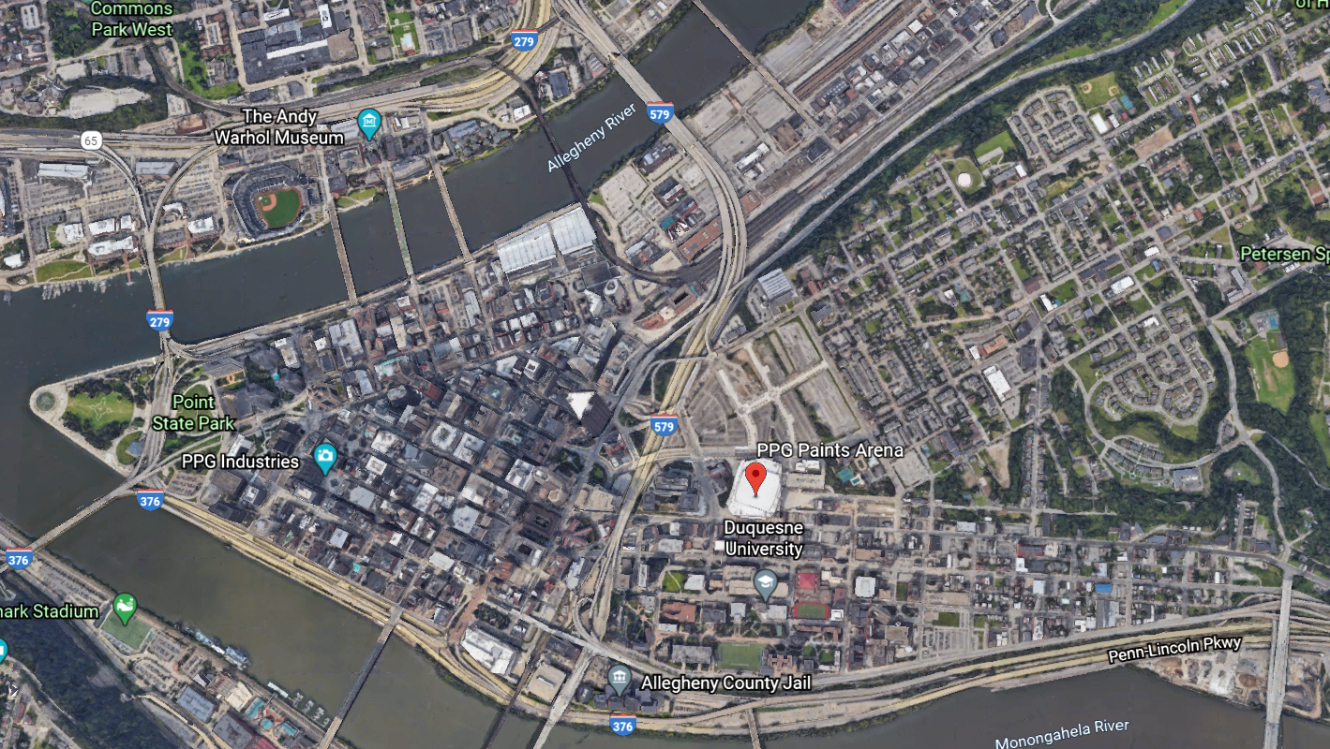
Pittsburgh
Notes:
The Pittsburgh Penguins play their home games at PPG Paints Arena in Pittsburgh, Pennsylvania. PPG Paints Arena opened in 2010 and seats 18,387 fans for ice hockey games. At 18,500 fans per game, the Penguins sellout and seat over capacity for the 2018-2019 and 2019-2020 seasons. The arena is located in downtown Pittsburgh near the campus of Duquesne University.
Google Earth

Slide 66
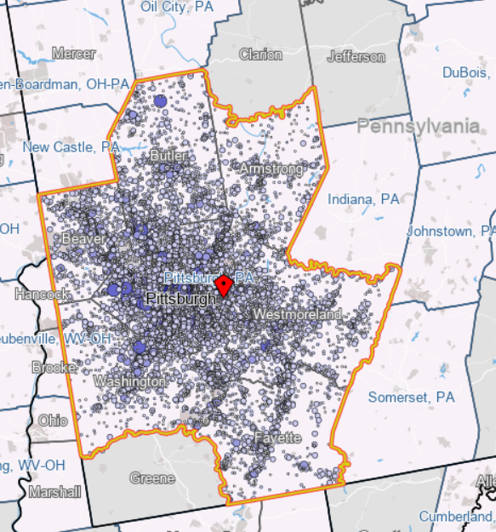
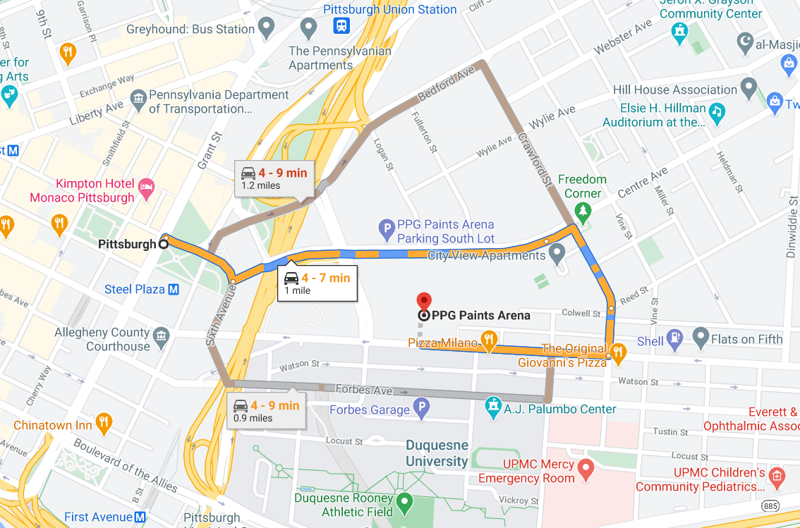
Pittsburgh
Notes:
The jobs in Pittsburgh are centered around the downtown and PPG Paints is easily accessible with its downtown location.
Google Maps

Slide 67
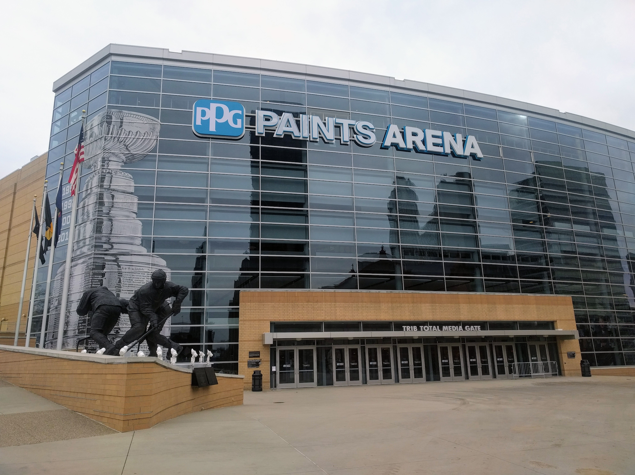
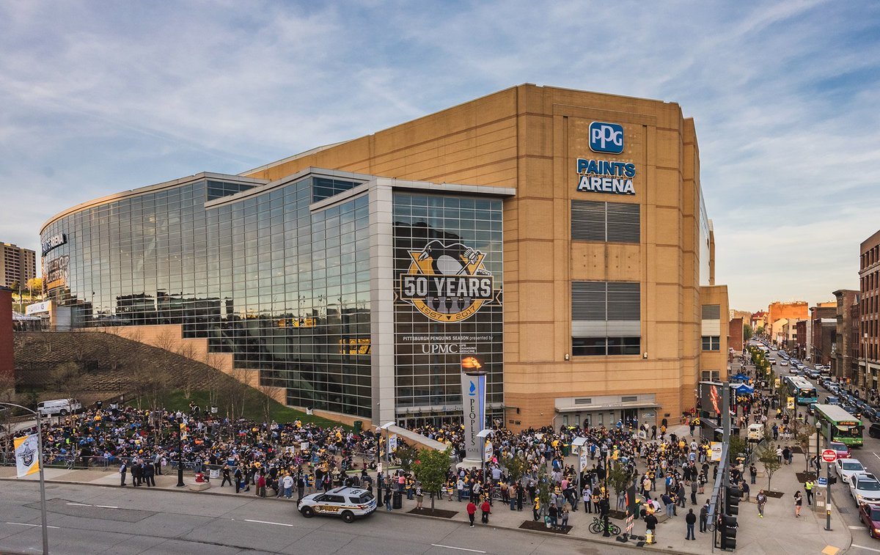
Pittsburgh
Notes:
PPG Paints Arena uses glass to create a unique side that can show displays and be lit up at night. The Arena uses different angles along the streets apart from the traditional rectangular configuration. The Mario Lemieux statue outside the arena provides a landmark for fans to visit to pay homage to a Penguin legend. The Penguins are a successful franchise and display their accomplishments outside their arena. The downtown setting provides fans an opportunity to engage with surrounding businesses before and after the games.

Slide 68
Takeaways
The larger markets of Phoenix and Miami have located their hockey arenas away from the job centers and made travel difficult without much incentive to travel long drives. There is little attraction around these arenas that would bring fans to games early or keep them around late.
Las Vegas and Pittsburgh developed unique arenas located around the job centers in the downtowns of their cities. The franchises sell out games and attract large crowds of fans to their footprints before, during, and after game time. These franchises have aligned their arenas and teams with the cities they play in and are a part of the downtown. It is valuable to attract fans to games and even more valuable to capture their economic spending around the arena.

