Slide 1
Content Creation
UM Rec Sports Facilities/Department
Emily Argersinger, Nate Lazor, Webb Sarris, Lukas Stauffer
Notes:
Luke has 1-3
Webb will screen share

Slide 2
Extreme
Makeover
Rec Sports Edition

Slide 3
Brand Strategy
Instagram
Twitter
aesthetic
informational
tied together with #RecSportsMakeover
show pictures of the “makeover”
funny
event sensitive
trendy

Slide 4
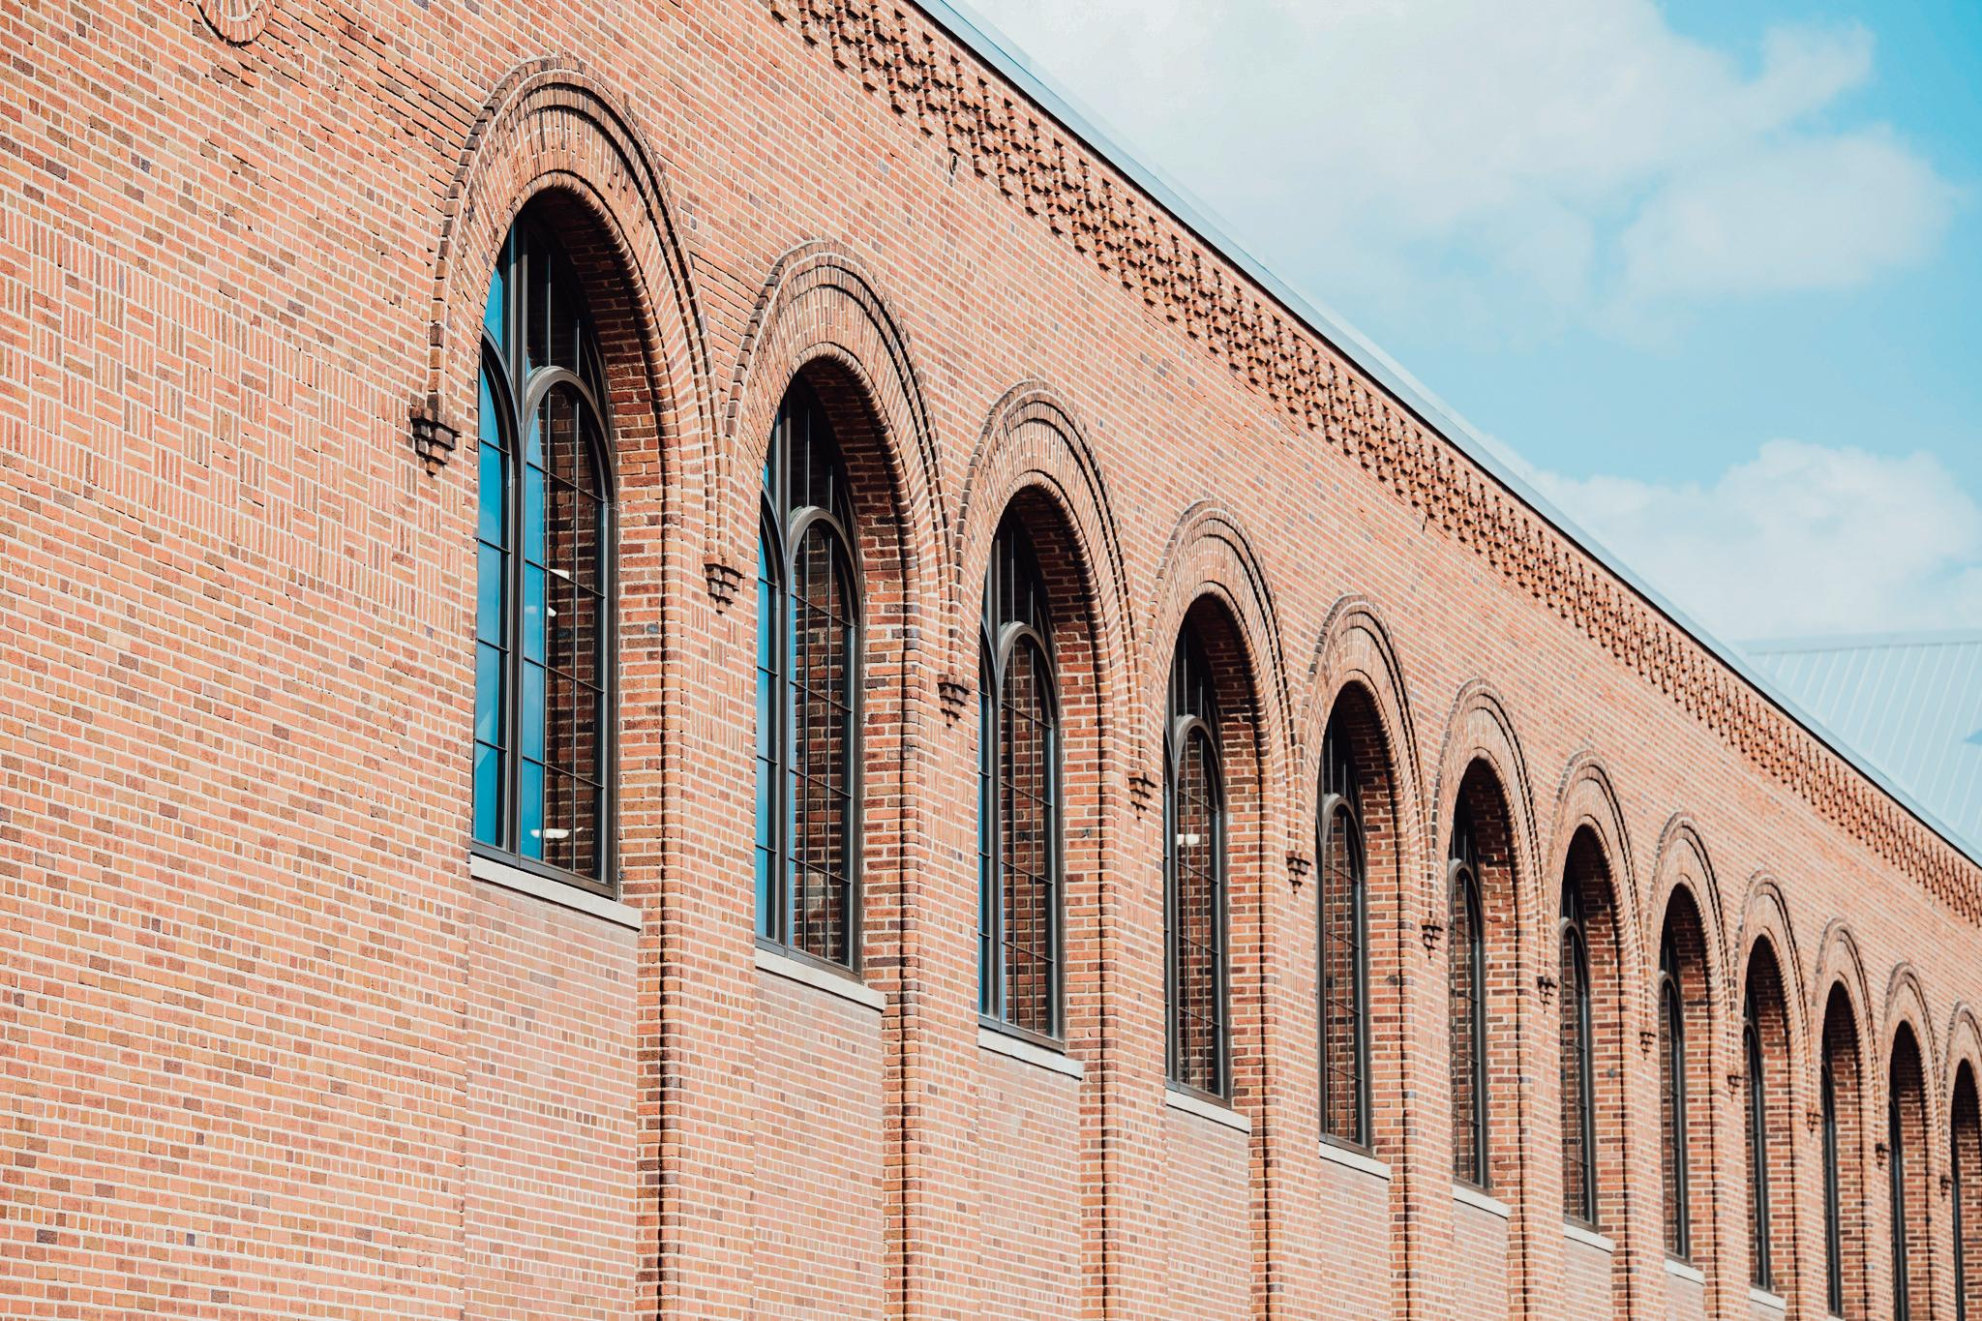
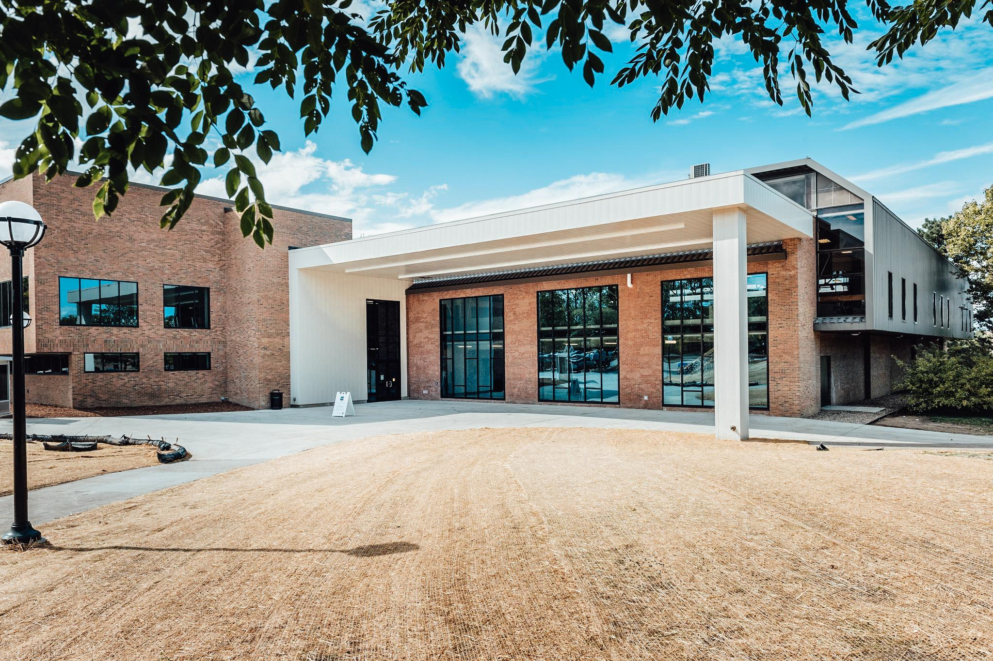
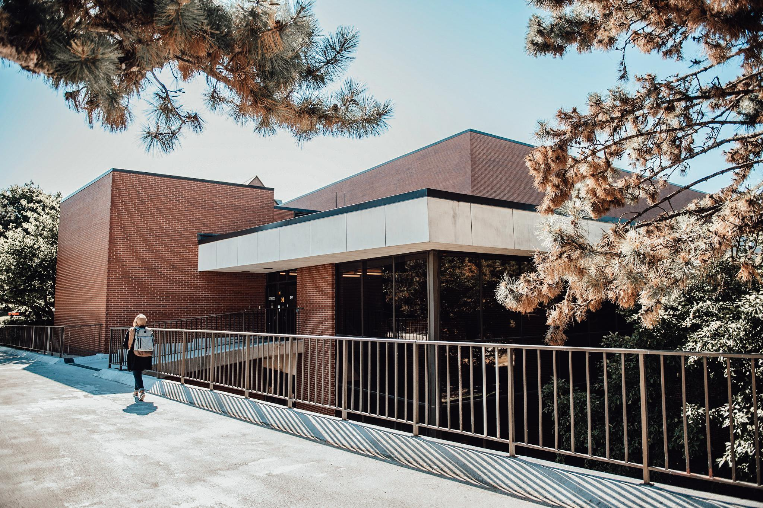
Instagram Post 1
To re-open our facilities safely, we had to undergo an #ExtremeRecSportsMakeover this semester. Follow along to see how U-M Rec Sports changed our facilities to keep our students safe!

Slide 5
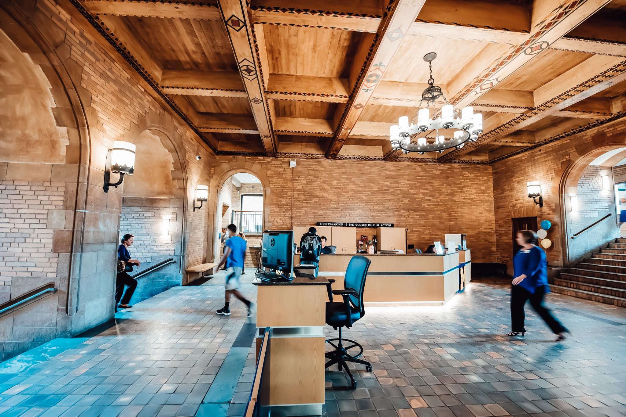
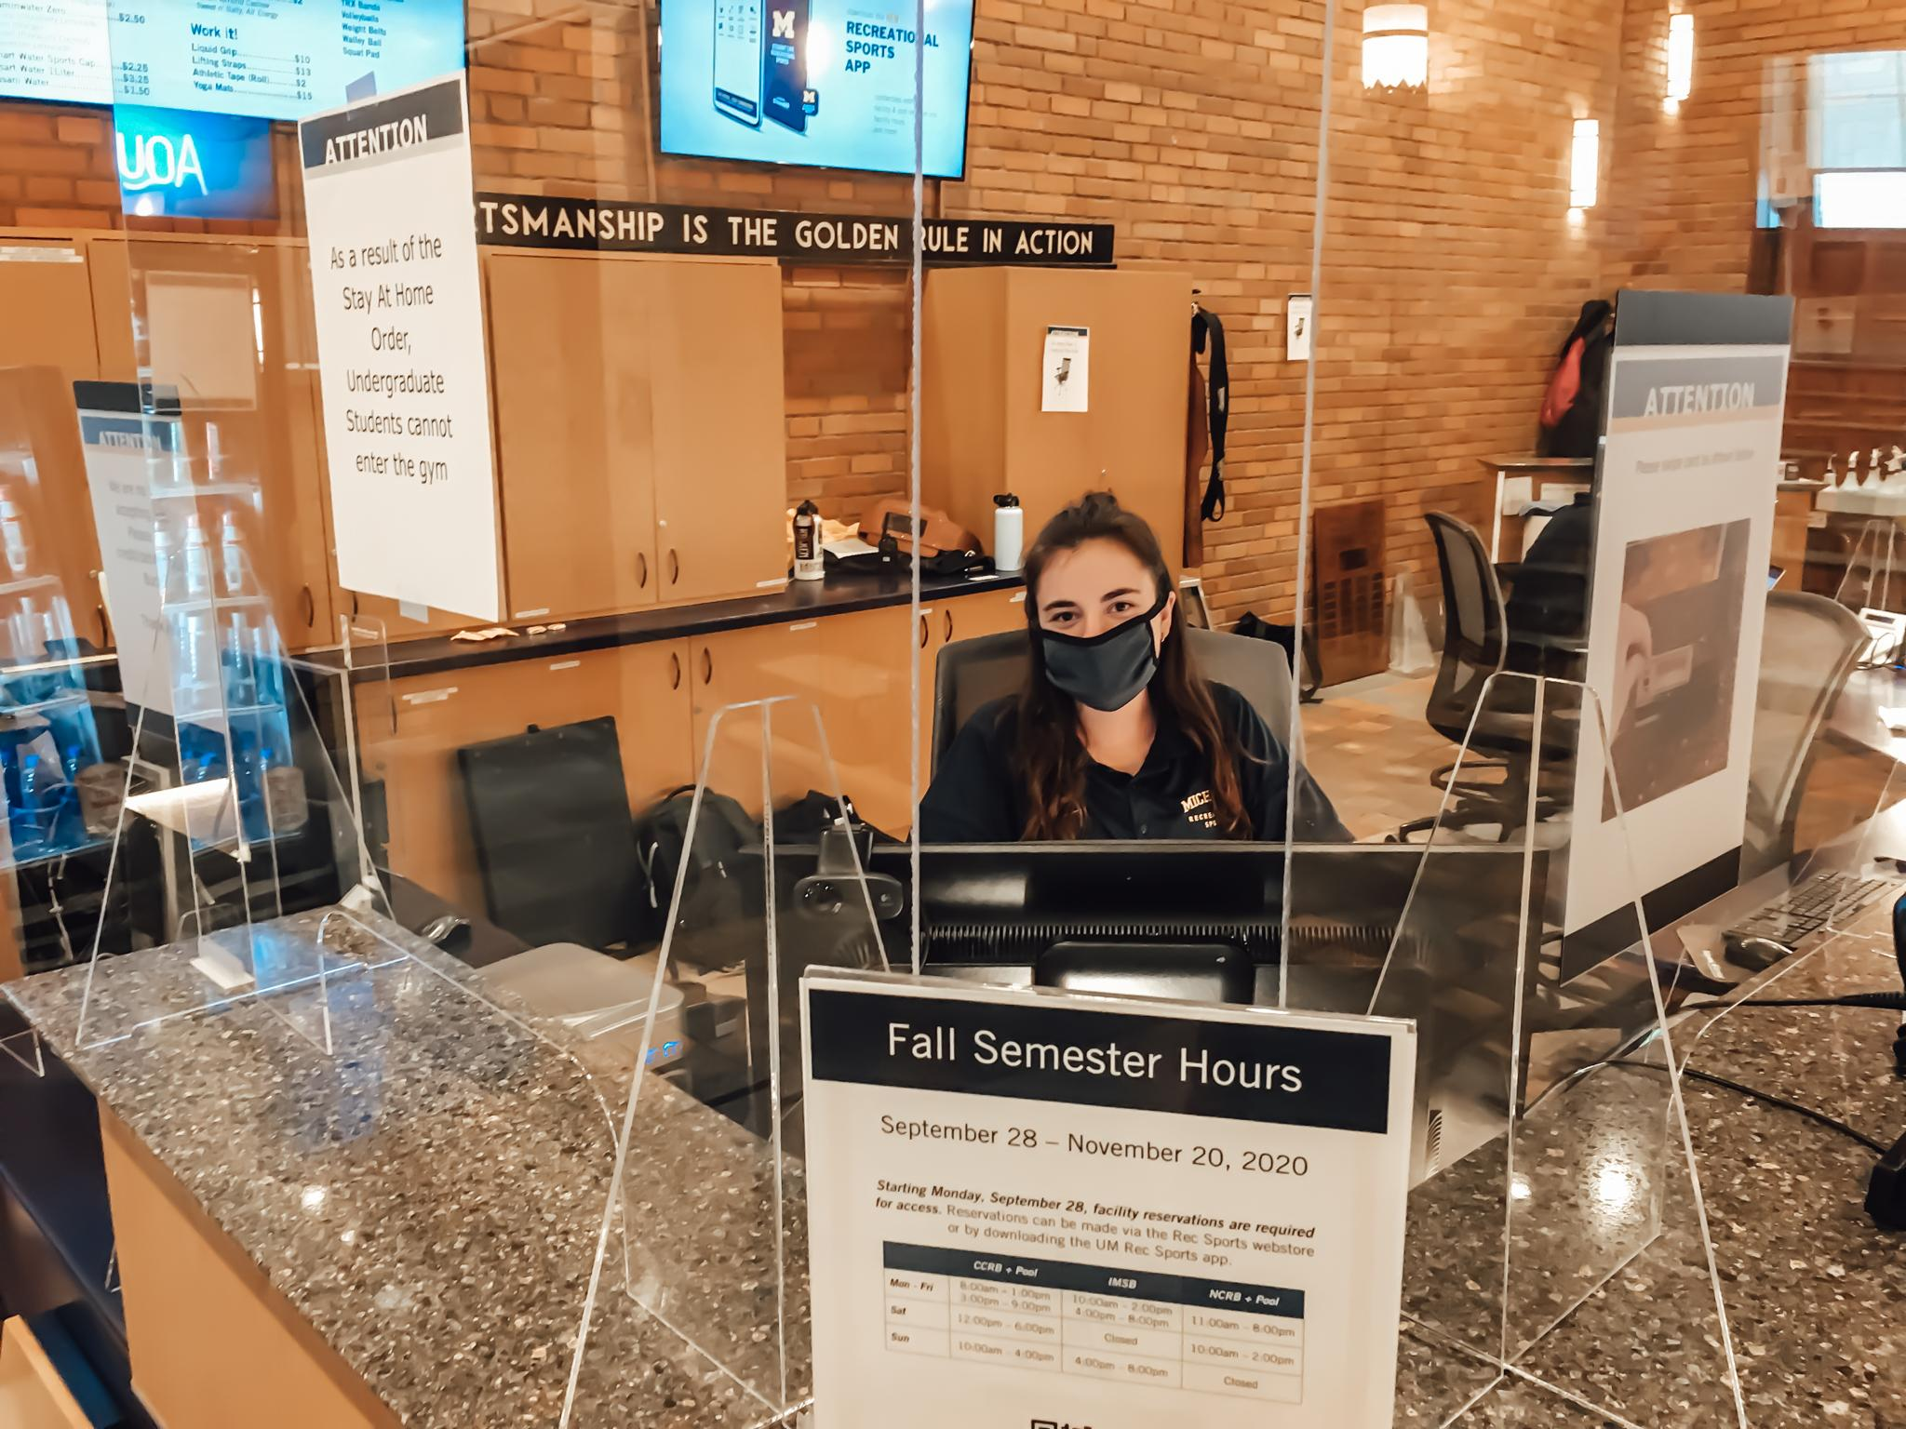
Instagram Post 2
Our staff is as committed as ever to keeping you safe. As part of the #ExtremeRecSportsMakeover, our staff is now socially distance, separated from you by partitions, and required to wear masks. #BeforeAndAfter

Slide 6
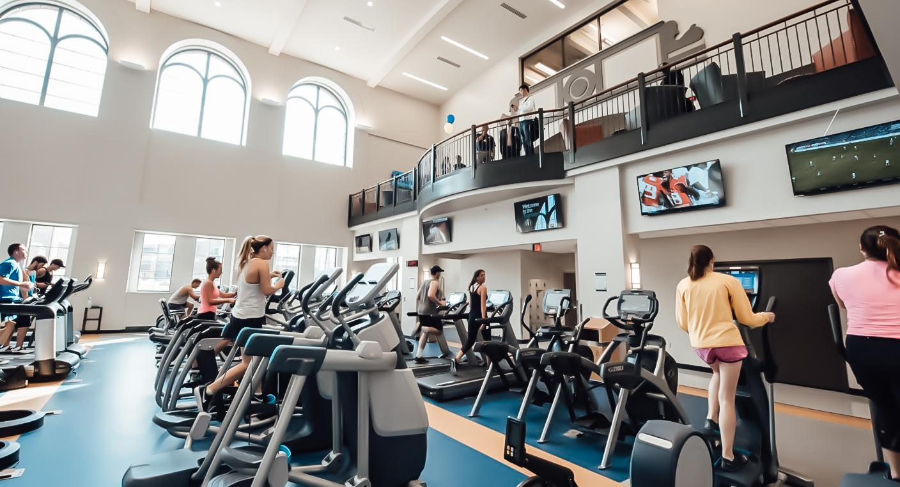
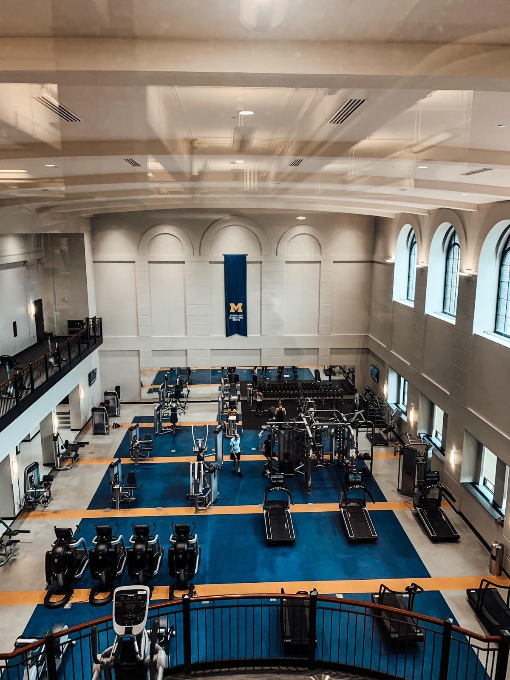
Instagram Post 3
The layouts of the facilities have also changed- instead of just six feet apart, Rec Sports decided to separate pieces of equipment by ten feet. #BeforeAndAfter #ExtremeRecSportsMakeover

Slide 7
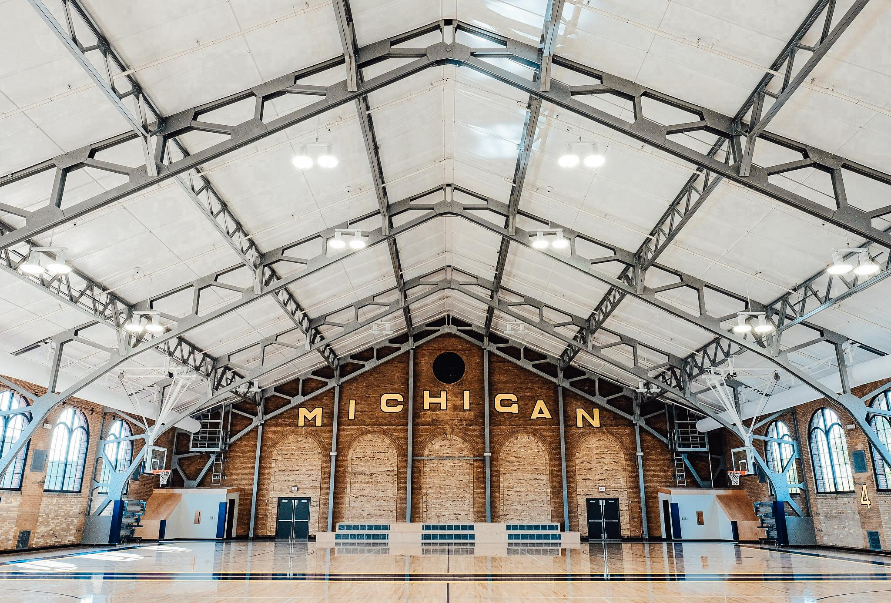
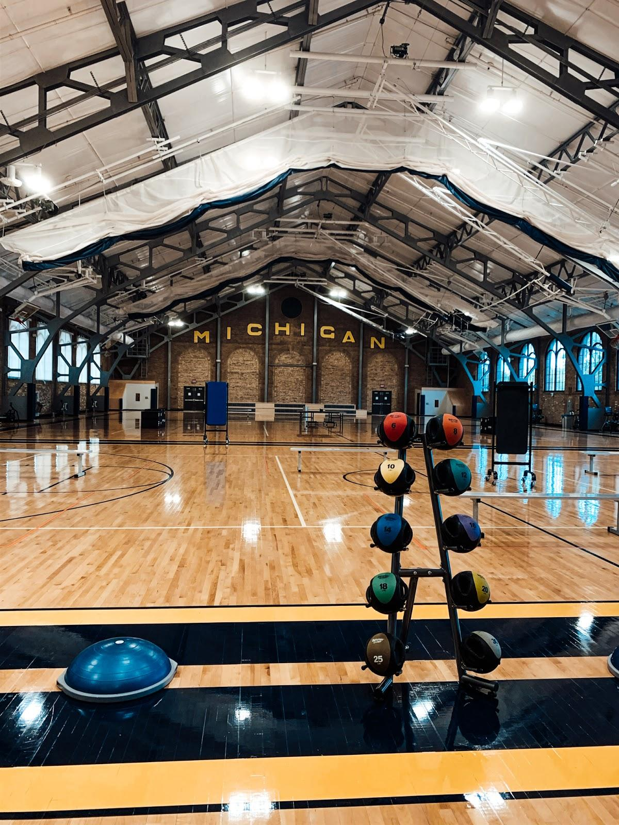
Instagram Post 4
To accommodate the new facility layout, some of our equipment has found a new home in the gym! #BeforeAndAfter #ExtremeRecSportsMakeover

Slide 8
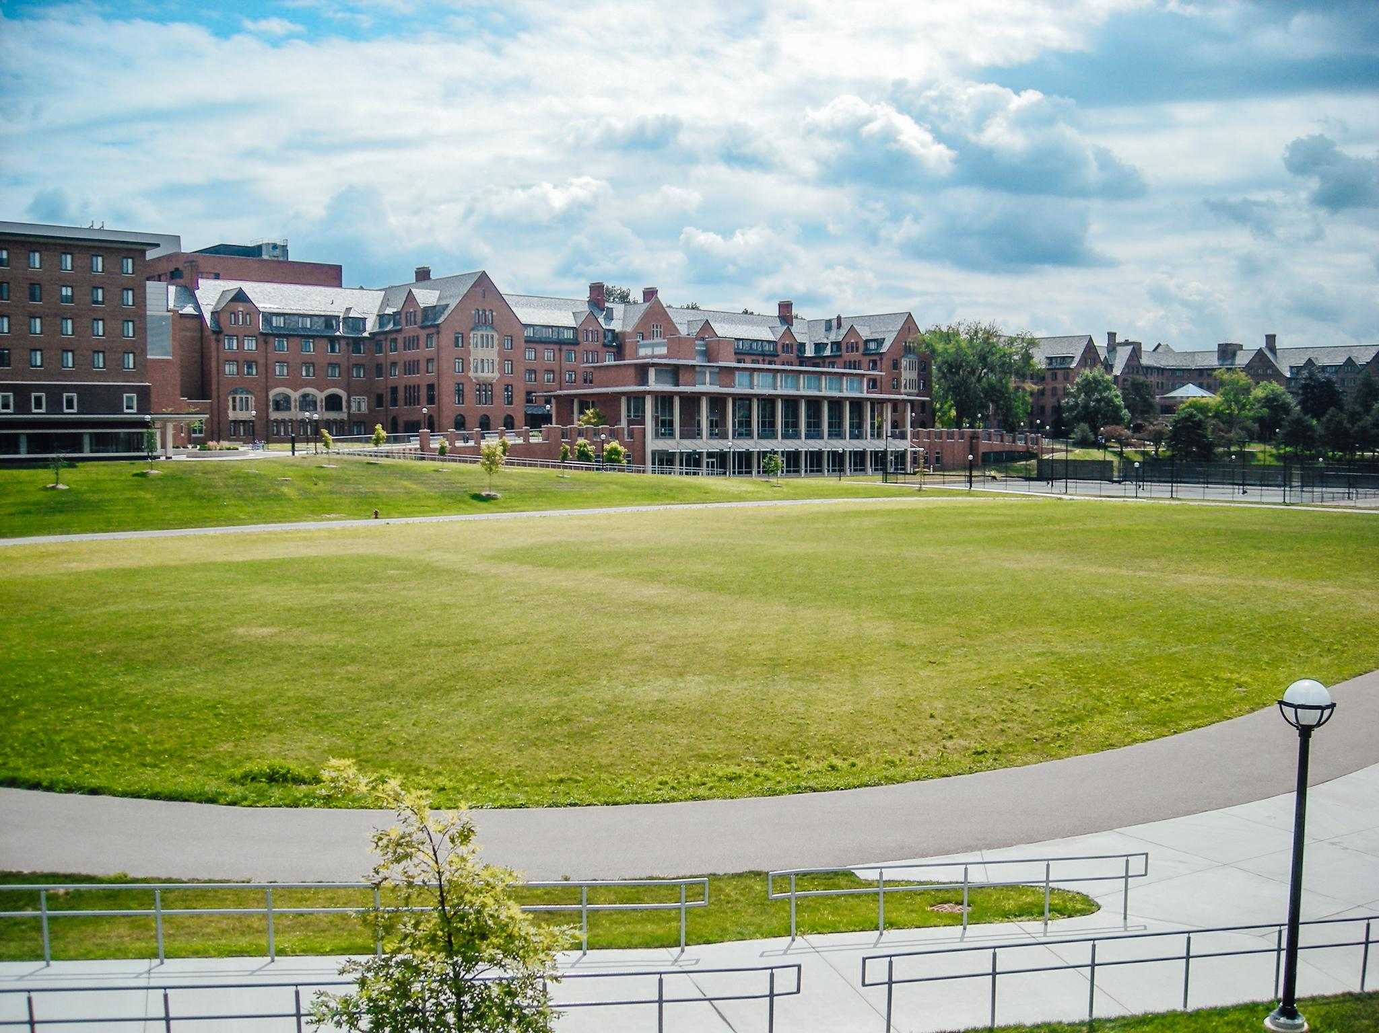
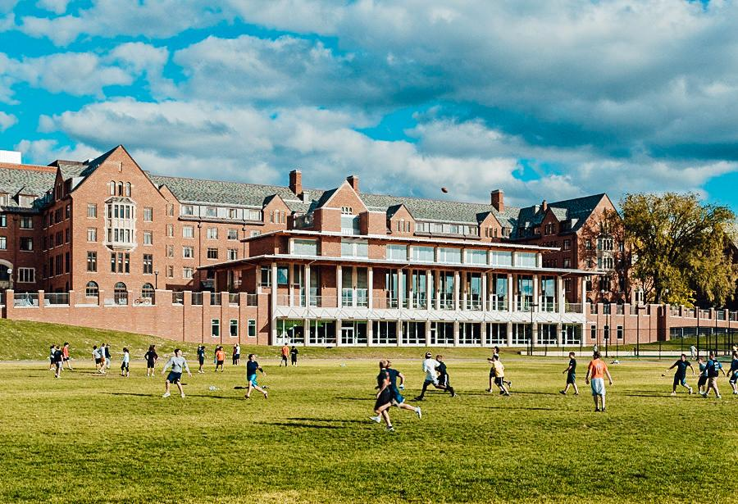
Instagram Post 5
While we are happy that we’ve found ways to keep you safe, we can’t wait to welcome all of you back. Palmer Field will hopefully look like this #BeforeAndAfter in a few months! And when it does, we’ll be happy to undergo another #ExtremeRecSportsMakeover to get everyone back in our facilities.

Slide 9
Instagram Story 1
Before, there was no need for a reservation.
After our #ExtremeRecSportsMakeover, we had to ensure our facilities didn’t get too crowded. Reservations are now required.

Slide 10
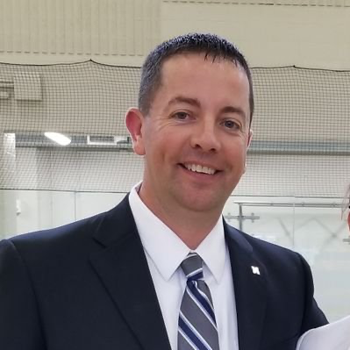
Instagram Story 2
The Faces Behind The Makeover
“We’ve created safer environments for our users and employees to protect their health and safety.”
Director, Recreational Sports
Mike Widen

Slide 11
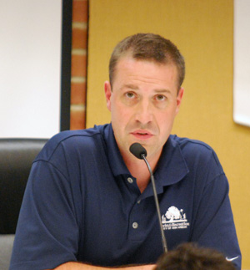
Instagram Story 3
The Faces Behind the Makeover
“Our decisions and timeline were driven by the State of Michigan’s executive order for gyms. . . we implemented those as quick as possible.”
Associate Director, Facilities
Jeff Straw

Slide 12
Instagram Story 4
The Faces Behind the Makeover
“Probably the biggest change was not how I was working but what it was that I was promoting. There was a bit of scrambling as we figured out which programs we could move online.”
Student Marketing Coordinator Clare Dipaola

Slide 13
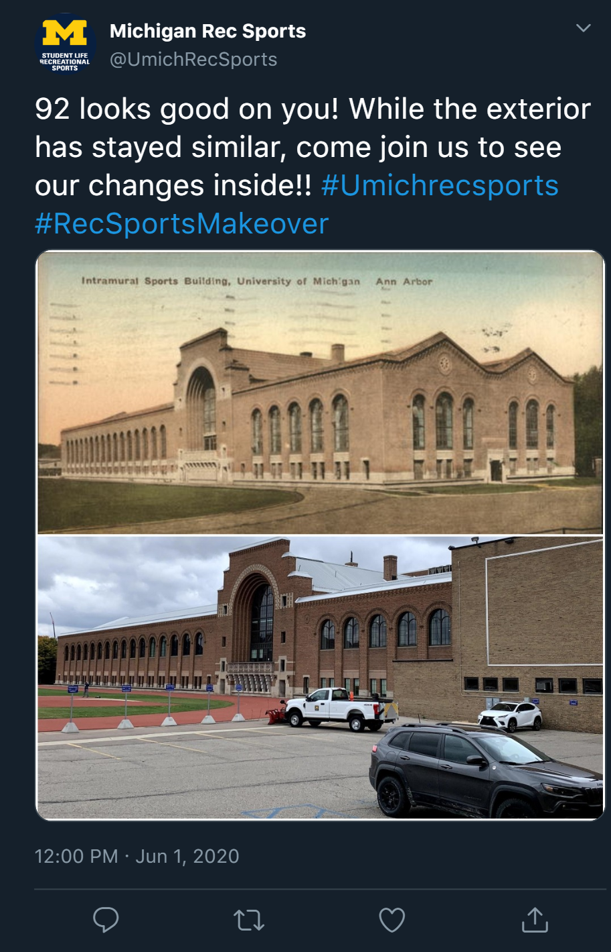
Twitter Post 1

Slide 14
Twitter Post 2
Caption: Safe travels to all our Wolverines headed home for winter break! #RecsportsMakeover
https://tenor.com/view/safe-travels-up-bye-wave-gif-8102418

Slide 15
Twitter Post 3
Caption: Shopping 👏 is a 👏 workout #Workout #BlackFriday #RecsportsMakeover
https://tenor.com/view/black-friday-neon-neon-sign-icon-shopping-gif-12896117

Slide 16
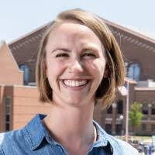
Twitter Post 4
Caption: We had the opportunity to work with Sarah Button, Jeff Straw, Michael Widen and Clare DiPaola to learn more about Rec Sports and the work they are doing to keep the students safe and active throughout the makeover! Stay tuned to hear what they had to say! #UmichRecSportsStaff

Slide 17
Twitter Post 5
Caption: Download the @UmichRecSports App and reserve your space right from your phone! Join us at our facilities on campus for a safe workout! #Umichrecsports #ExtremeMakeover

Slide 18
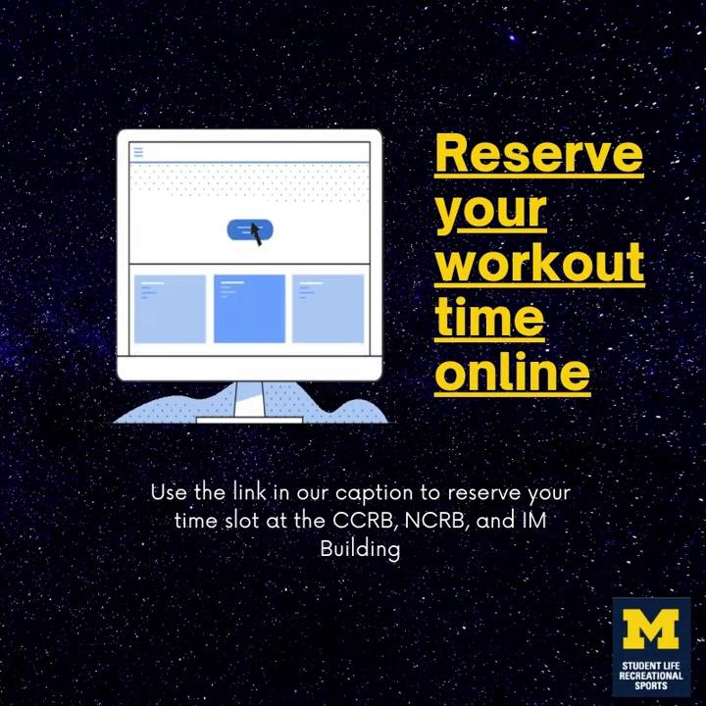
Animation
Caption: Sometimes we have to change our lock on the front door to our house...Reserve your workout time in our re-arranged facilities by using this link: https://webstore.recsports.umich.edu/booking
.
.
#RecsportsMakeover #ExtremeRecMakeover

Slide 19
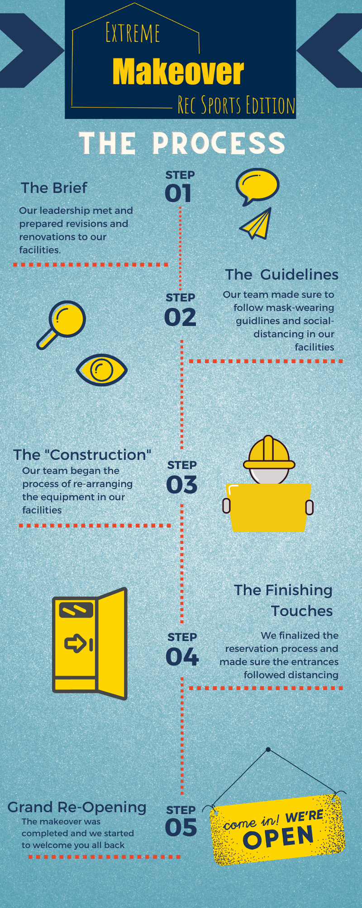
Infographic
Caption: Check out our behind-the-scenes process of our Extreme Makeover at our facilities! #RecsportsMakeover #ExtremeRecMakeover

Slide 20
YouTube Video

Slide 21
Thank you!

