Slide 1
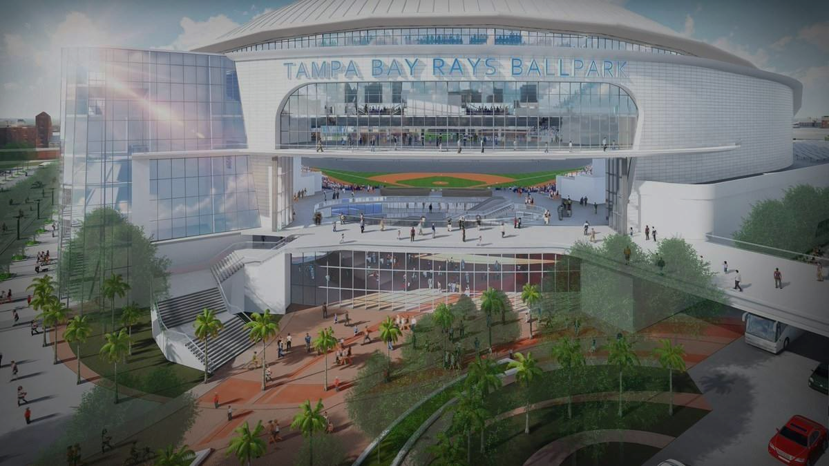
Issue 1:
Funding a new ballpark for the Tampa Bay Rays

Slide 2
Primary Concerns:
Public/Private Partnership
Municipal Bond Repayment Strategy
TIF Districts
Property
Sales
Other public financing tools
Ballpark Locations

Slide 3
Background
Proposed Partnership between public sector and Rays ownership
$900 Million Project (50/50 split)
In the following slides we will propose a financing plan for the the city of Tampa/ Hillsborough County

Slide 4
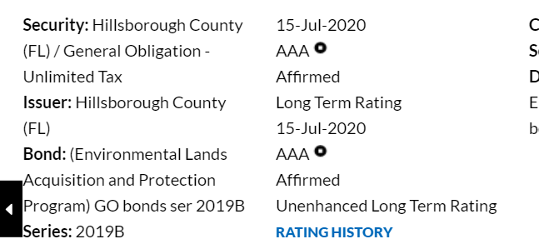
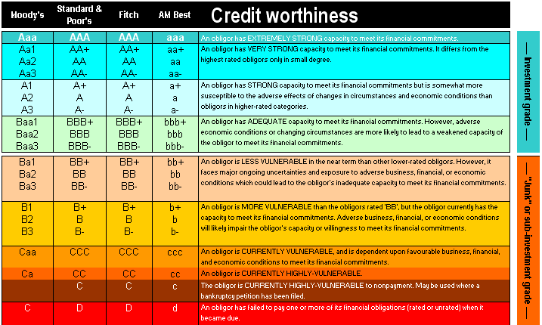
Bond Repayment Strategy- Hillsborough County (1)
To create a financing plan for the public sector, we must first determine the tax revenues needed to repay the bonds
Hillsborough County Bond Rating
AAA
Critical Key: In the case of a bond being issued to finance the new ballpark in Hillsborough County, the bond rating will be very strong at AAA.
Notes:
Importance: This is critical because this allows them to get the lowest interest rate possible, which will be explained in greater detail on the next slide

Slide 5
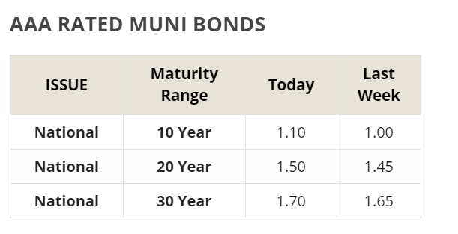
Bond Repayment Strategy- Hillsborough County (2)
To create a financing plan for the public sector, we must now determine the interest rate, given the bond rating for HC is AAA
AAA Municipal Bond Interest Rate
1.70%
Critical Key: An interest rate of 1.7% will help us to determine the annual bond payment.
Potential Bond Values for $450 Obligation
$300 Million -> $350 Million -> $400 Million -> $450 million
Notes:
Key: With the interest rate being 1.7%, we can now calculate the tax revenue needed to repay the various potential bond values

Slide 6
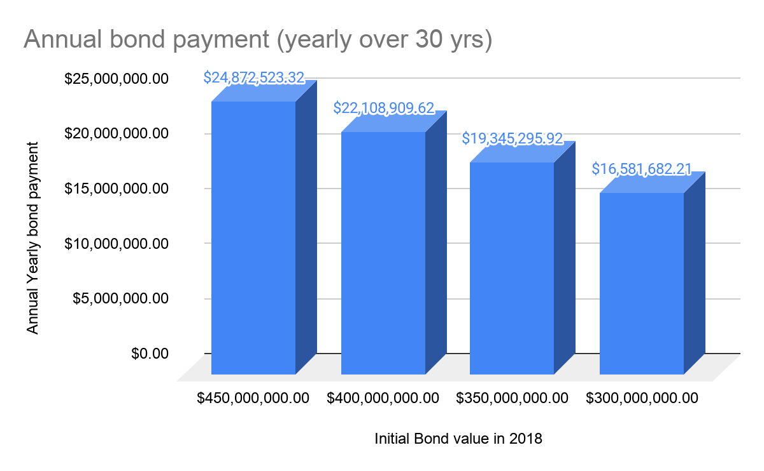
Bond Repayment Strategy- Hillsborough County (3)
Total Original Cost: $900,000,000
Rays cost: $450M
Hillsborough County: $450M
Hillsborough County Financing= $450M
$450M (cost in 2028) * ((1+0.017)*30)=$746,175,699.62 (total cost over 30 yrs)
X/30(years)= ~$24.87M
Public Sector Annual Bond Payment: ~$24.87M
Tax Revenue Needed:
Notes:
Critical Keys: The annual bond payment would be $24.87M for a $450M, 30 year bond. This is a significant amount of tax revenue that will need to be generated. Our plan will determine if this is a feasible amount and in the likely case that it is not, we will counter to the Rays with a lower initial contribution based on the other bonds shown in the graph.
Compound Interest Calculator | Investor.gov

Slide 7
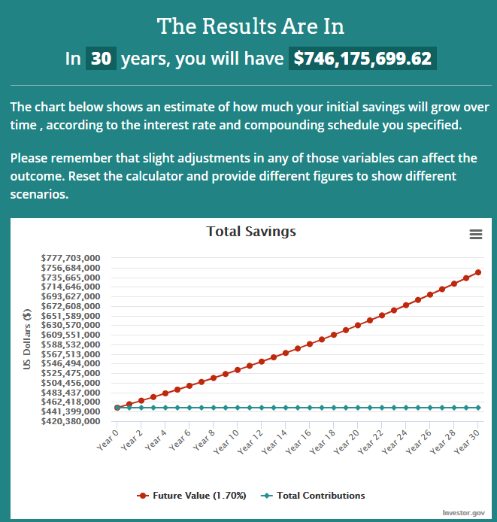
Notes:
Total Cost of a $450M bond for Hillsborough County after 30 years.

Slide 8
Tax Revenue needed to repay different valued bonds
Annual Bond Payment = Tax Revenue needed
Notes:
Note: Should the tax revenue be less than the annual bond payment, the county will have to use the general fund as a backstop (not ideal or desired for that matter)

Slide 9
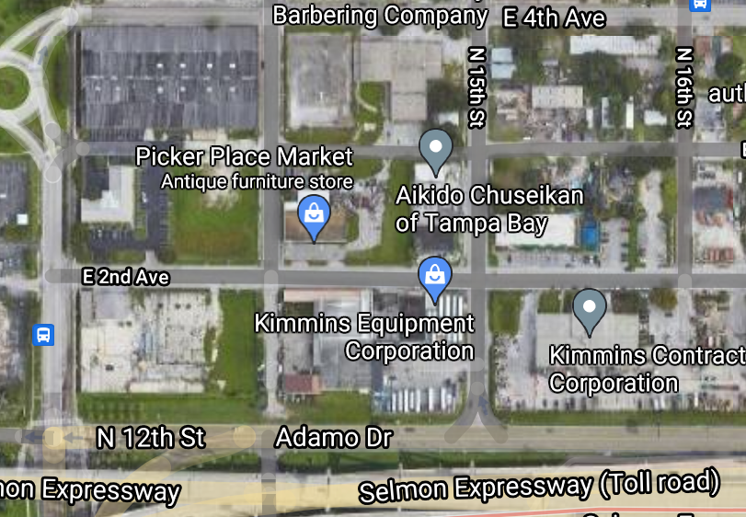
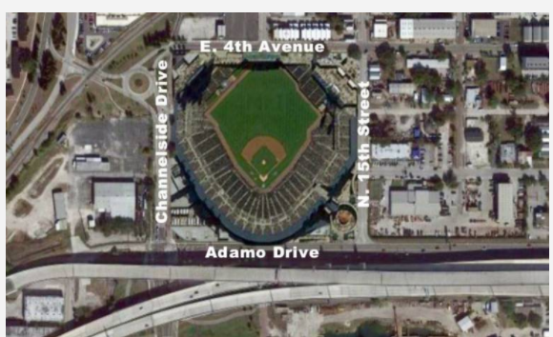
Location Option 1
Ybor City, City of Tampa, FL
Notes:
Ybor City ballpark still option for Rays: Developer | Ballpark Digest
Key: This location is great for urban planning principles and keeping the ballpark within a close proximity to downtown Tampa Bay. Also, this site allows for the development of a district because of the high availability of real estate in Ybor City.

Slide 10
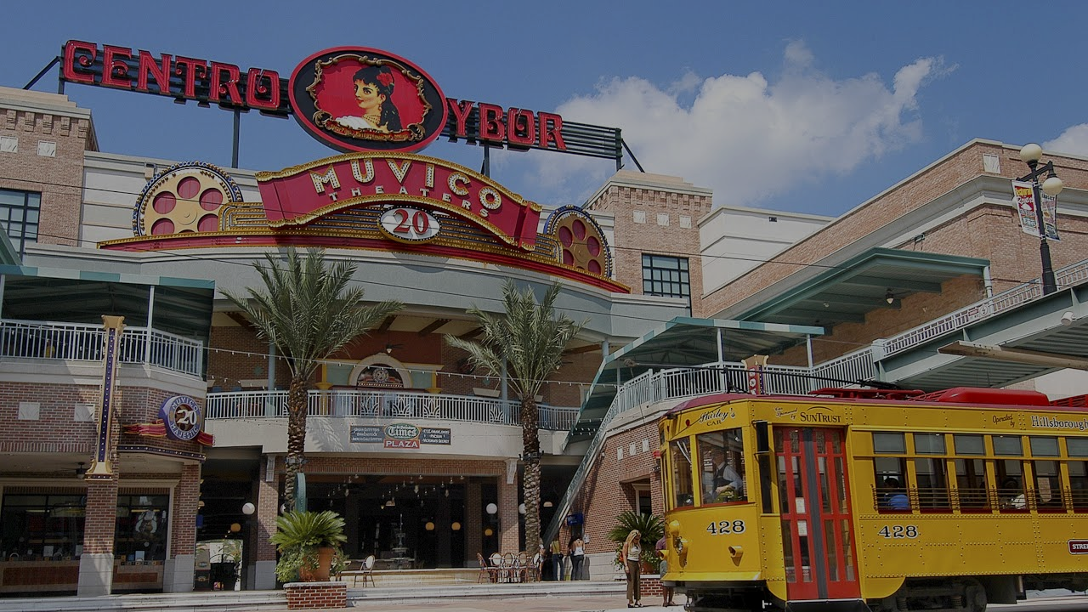
Ybor City and District Potential
Demonstrated support from Rays organization
Their preferred site due to urban planning principles
Close access to freeways, TECO Streetcar, Downtown Tampa, Water Street Development
14 acre stadium site
Ability to increase to 65 acres to develop as a mixed-use development
Will include residential, retail, and commercial
Built to fit the neighborhood landscape (vibrant, Spanish/Cuban architecture)

Slide 11
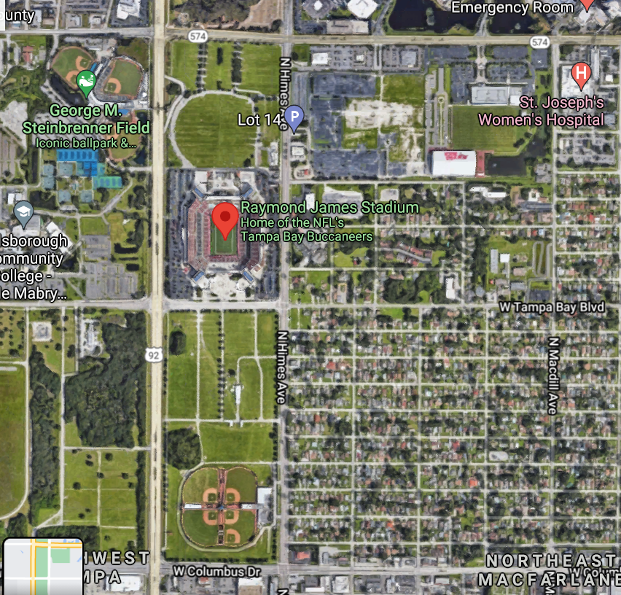
Location Option 2
Near Raymond James Stadium, City of Tampa, FL
Great accessibility due to intersection of I-574 and 92
Notes:
Critical Key: Raymond James Stadium has some undeveloped land around the stadium that could work great for a new ballpark and possibly even a district with retail, commercial and residential properties. Another positive that we will cover later is the ability to do a Property TIF district here.
One negative drawback is the location is further from downtown and the lively Water Street development and could further decentralization trends within the city of Tampa Bay.

Slide 12
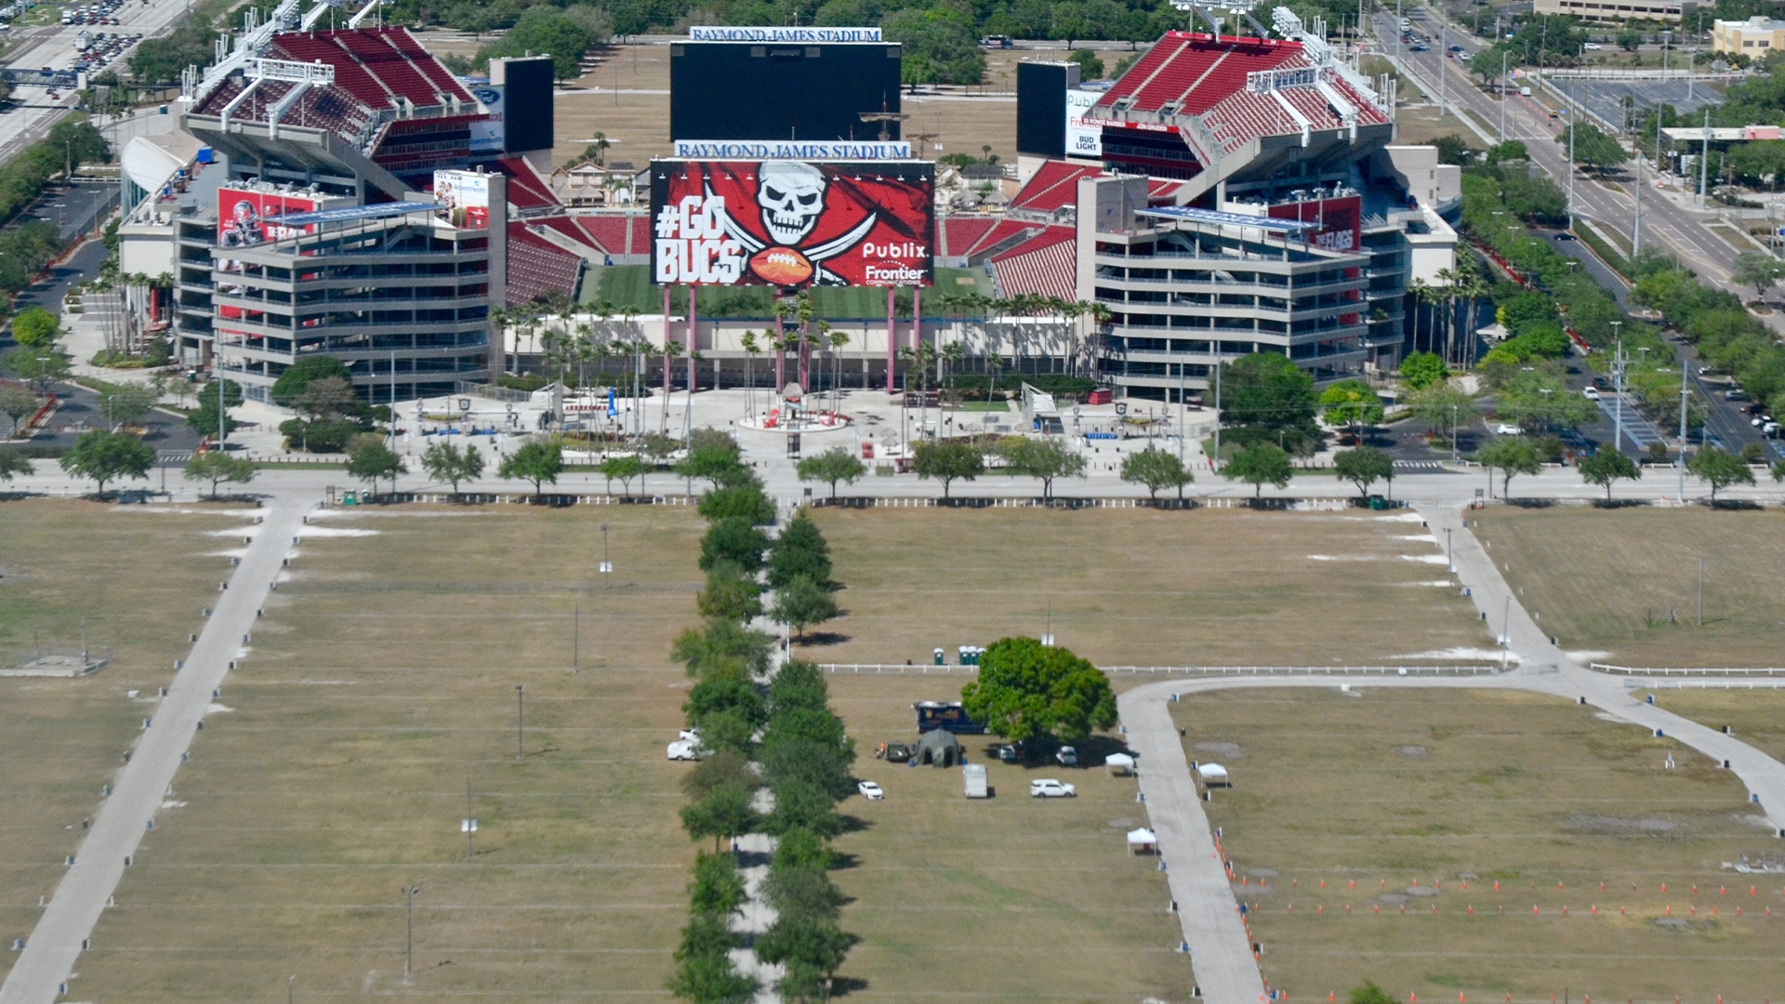
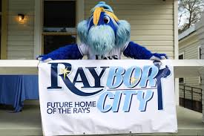
Public Financing Plan
1
2
Notes:
Potential plans for the 2 proposed locations

Slide 13
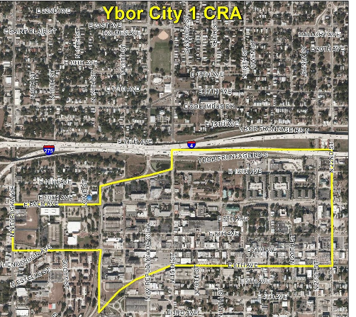
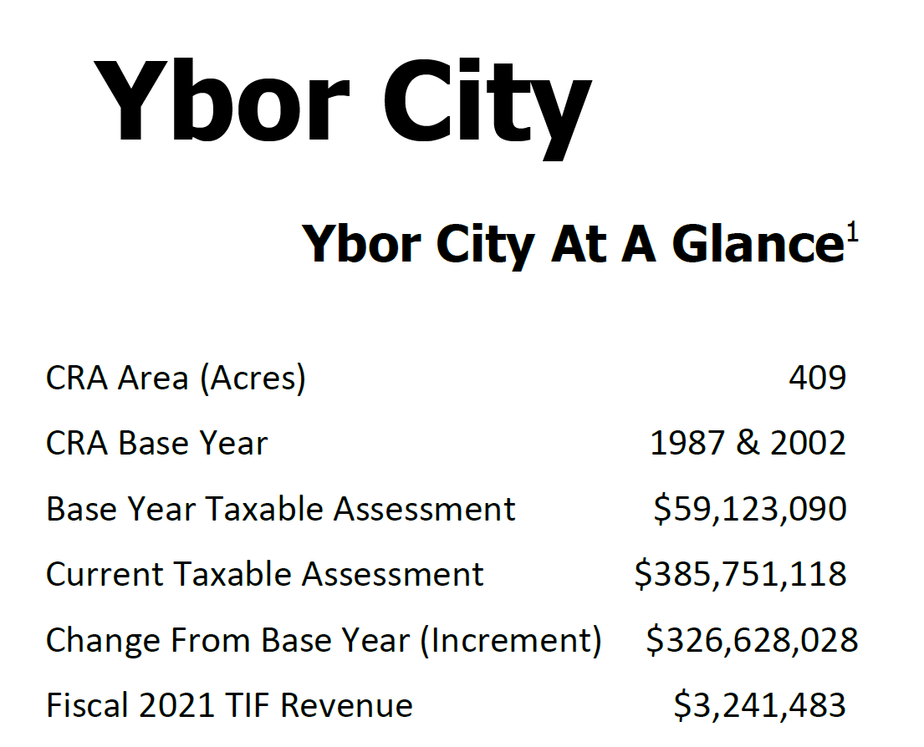
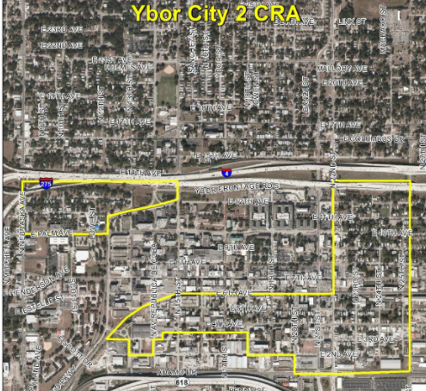
Financing Ybor City Ballpark
Property tax TIF Feasibility
Critical Key: A Property TIF would not be feasible in Ybor City due to there already being an existing TIF.
Notes:
Critical Keys: Ybor City already has two Property Tax TIF districts in place (CRA 1 and CRA 2). As noted above from their financial report in 2021, their fiscal TIF revenue was $3,241,483. This is a significant number that the new ballpark COULD NOT capitalize on because you cannot TIF an area, by law, that has already been under a TIF district.

Slide 14
Financing Ybor City Ballpark
Sales tax Increase Feasibility
Hillsborough County:
2019 total sales tax revenue: $563,208,000
Pinellas County:
2019 total sales tax revenue: $166,327,000
Combined revenues= $729,535,000
Critical Key: By implementing this 0.1% increase, we can expect to capture tax revenues of $29.2M. This should only be proceeded with if agreed upon by a local survey, to avoid political suicide.
Implement an increase
Increase sales tax rate by 0.1%
This increase = $29.2M (increment)
Notes:
Key: Because both Hillsborough and Pinellas counties receive the benefits and positive externalities from the franchise staying in the MSA, we will target both of them with this increase in sales tax. This lessens the burden on Hillsborough County to generate tax revenue on their own.

Slide 15
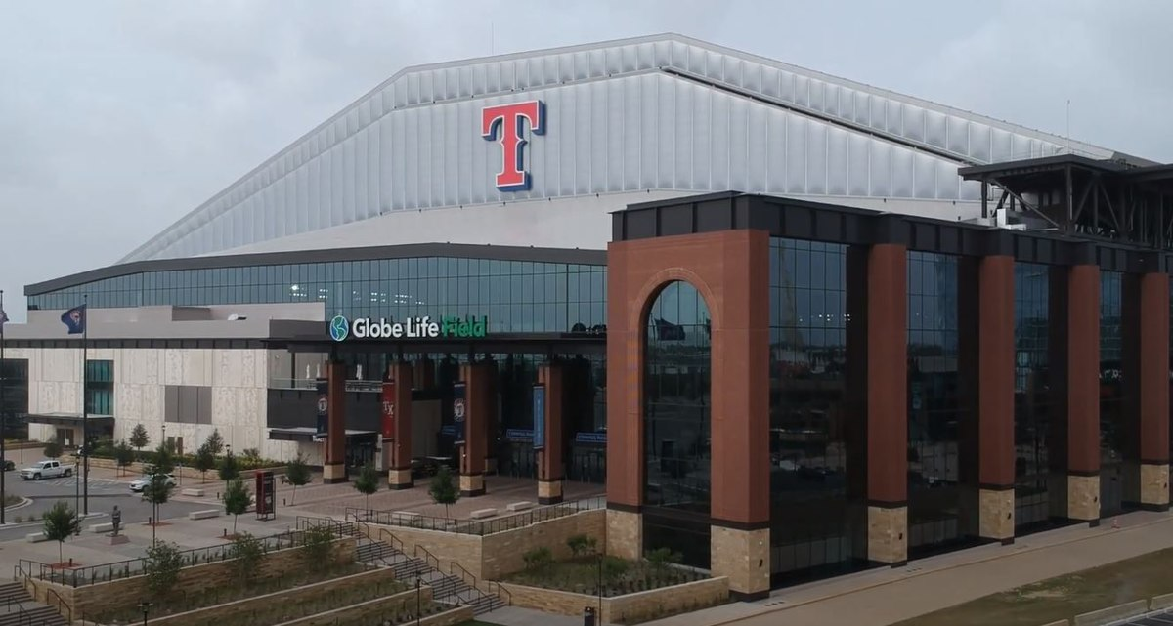
Comparable Example: Globe Life Field, Arlington, TX
60% of residents voted to extend tax used to fund AT&T Stadium
Half-cent increase in sales tax, 2% hotel tax, 5% car rental tax
Opened in 2020
Cost $1 Billion: 50/50 split
Arlington Population
395,477
Tampa Population
387,916
Notes:
We would target a similar plan if we were pursuing a sales tax increase rather than a TIF district.

Slide 16
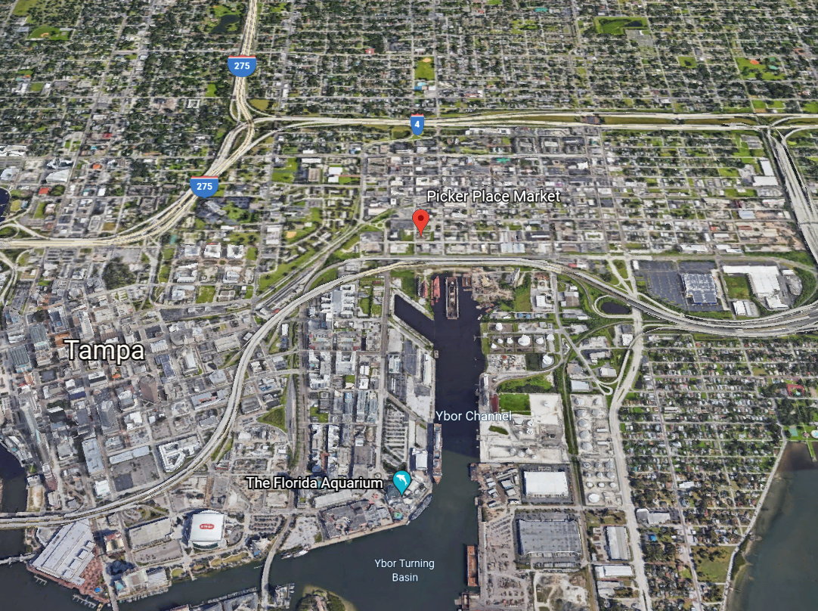
Financing Ybor City Ballpark
Sales tax TIF Feasibility
Stadium Site
Potential area for a TIF with district around new stadium site
Tampa Downtown
Potential TIF around downtown district depending on development
Sales TIF Estimated Revenue: ~$2-$5M
Notes:
The red box denotes a potential area for a sales tax TIF for a new stadium development district. The proximity to downtown and the potential for new residential, commercial, and dining developments would attract spending. Depending on the city’s desire to expand the TIF district or location for the ballpark, the Tampa downtown area could be used for a TIF district as well.

Slide 17
Financing Ybor City Ballpark
Tourism Taxes
Tourism Development Tax (both counties)
Hotel Tax
Increase bed tax by 1%
Rental Car Tax
Implement this tax as part of the Tourism Development Tax
Pinellas County: Additional $12,600,000
Hillsborough County: Additional $11,200,000
Total Revenue Generated: $23,800,000
Conservative Estimate: $20,000,000
Notes:
*May be slightly inflated due to accounting of “other taxes” under Hillsborough CAFR, 2019
Key: This tax would be less fiscally risky than most of the other financing streams as we are sweeping taxes in both counties, since they both derive the benefits of the new ballpark and also would be less politically volatile than some of the other options because the taxes mainly affect non-residents coming to the area.

Slide 18
Financing Ybor City Ballpark
Food/Beverage Taxes
F/B Tax
An increase or implementation of F/B tax affects both locals who dine out and tourists as well
Target both Hillsborough and Pinellas counties
Look towards other cases who have success with F/B tax: Cleveland, Indianapolis
Lower risk, less fiscally beneficial comparative to other possible taxes
Notes:
For Your Own Good (mercatus.org)
(Coates and Depken, 2018)

Slide 19
Financing Ybor City Ballpark
Opportunity Zone
Opportunity to implement a federally designated Opportunity Zone
Allows private investors to put cash into the proposed district surrounding the ballpark
Incentivization -> Allows for deferred payments on capital gains
Lessens the financial burden on Hillsborough County
Critical Key: By bringing in private investors into the mix, this will allow the Rays to keep their same financial contribution ($450M) and will allow Hillsborough County to potentially lessen their burden by contributing a lower total in order to have a lower bond value and thus, a lower annual payment.
Notes:
Key: This remains one of the most feasible options to coming anywhere near close enough to generating enough revenue to attempt to pay back a bond of $450M without implementing a Property TIF (which we determined to not be legally feasible).

Slide 20
Most Political Risk
Less Political Risk
Most Fiscal Risk
 | Sales TIF District (“Don’t like it, don’t come in the district”)
Sales Tax Increase of X% | Tourism Tax Increase (both counties)
Less Fiscal Risk
Notes:
Key: This slide encapsulates the risk, both fiscally and politically, to implement the various public financing tools in order to pay the bond back for this project. When the bond is sent to market, the tourism taxes seem to be the best option due to their lower fiscal risk and also less political risk because they are taxes that affect non-residents. Sales TIF district are less politically risky than sales tax increases, but have more fiscal risk due to the need to develop new infrastructure and the challenges that can come with that (zoning, land assembly, etc.). Also sales TIF districts can be overcome by the “whims of consumer spending” (Sroka, 2020)

Slide 21
Financing Ybor City Ballpark
Recap of our Model
Sales Tax Increase
Sales TIF District
Tourism Tax
$29.2M
OR
~$2M-5M
OR
$20,000,000
~ $22M - $30M
Takeaway: Our plan generates approximately $22M - $30M, which is greater than the annual bond payment of $22,108,109, with an initial public contribution of $400M.
Notes:
Key:

Slide 22
Public Financing Plan- Option #2
Notes:
The one key thing that separates potential financing for this site compared to Ybor City is the ability to implement a property TIF district. Since this is not the site of choice for the Rays, we will not explore other financing streams in depth (they would also be very similar options to Ybor City). The next few slides discuss a possible Property TIF District.

Slide 23
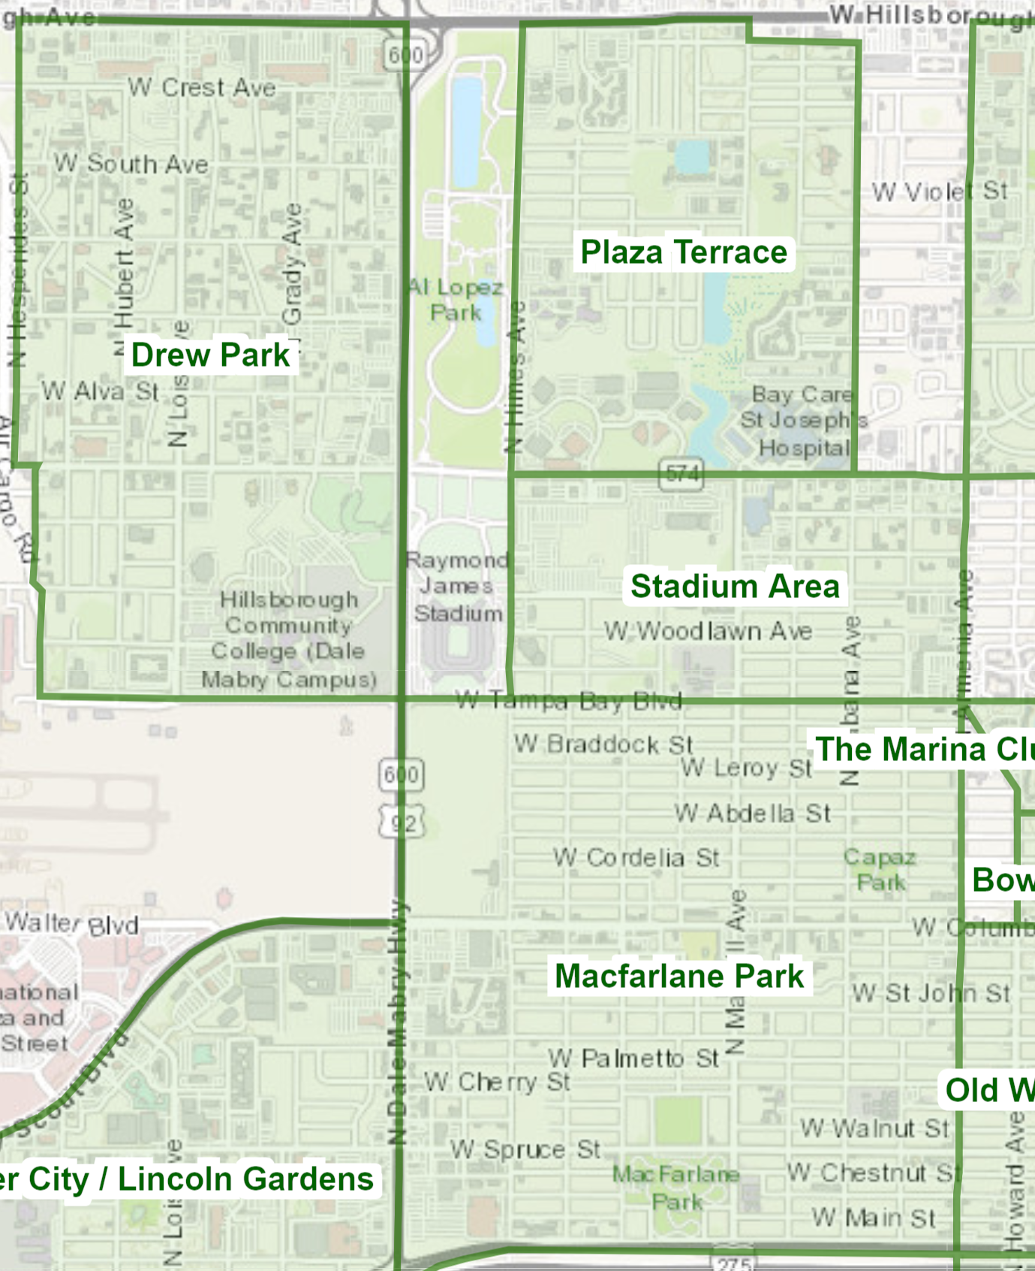
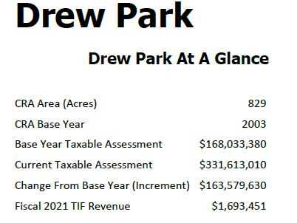
Financing Ballpark near Raymond James
Property tax TIF Feasibility
Creation of a new TIF District that encompasses new ballpark site, Stadium Area, and MacFarlane Park (see picture below)
Slightly larger area than Drew Park + Higher Taxable Assessment due to Ballpark District = Higher Expected TIF Revenue
Estimated Annual TIF Revenue = $8.5M-$14.5M*
Notes:
*Estimation based on a few factors: Drew Park TIF Revenue, Average of other Tampa Bay CRA’s TIF revenues, growth rate of property values
Estimates are significantly higher than Drew Park due to the inclusion of retail and commercial properties (and residential) in the proposed district, whereas Drew Park is primarily residential.

Slide 24
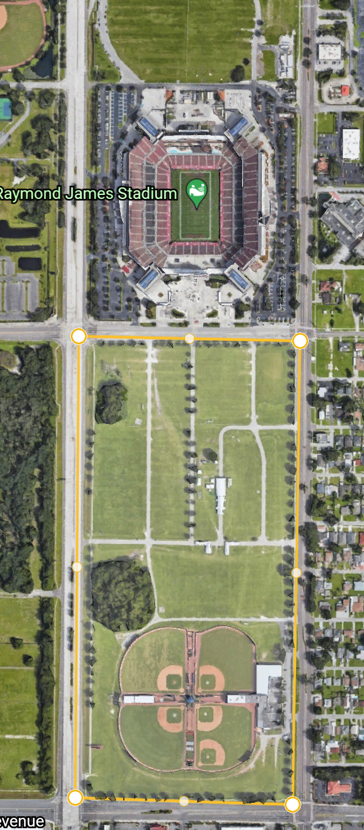
Financing Ballpark near Raymond James
Proposed TIF District and Development
70 acres
Residential
4,000 new residences (based on Water St, Development)
Condos, Townhomes, Apartment complexes, BMR housing
Commercial/Retail
Area that competes for local residents disposable income
Notes:
Critical Keys: By building this new district and including it as part of a new, proposed property TIF it will greatly affect the tax revenue generated, alleviating some of the pressure on the county to pay back a bond. The 4,000 residences are based on the Water street developments new residences (3,500). Because this district is larger in size and will have a greater focus on BMR housing, we can expect to build slightly more residences. Also, the commercial/retail should incorporate local business from Tampa Bay and St. Petersburg to entice visitors from around the MSA, bringing economic activity back into Tampa Bay and helping to reduce decentralization trends.

Slide 25
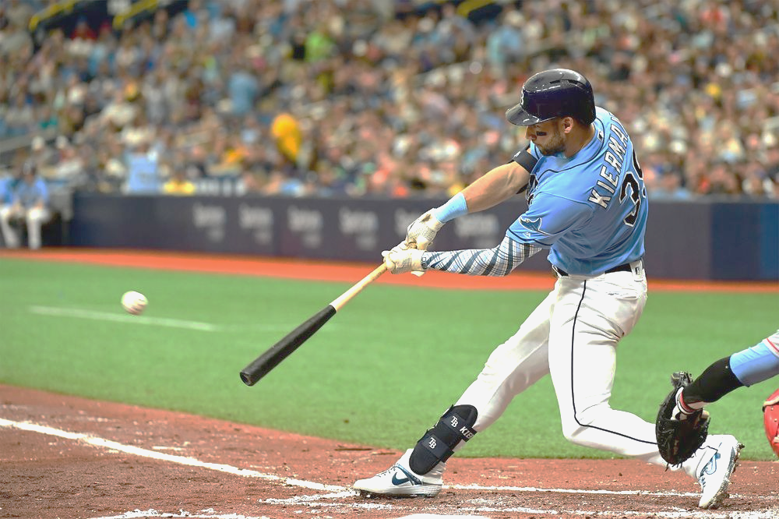
Conclusion: What is the best plan of action for Hillsborough County in regards to financing the new Rays Ballpark?
Based on the Rays desire to build in Ybor City we feel most confident with:
Hillsborough County counter offering to cover $400M of the proposed stadium
The bond repayment will consist of revenues from:
Sales TIF District OR Sales tax increase
Tourism Taxes from Pinellas/Hillsborough
Private Investment through Opportunity Zone
Notes:
Evidence Reasoning: Our expected revenue streams could possibly cover the $450M bond, however we are more confident that we will be able to pay back the $400 bond with greater certainty.
Should the financing streams implemented not be enough, the backstop to get the project done would be Hillsborough County's General Fund

Slide 26
Question#2
Thinking back to Question 1 and the formation of a public/private partnership to build a new ballpark for the Rays, what factors, theories, or principles would you offer to justify the use of taxpayers’ money to pay for half of the cost of a ballpark?
Base your response to this question to the financing plan you suggested for the repayment of the bonds sold by the public sector to pay for half of the new venue.

Slide 27
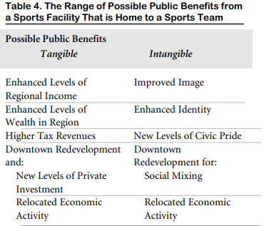
Expected Benefits of Public Financing of Sports Facilities
Though we proposed a Sales Tax TIF for our Ybor City build (Hillsborough County), the area can also expect Property Value Increases that are part of the benefit of the proximity of the new stadium.
Increases in Property Value accrue to the area property owners
The property value increase also increases the calculation basis for the two Property TIFs currently in place.
This can help the city to repay their obligations and place them in a better future financial position
Rosentraub, Mark S.International Journal of Sport Finance Vol. 1, Iss. 4, (November 2006): p. 218

Slide 28
Expected Benefits:
Property Value Increases (cont.)
Theory: Investment in stadiums by the populace can be justified by tangible future returns in the form of improved land values
2007 study by Ahlfeldt and Maennig based in Berlin, Germany, found that sports arenas have significant positive impacts on land value within a radius of about 3,000 meters (almost 2 miles)
Impact depends on how authorities handle negative externalities (complications) such as emerging traffic congestion and crowds
Authors note that structures that increase neighborhood desirability can help to justify the relatively large investments
Impact at the neighborhood scale suggests motivation for creation of sports districts
Notes:
Source: Impact of sports arenas on land values: evidence from Berlin Gabriel M. Ahlfeldt · Wolfgang Maennig
https://link.springer.com/content/pdf/10.1007/s00168-008-0249-4.pdf

Slide 29
Intangible Benefits:
Rents, Quality of Life, Local Amenity, Advertising
2015 study by Agha and Coates used Hedonic rent equations to determine the extent to which a team adds to local quality of life
Teams induce greater demand for living space in the community resulting in higher rents.
Professional sports teams viewed as a local amenity
Team becomes free advertising for city
Data on individual housing units from 138 Primary Metropolitan Statistical Areas (PMSAs) from the American Housing Survey (AHS) conducted by the Bureau of the Census
Affiliated minor league teams in mid-sized markets ranging in size from 0.4 to 1.4 million people are associated with a 6%-8% (p<.05) increase in rents.
Intangible benefits alone cannot justify the cost of new stadiums
Pittsburgh Penguins value did not exceed cost of proposed arena (Johnson, Groothuis, and Whitehead 2001)
Public good of Jacksonville Jaguars less than annual public stadium expenditure (Johnson, Mondello, and Whitehead 2007)
Notes:
Source: A compensating differential approach to valuing the social benefit of minor league baseball
Authors: Nola Agha and Dennis Coates
Date: Apr. 2015
https://go-gale-com.proxy.lib.umich.edu/ps/retrieve.do?tabID=T002&resultListType=RESULT_LIST&searchResultsType=SingleTab&hitCount=12&searchType=AdvancedSearchForm&currentPosition=4&docId=GALE%7CA411013119&docType=Article&sort=Relevance&contentSegment=ZONE-MOD1&prodId=AONE&pageNum=1&contentSet=GALE%7CA411013119&searchId=R1&userGroupName=umuser&inPS=true

Slide 30
Intangible Benefits (cont.):
Team/Stadium as a Public Good
Additional 2004 study by Carlino and Coulson used hedonic rent and wage equations to measure compensating differentials in central cities and metropolitan areas with franchises in the National Football League
Authors note that the central city results indicate that sports franchises appear to be a public good and that new stadiums appear to be a good investment for cities and their residents
Study estimates an NFL premium of between 7% and 10% within central cities
Notes:
Source: Journal of Urban Economics 56 (2004) 25–50
Compensating differentials and the social benefits
of the NFL
Gerald Carlino and N. Edward Coulson
https://www-sciencedirect-com.proxy.lib.umich.edu/science/article/pii/S009411900400035X?via%3Dihub

Slide 31
Tax Increment Districts and TIF
Tax Increment Financing (TIF) allows a municipality to fund development in a designated area by allocating a portion of the future tax revenues from the area for paying off development costs
A municipality utilizing TIF freezes the tax assessment on properties within a Tax Increment District “TID”
The municipality then creates a special fund for the development and issues bonds to pay for the cost
If the property values and property taxes rise, the municipality uses the increase to pay for the initial development
Overlying tax districts (school districts and the county) do not reap the benefits of the increased tax revenues until all the bonds for the initial “improvements” are paid off
This process can take more than 20 years.
Notes:
Mostly quoted with structural adjustments from:
Knavel, K. (2002). Wisconsin's Tax Incremental Finance Law: How Wisconsin's Cities Subsidize Sprawl. Wisconsin Environmental Law Journal, 8, 115
https://heinonline-org.proxy.lib.umich.edu/HOL/Page?handle=hein.journals/welj8&id=209&collection=journals&index=

Slide 32
Sales Taxes and Sales TIFs
A 2009 article in The Urban Lawyer found that the inclusion of non-property taxes in the tax increment is preferable to repaying development costs with property taxes alone
A sales tax is, generally speaking, imposed by law on the purchase of a good or service in a specific geographic area, such as a city, county, or state.
Two methods of using sales taxes to finance stadium debt are 1. Developing Tax Increment Districts with the purpose of introducing Sales Tax Increment Financing and 2. Temporary increases in the local sales tax.
As of 2015, 8 of 32 NFL stadiums, 10 of 30 MLB teams, 5 of 30 NBA teams and 4 of 30 NHL teams used sales tax as part of their financing for construction or renovation.
The impact of a sales tax depends on how narrowly the tax is applied (quantity and type of goods taxed).
The burden of a sales tax tends to fall more on the teams since the fan demand for sporting events tends to be elastic (people have many substitutes for sports).
Notes:
Sources:
Alternatives to Property Tax Increment Finance Programs: Sales, Income, and Nonproperty Tax Increment Financing
Lauren Ashley Smith
The Urban Lawyer
Vol. 41, No. 4 (Fall 2009), pp. 705-724 (20 pages)
Published by: American Bar Association
https://www-jstor-org.proxy.lib.umich.edu/stable/27895745?pq-origsite=summon&seq=2#metadata_info_tab_contents
Tax Schemes for Sports Venues by Dennis Coates, Craig A. Depken :: SSRN

Slide 33
Tax Increment Financing Criticisms
Prosperous, growing outer suburbs use TIF to lure jobs from center cities, inner suburbs, low income and minority populations
TIF should only be used for blighted urban areas and not used to support projects in well-established, successful commercial areas
TIF is often used to subsidize retail development--displacing sales from other locations
Tax increment projects drain property tax revenues from schools and counties while attracting new residents and firms, increasing demands for public services
Local governments sometimes confer excessive TIF-funded benefits to attract private redevelopers
Many local governments hide or neglect to gather information that would reveal whether each of their TIF projects was a net tax producer or loser, and whether actual property tax yields matched the estimated yields forecast”
Notes:
Mostly quoted with structural adjustments from:
Competing for the Next Hundred Million Americans: The Uses and Abuses of Tax Increment Financing
Lefcoe, George. The Urban Lawyer; Chicago Vol. 43, Iss. 2, (Spring 2011): 427-482
https://search-proquest-com.proxy.lib.umich.edu/docview/878742340/BBF30F4EA04F4C63PQ/1?accountid=14667

Slide 34
TIF Usage in Major League Baseball Parks
“Of 30 MLB parks, 27 are in jurisdictions that would have allowed for TIF to be used for direct stadium costs at the time of construction or substantial renovation (Minneapolis, Phoenix, and Toronto were not). However there are only three that have used direct TIF contributions to the public share of capital costs: Detroit, San Diego, and San Francisco. These ballparks respectively opened in 2000, 2004, and 2000.”
“However TIF has been a stronger presence in development efforts near or related to ballparks. Of 19 ballparks that were designated as having been intended to spur development, 12 have an ancillary TIF presence, with eight classified as “strong.” Of these 19, eight are found to have had significant original development plans, while nine have seen such plans emerge after the deal making stage.”
Notes:
Source:
Sroka, R. (2020), "Tax increment financing and major league venues", Sport, Business and Management, Vol. 10 No. 4, pp. 495-517. https://doi.org/10.1108/SBM-09-2019-0076

Slide 35
Sports District Development
Sports Districts are created to concentrate and tax revenues from sporting events and related activities .
TIFs are often established based on revenue increases in geographically defined sports districts
The districts also allow governing bodies to target infrastructure improvements and tie cost centers to the direct revenue sources used to pay for the enhancements.
Politically speaking, it is often easier to allay the fears of citizens opposed to tax hikes by letting them know that all tax increases tied to satisfaction of stadium construction debts will be borne only by individuals attending the sports district.

Slide 36
Other Financing Tools:
General Obligation Bonds
The most generic means of financing a stadium project
Serviced using general tax revenues from all sources (Income taxes, property taxes, excise taxes, lottery proceeds, and business taxes.)
Relatively rare for a borrowing government to use general obligation bonds.
Having separate stadium debt increases transparency which might reduce the interest rate
Separating the stadium debt allows for sources of funds to be negotiated (sales taxes, excise taxes, hotel occupancy taxes, car rental taxes, and ticket surcharges)
Separating stadium debt might yield a political advantage in the case of a public referendum
Notes:
Source:
Tax Schemes for Sports Venues by Dennis Coates, Craig A. Depken :: SSRN

Slide 37
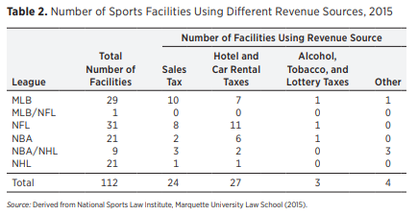
Other Financing Tools:
Tourism Taxes
Tourism Taxes are other special sales taxes used to finance stadiums:
Additions to hotel, lodging, or accommodations tax
Increased taxes on car rentals.
These taxes are exported to tourists, since they primarily consume the goods
11 NFL facilities, 5 MLB stadiums, 3 NBA arenas, and 1 NHL arena are partially funded by hotel taxes.
4 NFL stadiums, 4 MLB stadiums, 4 NBA arenas, and 1 NHL arena are funded in part with car rental taxes.
Notes:
Source:
Tax Schemes for Sports Venues by Dennis Coates, Craig A. Depken :: SSRN

Slide 38
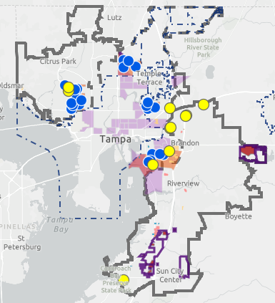
Other Financing Tools:
Opportunity Zones
Introduced in December 2017
The Opportunity Zones program incentivizes real estate and business investments in certain low-income communities by providing investors with major tax breaks, so long as certain requirements are met.
Ex: 18 out of 30 NFL stadiums are located in or adjacent to Opportunity Zones
Hillsborough County has several designated Qualified Opportunity Zones
Near the University of South Florida, Tampa International Airport, Ybor City, Palm River and Port of Tampa.
Notes:
Sources:
https://www.hillsboroughcounty.org/en/businesses/land-development/opportunity-zones
These 18 NFL stadium neighborhoods are eligible for the Opportunity Zones tax break
https://opportunitydb.com/2019/02/nfl-stadiums-eligible-for-opportunity-zones-tax-break/

Slide 39
Theory Behind Debt Service Choices
The team seeks to retain the revenue generated by events in the stadium, advertising and other revenue streams that the team generates.
Therefore, teams and leagues push for any public debt to be serviced using revenues generated outside the sphere of the team.
Retains revenue for the team
Makes the incidence of taxes (the burden of the taxes) as opaque as possible.
Notes:
Source:
Tax Schemes for Sports Venues by Dennis Coates, Craig A. Depken :: SSRN

Slide 40
Our Recommendation Revisited
To raise the negotiated $450M and the resultant $24.87M yearly debt service on the bond issuance, our team has created these choices to be considered by the municipality:
Ybor city build featuring the creation of a sports district with mixed-use development, sales tax increase or TIF, food & beverage tax, tourism development tax (Hillsborough Co., Pinellas Co.) and federal Opportunity zone utilization
Raymond James site with creation of mixed use development, property tax TIFs

