Slide 1
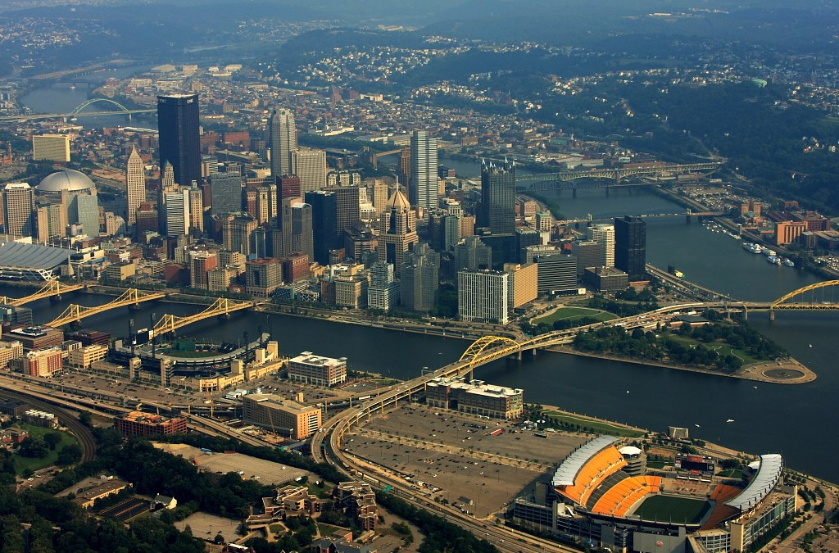
Claire Genord and Lukas Stauffer
Pittsburgh
North Shore District
Notes:
Lukas 1-3
Claire 4-10
Lukas 11-14
Claire 15
Lukas 16

Slide 2
Outdated Three Rivers Stadium
Opportunity to revitalize the North Shore
Notes:
The creation of the North Shore District lies within the state of Pittsburgh Sports in the late 1990s. Ultimately, 3 rivers stadium became an inhibitor of pride and economic growth for Pittsburgh and the city knew that it needed to go as it was exponentially diminishing in value. The citys decision to tear down 3 rivers and build 2 new anchors, provided the district with a new, fresh idea: the revitalization of the previously barren North Shore.

Slide 3
A Restoration of Pride
Notes:
The formation of this district lies within the backdrop of Pittsburgh and its pride in sports. The city of Pittsburgh has long been known for its rabid fandom in support of their Steelers, Pirates, and Pens. However, with the aging nature of 3 rivers stadium, the fans and city could no longer rely on the north shore as being a placemaker; a cathedral of their fandom. 3 rivers had become a financial drag as well carrying a total debt of around 28 million into 2001. This backdrop laid the foundation for the Pirates and Steelers to begin talks of developing their own venues. That is when the stadium authority (a public group), acting on behalf of the city jumped in and formulated the plan for the now north shore district. They aimed to restore pride in pittsburgh through this district being an economic and tourism driver. On a side note, Pittsburgh had unique steel architecture that harkened back to its founding and this district would be integral to creating synergy between the beautiful bridges in Pittsburgh the north shore district.
Three Rivers Stadium
Multi-purpose stadium that was not a placemaker or revenue generating
Pirates and Steelers started to look to build on their own in early 1990s
Carried a debt of $27.93 million into 2001. Wasn't retired until 2010 Pens gone, but Igloo $9.3 million in debt | TribLIVE.com
Takeaway - the District was created from the ideas of the 3 main players, the rationale was to drive new economic activity and restore pride to Pittsburgh sports

Slide 4
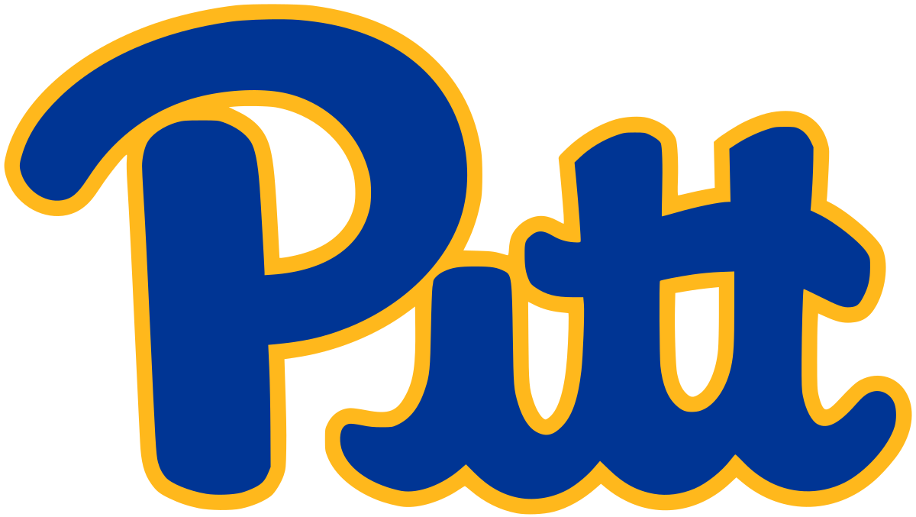
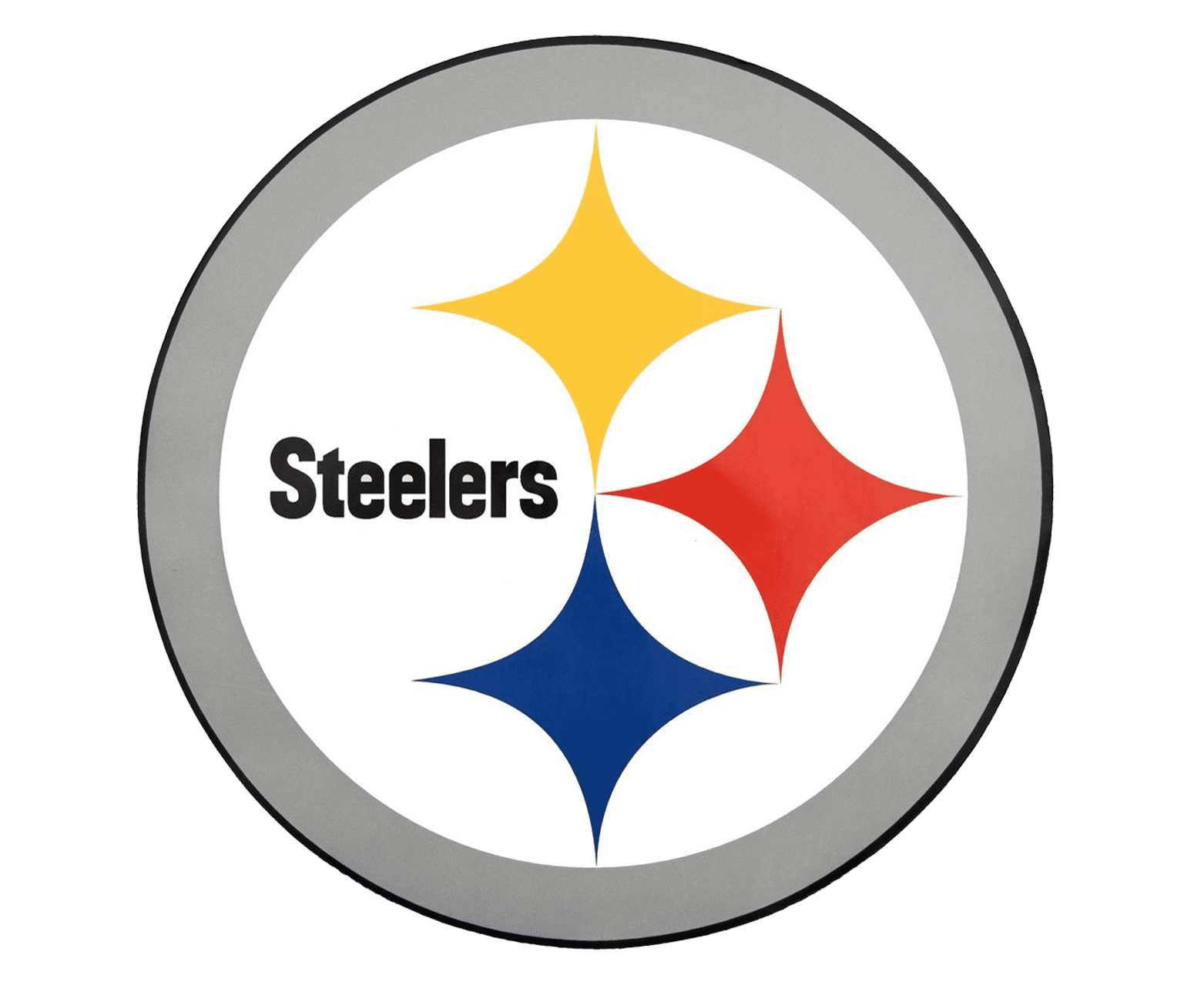
Untapped Demand for Tourism
N o r t h S h o r e
D o w n t o w n
Notes:
http://www.espn.com/nfl/attendance/_/year/2019
https://www.espn.com/mlb/attendance
Heinz Field attendance = 8 games x average attendance of 62,237 fans per game
PNC Park attendance = 81 games x average attendance of 18,412 fans per game
Average attendance at PNC Park in 2005 was 23,003 fans per game for the same number of games
This is average number of sports fans that visit the North Shore district every year for Pittsburgh Steelers and Pirates games alone, plus those who visit for retail, entertainment, dining purposes
With two large Division I institutions in the city, as well as three major professional sports teams, it goes without saying that there was, and still is, an extremely high demand for Pittsburgh natives and Pittsburgh fans across the world to come and partake in the entertainment produced by these storied sports teams.

Slide 5
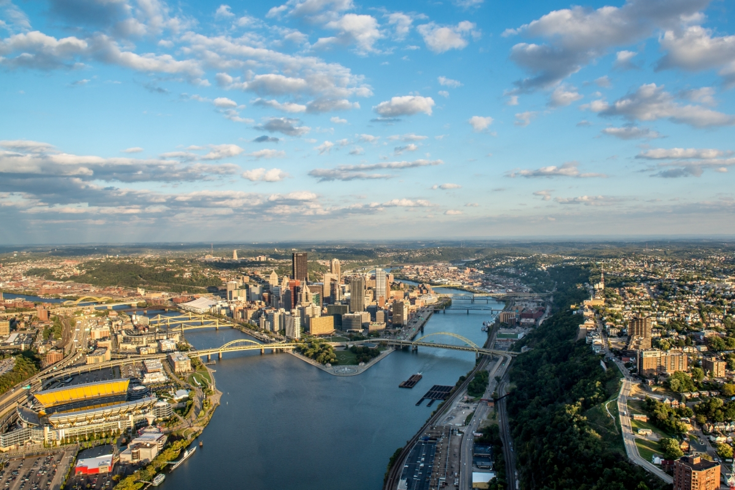
Picturesque Setting
for a New Development
Notes:
This is an aerial shot of the city of Pittsburgh, with the North Shore on the left side of the photo, where Heinz Field and PNC Park are located. In the middle of the photo is downtown, which is also referred to as the Cultural District. This is where PPG Paints, home of the Pittsburgh Penguins, and Duquesne University, are located. Finally, the South Shore is pictured to the right of the photograph. There are two rivers that converge at the point near downtown, and they become the Ohio River. As you can tell from this picture, Pittsburgh is a very beautiful and picturesque city, and the underdeveloped North Shore proved to be a very valuable area for revitalization within the city.

Slide 6
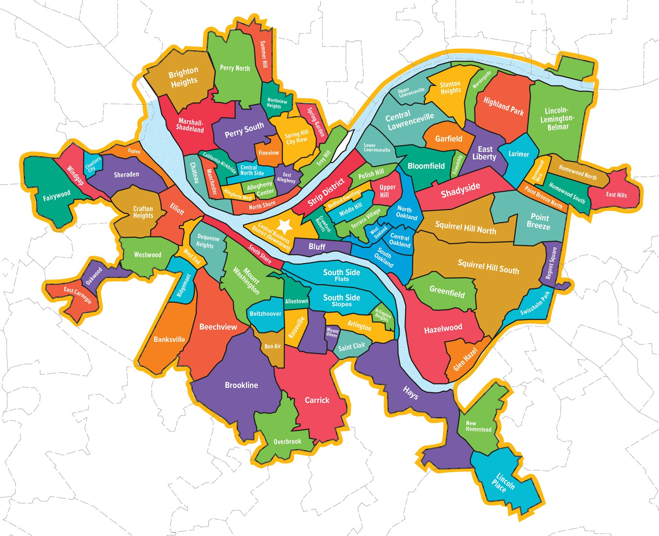
Connecting metro-Pittsburgh through the North Shore
Notes:
It is important to connect the economic development of the city through all three areas within the city of Pittsburgh, including the North and South Shores, and the downtown area. This provides a backdrop as to why the development of the North Shore district is critical to the city as a whole.

Slide 7
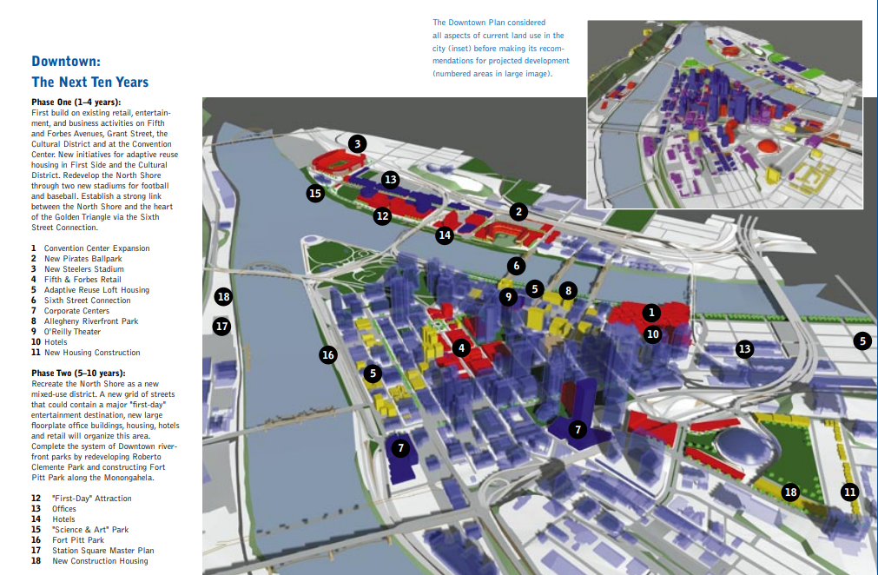
Notes:
Pittsburgh Downtown Plan of 1998
DowntownSum.pdf (briem.com)
This visual city plan outlines the overall development of the city, and most importantly for us the North Shore within two phases. It is interesting to note that the two venue anchors are in phase 1 of the city plan and the ancillary comes later in phase 2.

Slide 8
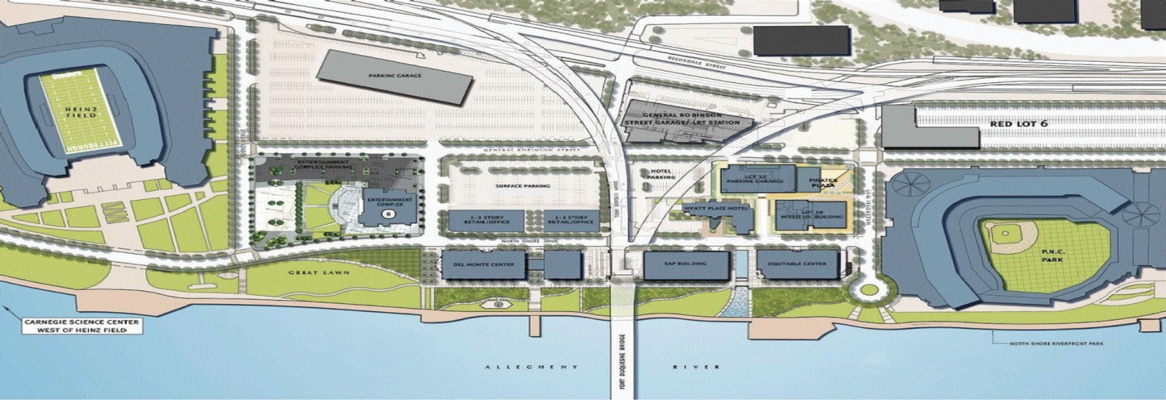
Two Anchors, & the prized Option Area
Notes:
http://www.pgh-sea.com/index.php?path=rel-ns-dev
Numbers: 917k sq. ft. of GLA (634k for office and 139k for retail)
As we previously mentioned, after the Three Rivers Stadium was demolished, Heinz Field and PNC Park were built along the North Shore.
Because these two stadiums were strategically placed along the waterfront, it naturally left a considerable land tract between the two venues, which became the Option Area, or the area for redevelopment
The Option Area includes the land between PNC Park and Heinz Field, and the plan includes a heavy focus on development of office, retail, and residential space, creating a mixed-use portfolio. Specifically, they planned for 634 thousand square feet of office space, and 139 thousand square feet of retail space.
This was really the only area of land considered for the district because it had the most acreage available for two major league venues, and other areas of the city were already pretty fully developed

Slide 9
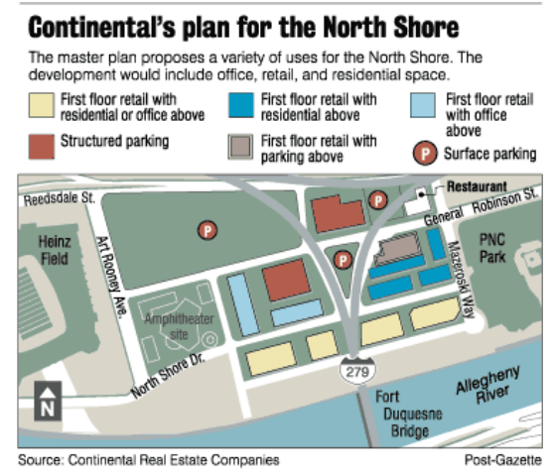
Notes:
Original plan and motivations of the city through district creation
$200 million North Shore plan unveiled (post-gazette.com)
The picture on the slide outlines Continental’s initial plans for the North Shore development in 1998. They believed that development on the North Shore would position the area as a regional sports and entertainment draw. There were a number of possible development scenarios for the area, but the common denominator among all of them was the desire to reposition the area using a high-quality, first-day visitor attraction with both regional and national appeal. There would be a combination of retail, destination restaurants, an outdoor performance space, and various recreational activities, which they thought would have broad family appeal and compliment the existing retail strengths and programming in the Triangle, Strip, and Station Square. There were also plans for residential space within the development, which never came to fruition.

Slide 10
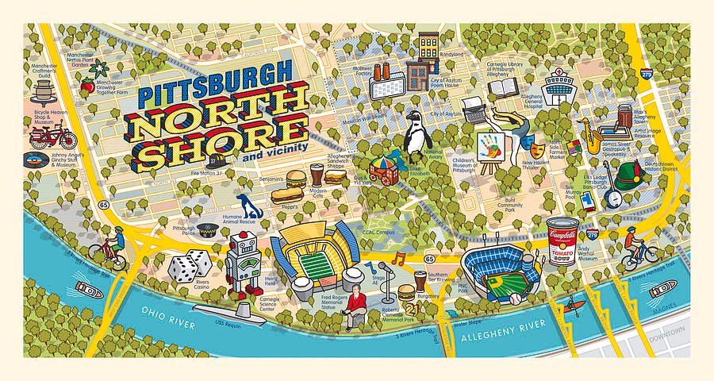
Notes:
This is an artists’ depiction of the North Shore, which shows the vibrancy of the district.

Slide 11
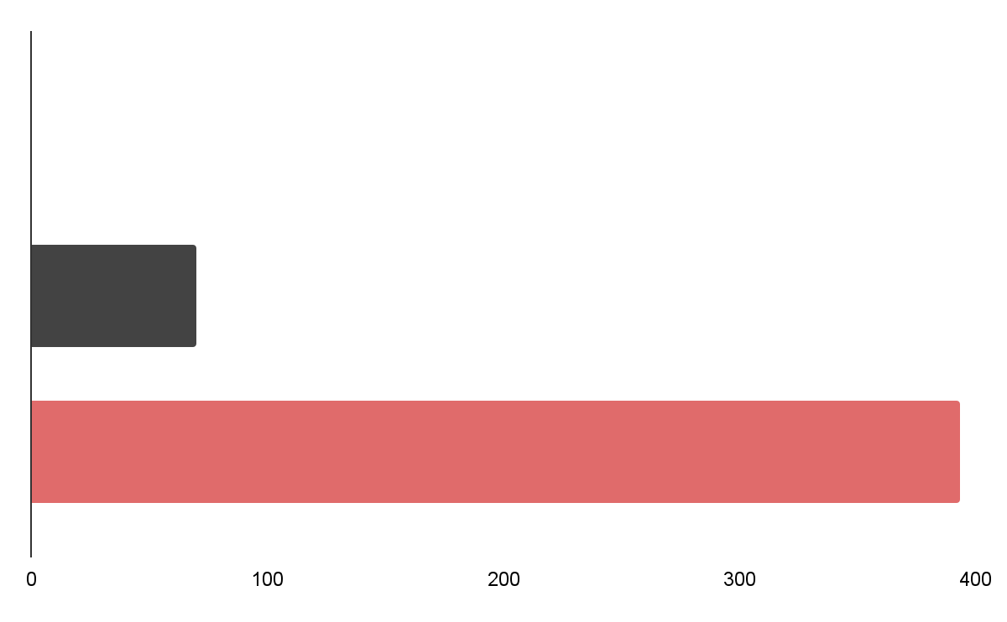
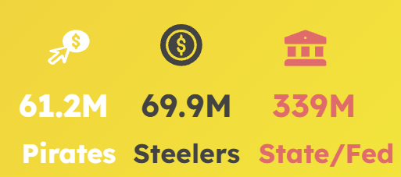
A project propelled by diverse funding...
Notes:
A unique piece of the North Shore District is its diverse financing. There are two main buckets of the district, those being the 2 stadiums and then the option area. For the option area which includes the mixed use development, that financing is much more difficult to obtain because of the private development. However, we discovered that Continental RE has spent a total of 190.5 million on the ancillary development in the district. In the other bucket, PNC park and Heinz field were a joint finance venture through the lens of the stadium authority. The Pirates contributed 61.2 M, the Steelers 69.9 mil and the state/federal gov’t 339 million. These three main sources of funding are contributed in addition to sales and hotel taxes being levied. The interesting takeaways from the financing plan are that not a single dollar of city or county funds were deployed, generating strong local support for the district. The second takeaway is that much of the additional funding was diverted to improve the North Shore infrastructure, as well as $30 million for the North Shore Riverfront Park.
Private
Pirates agreed to pay $40 mill towards ballpark-ended up $61.2 mill
Steelers agreed to pay $76.5 mill toward stadium- ended up $69.9 mill
Personal Seat License Fee - $43,868,648
Both agreed to cover cost overruns
Authority owns PNC Park, Heinz Field--leases both
Financing tools
They included a 1% increase in county sales tax beyond the 6% base sales tax, a 7% tax on hotel and motel rooms rented in Allegheny County as well as revenue generated from parking and a payroll tax on athletes that are not residents. In short, the contributions from local and state residents in addition to federal and state funding amounted to 72% of the costs associated with this plan. The North Shore Development Project Revisited | Pitt Business Review
Fund Uses
PNC Park - $273,548,391
Heinz Field - $262,893,423
North Shore Infrastructure - $63,416,617
North Shore Garage - $27,334,012
North Shore Riverfront Park - $30,307,159
Unique tidbits
No city or regional funding was used
The Stadium authority is responsible for the development of land. Entered into a joint venture with teams to sign a contract with Continental to develop a master plan. (pgh-sea.com)
Continental's development costs totaled $190.5 mill in 2019 Continental sells SAP building on the North Shore - Pittsburgh Business Times (bizjournals.com)

Slide 12
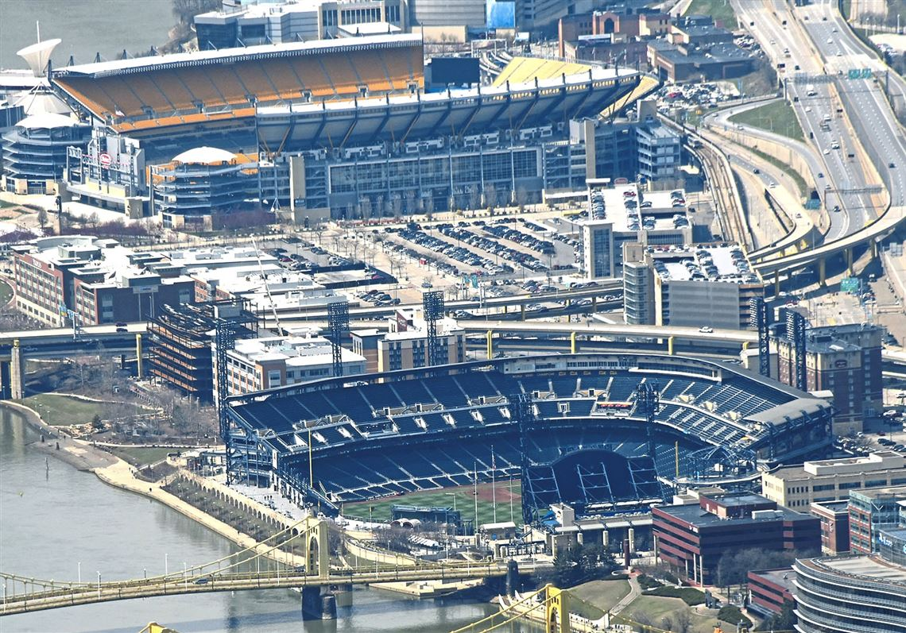
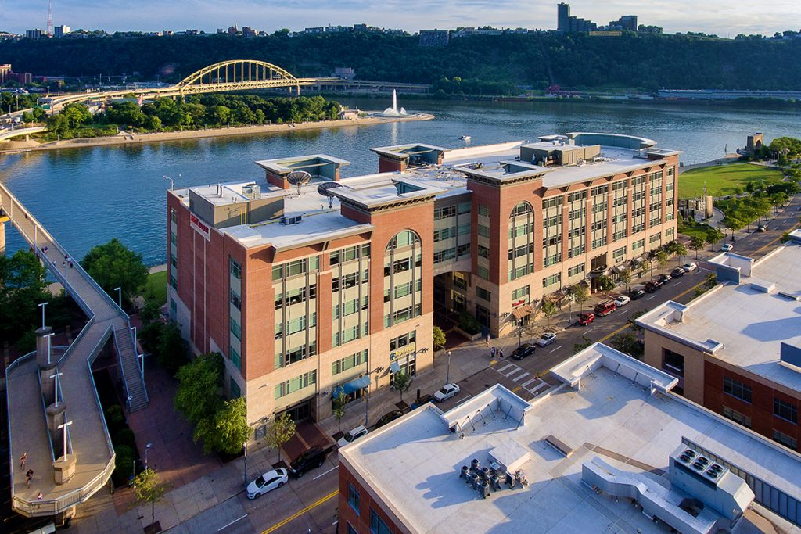
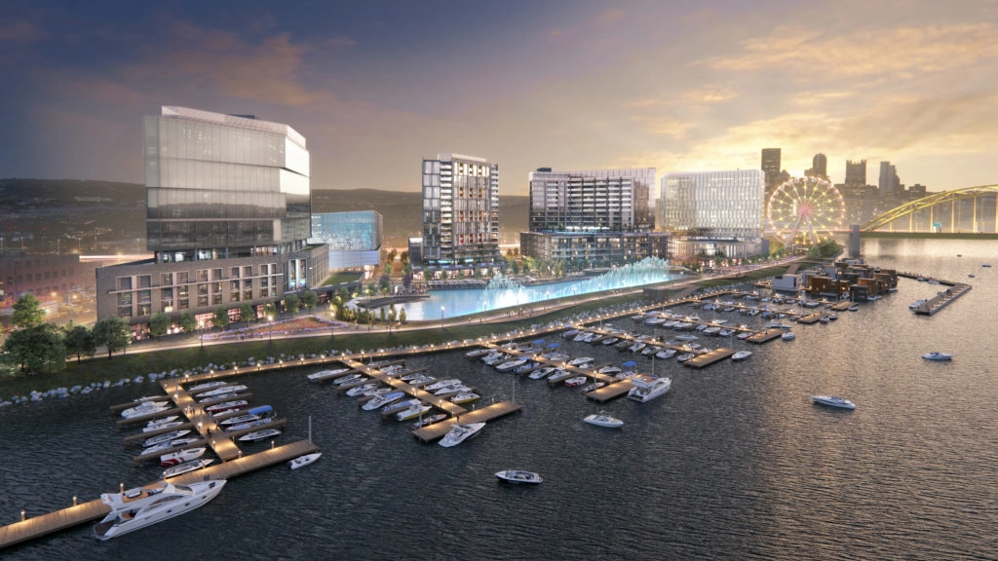
North Shore construction through the years
Phase 1: Anchors
1999-2001
Phase 2: Riverfront Development
2003-2008
Phase 3: North Shore Dr.
2008-2017
Phase 4: Parking/Esplanade
2017-Present
Notes:
Phase 1 of construction
The anchors (Heinz and PNC) were built first in 2001 after Three Rivers was torn down
Carnegie Science Center already in place
Phase 2- 2003-2008
Riverfront developments--3 parcels--2 buildings (Peoples Gas Building and Peoples Center)
Both buildings are mixed-use of commercial and retail
Phase 3- 2008-2017
North Shore Drive developments--4 parcels--5 buildings (Hyatt Place, Stage AE, North Shore Place I and II, SAP Building)
Usage: Hotel, Entertainment venue, Retail and Office for final 3 buildings
SAP was the last possible riverfront development
Phase 4-2017-present
Lot 4 Garage and spurred future development outside of district (Esplanade along Ohio River) Plan calls for towers, lagoon, Ferris wheel on North Shore of Pittsburgh - Pittsburgh Business Times (bizjournals.com)

Slide 13
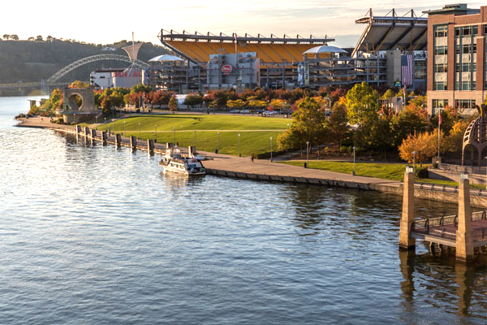
A catalyst for continued development
Notes:
With the continued construction throughout the years, we beg the question: How successful and similarly what are the major impacts of the North Shore district? To first tackle this inquiry it is important to understand how North Shore has served as a catalyst for continued development. The anchors have sparked a new buildings to be built within the option area, and enhanced the surrounding infrastructure, which includes the riverfront park shown in the picture. The revitalization efforts have also had spillover impacts in the ideation of the esplanade that was shown on the previous slid along with the inclusion of the carnegie science center and rivers casino into the surrounding north shore district area .
Modest external performance
Successes - all new buildings and development in Option area; has sparked continual North Shore developments over a 20 year period; and produced the revitalization of Riverfront park, which is a focal point of pride for Pitt natives

Slide 14
Drawing Critical Mass
Sports Mass
Steelers: 63k/game for 8 games
Pitt FB: 45k/game for 6 games
Pirates: 22k/game for 81 games
Total: 2.56 million visitors
Entertainment Mass
StageAE: 3k/event for 100 events
Total: 300k visitors
2.95 Million visitors
225 Events
Year-round capability
Festival/Community Mass
Festivals: 300/event for 30 events
Total: 90k visitors
**All calculations and totals are per calendar year
Notes:
Another key element in understanding the impact of the district is the ability of the district to draw in critical mass, thus increasing the attraction and opportunity for value creation and capture within the district. This harkens back to the City’s original planning goals of creating a “first-day visitor attraction with regional and national appeal.” By generating almost 3 million visitors per year through 225 events, the North shore is able to attract mass unlike any other attraction in pittsburgh.
Operating Performance Estimate
95 games/year
63k/game for 8 games at heinz • Pittsburgh Steelers average attendance 2020 | Statista
45k/game for 6 games at Heinz (Pitt) Pitt Football Sees 15 Percent Increase in Attendance in 2018 | Pittsburgh Sports Now
22k/game for 81 games at PNC • Pittsburgh Pirates average attendance 2009-2020 | Statista
Total Visitors for sports = 2.56 million
100 musical events + 3k/event = 300k
30 small scale festivals + 300/event = 90k
Grand Total = 2.95 million visitors/year

Slide 15
A Hub for Value Creation within the City of Pittsburgh
Public transit to and from the district, along with several parking lots
Retail and restaurant options for tourists and residents
$730 million generated in revenue by the sports teams
Notes:
https://pittsburghquarterly.com/articles/empty-and-ailing-pittsburgh-stadiums-seek-money/
The true value creation within the city of Pittsburgh, facilitated by the development of the North Shore district, is hard to capture in financial parameters. From Heinz Field and PNC Park alone, an estimate of $730 million is generated in revenue by the sports teams that play there, specifically the Pirates, Steelers, and NCAA Pitt Panthers. Other attractions along the North Shore include the Rivers Casino, the Andy Warhol museum, the National Aviary, Randyland, Bicycle Heaven, the Children’s Museum of Pittsburgh, the Carnegie Science Center, and more. The North Shore is also home to a thriving and rapidly growing restaurant scene, with several breweries and distilleries and more than 40 restaurants to choose from. Although the district is anchored by two incredible sports venues, the developments have restored life within a very historic and prized neighborhood in the city of Pittsburgh.

Slide 16
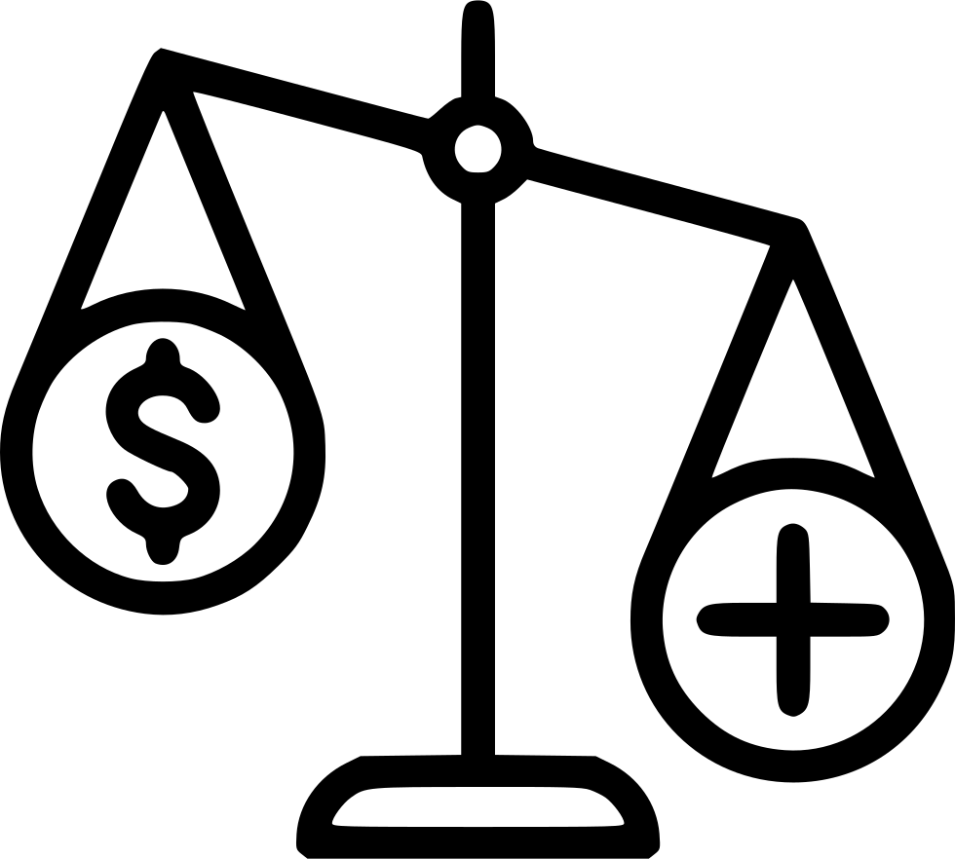
Key Takeaways
Residential Non-Existent
Shift in Land-Use → Revitalization
A city success story
Notes:
There is no residential aspect to the district unlike the original plans showed
They revitalized the land use by using city planning tactics to turn a barren tract of land into the current district
The North shore is considered a city success more than anything because of its spurred infrastructure improvements and synergy with the local community as opposed to the typical view of success being in term of tax revenues and development investments
Other interesting notes
Relatively small district land area given 2 anchors(25 acres) $200 million North Shore plan unveiled (post-gazette.com)
The district itself is not entertaining from my experience

Slide 17
Thanks!
Questions?
**All references are listed in the slide notes
Notes:
This concludes our analysis of the district and our presentation, and we welcome any questions you may have.

