Slide 1
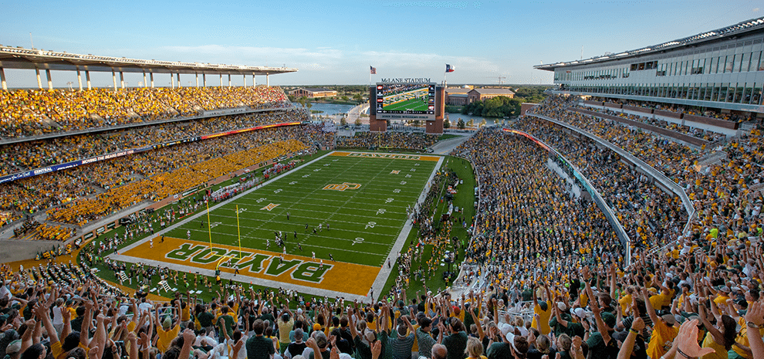
McLane Stadium Analysis
Lukas Stauffer
Lucas Reimink

Slide 2
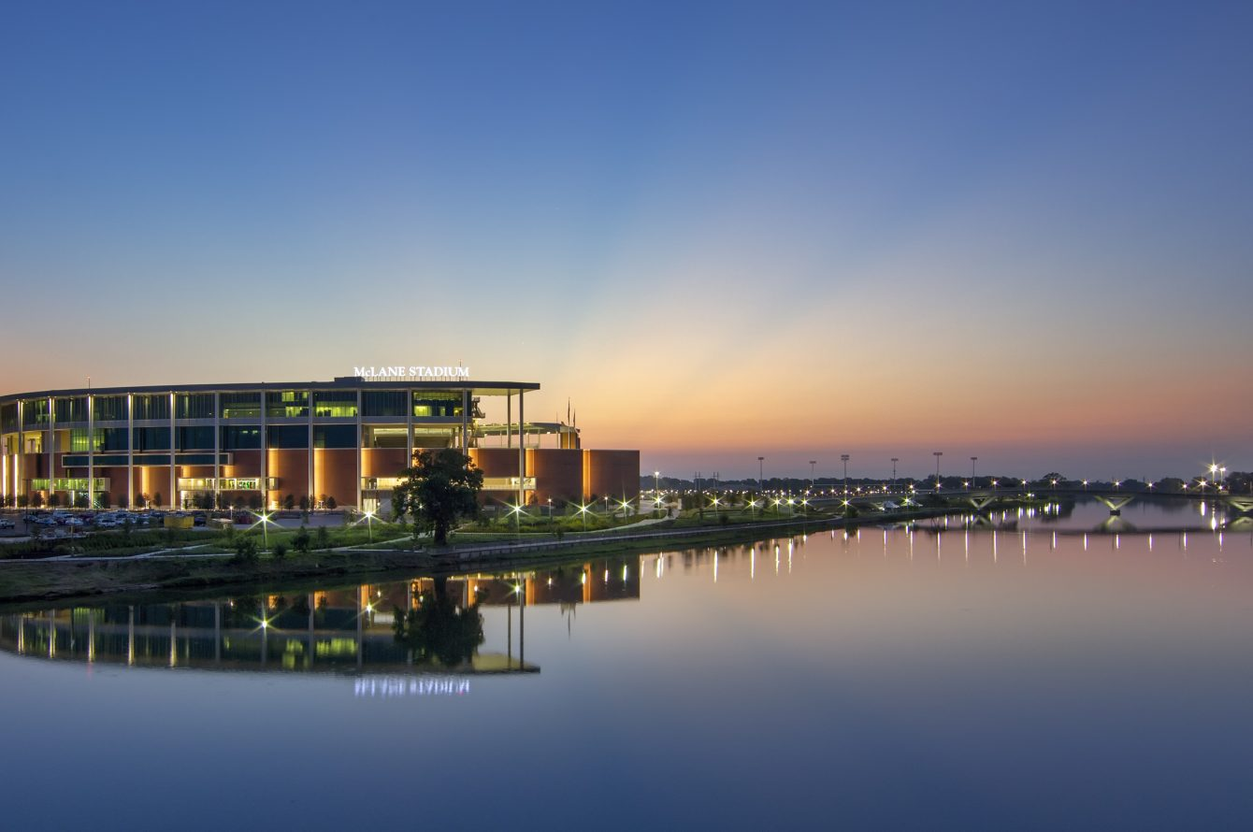
The Brainchild of Dayton McLane
+
Revitalization of Brazos River District
Notes:
The idea for the stadium was spearheaded by the donor Dayton McLane (Smith, 2014) (Baylor University Athletics, 2012)
Another key feature is how this stadium is serving as a future anchor for revitilizing the river district

Slide 3
1845- Private, Baptist University
Enrollment= 16k
Rising Athletic Department: “Year of the Bear”
Notes:
2011 was Baylor greatest athletic year, FB gained notoriety, Heisman

Slide 4
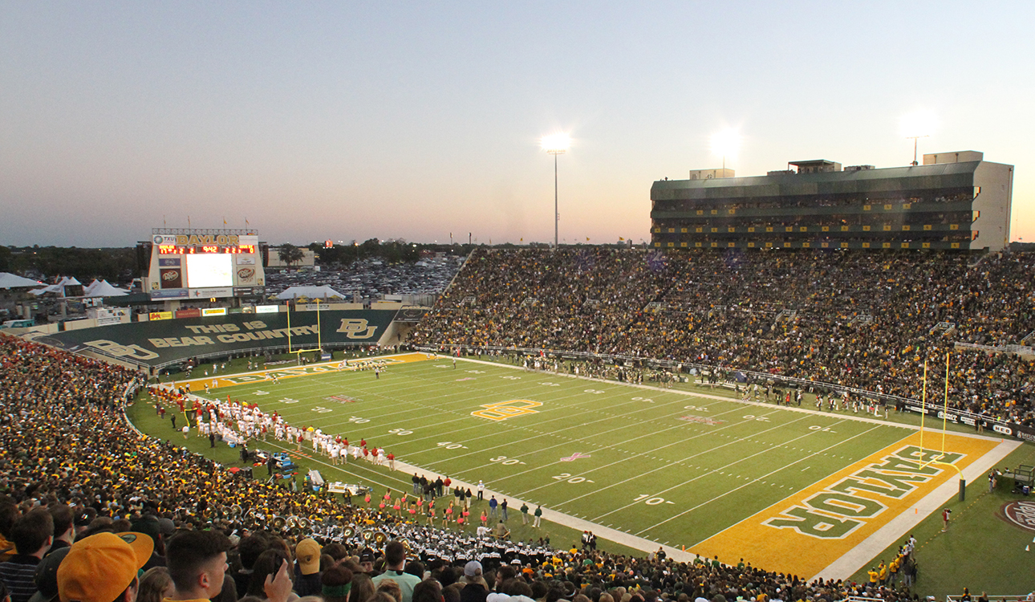
Diminishing Value-
Floyd Casey Stadium
Notes:
Floyd Casey was structurally becoming unstable, the technology needed to be updated, and Baylor was trying to compete wthrough facilities in the rise of their team to national prominence
It was also Located about 4 miles away from campus .
All of these led to the need for a new stadium to be an anchor for Baylor

Slide 5
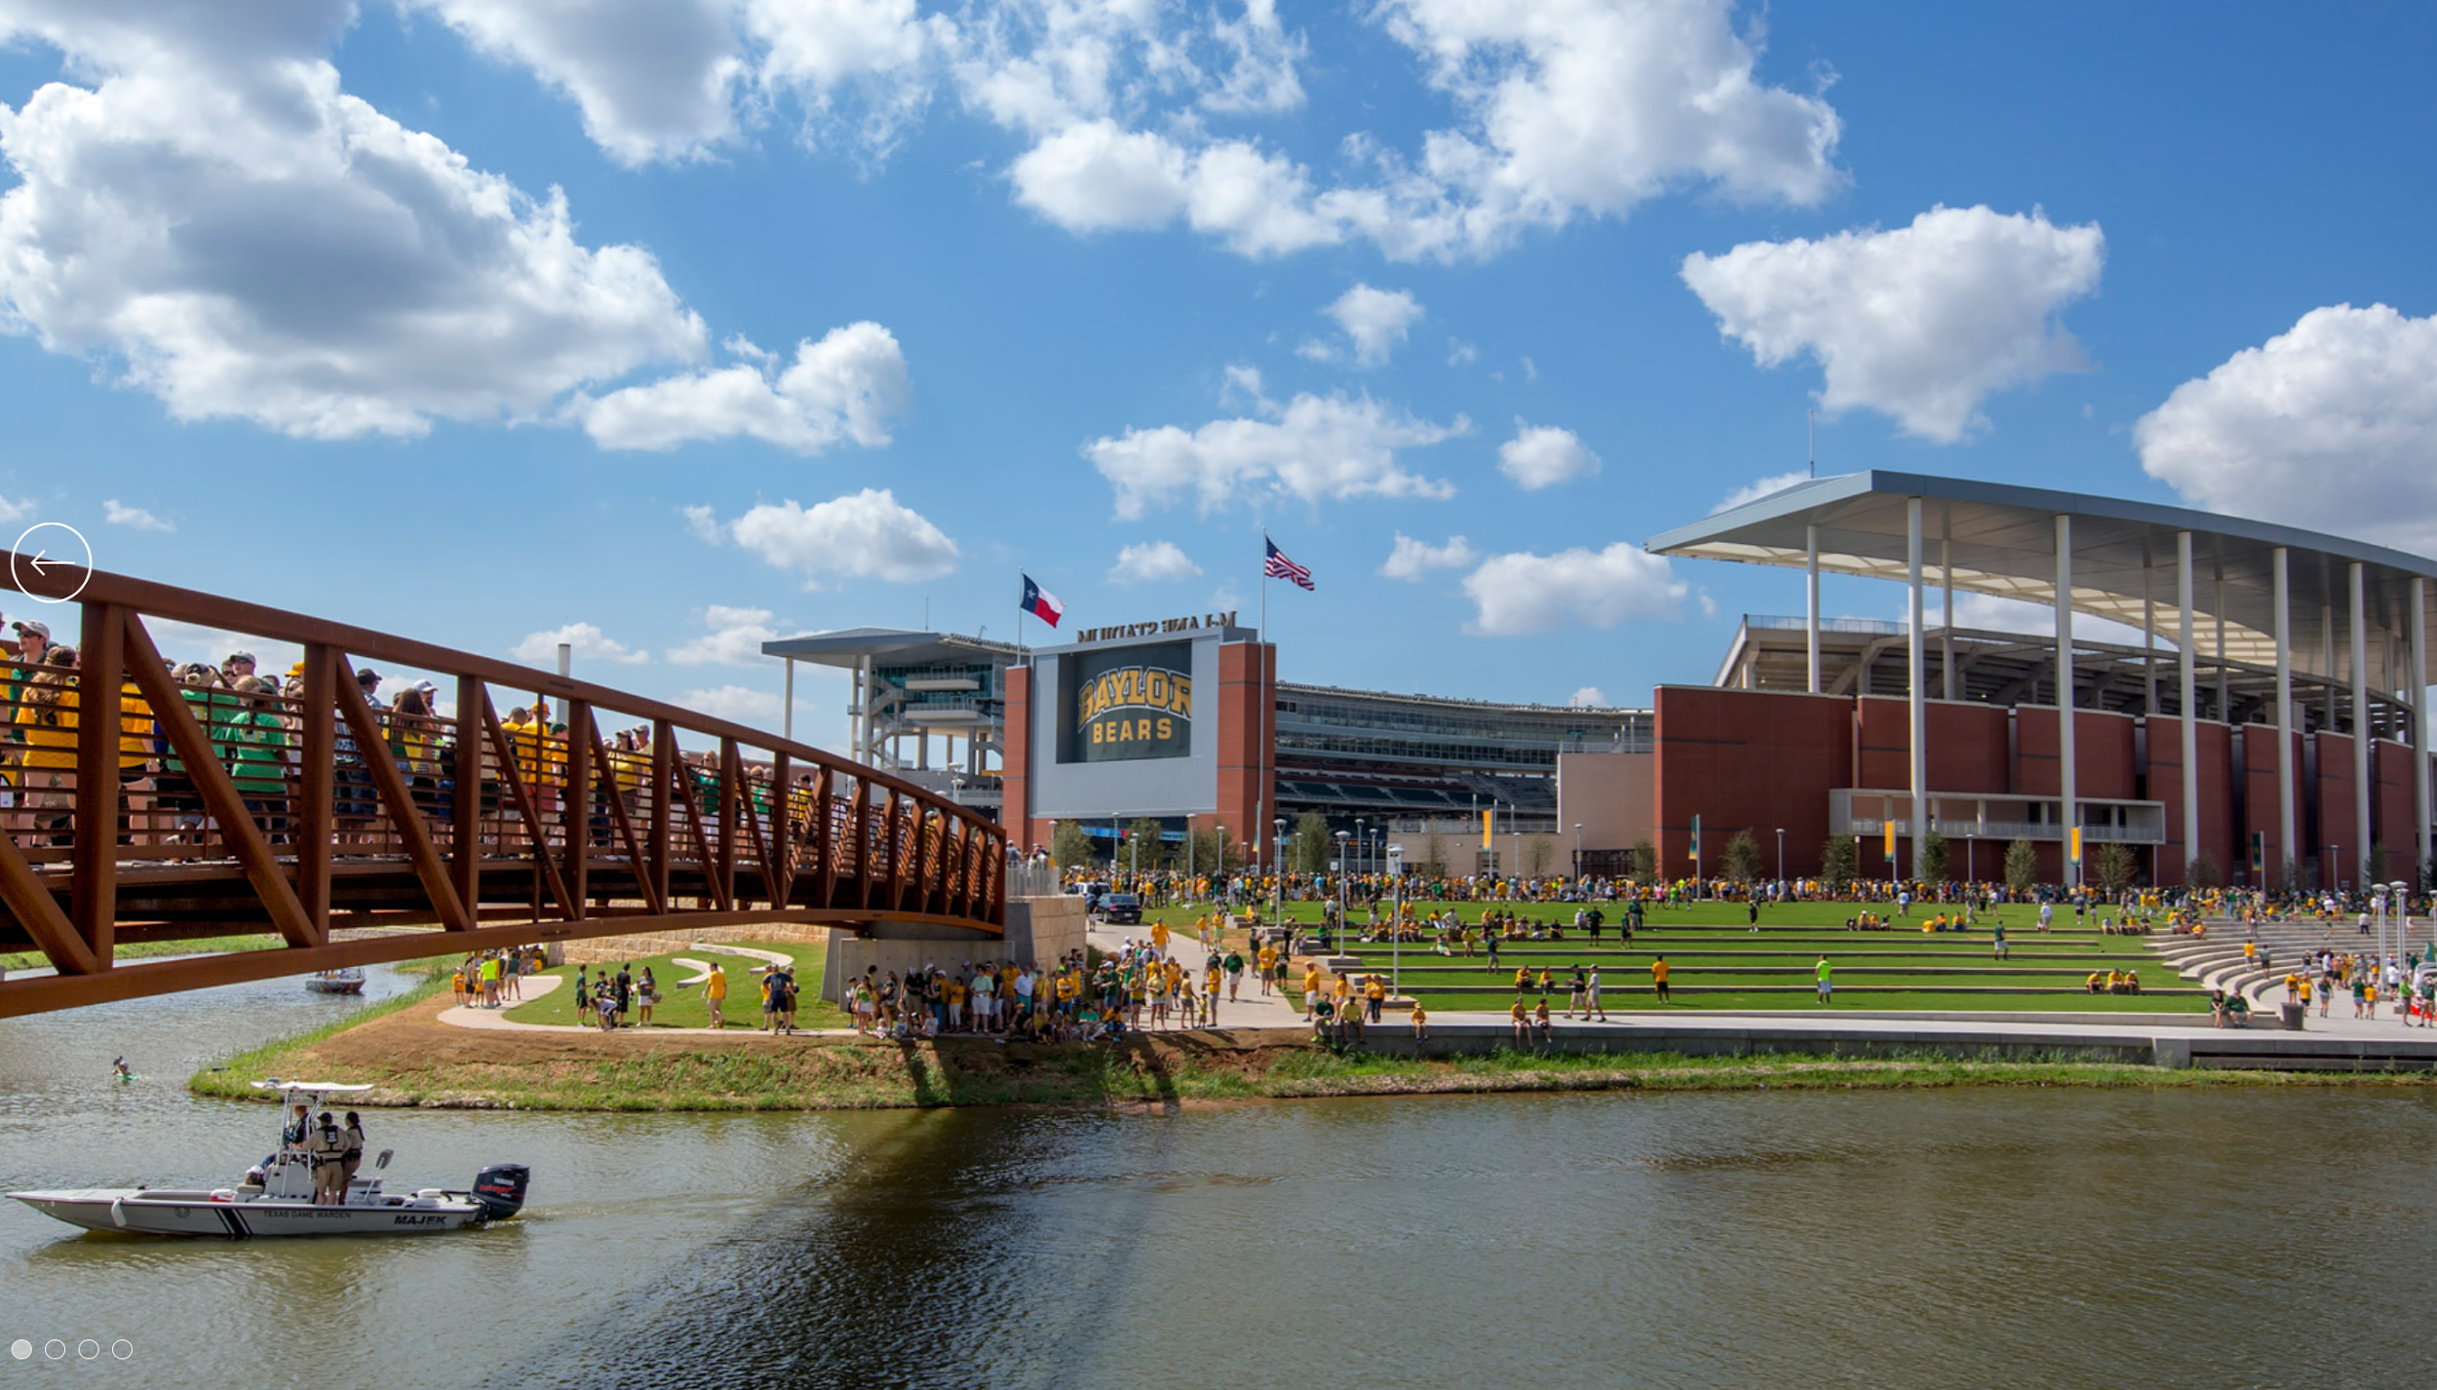
Untapped demand for campus proximity
-Walking distance to campus
-Parking and Tailgating space
-Growth of greater Waco area
Notes:
Looking at the market and baylors needs, they had a great demand for easier access from campus and downtown
-parking and tailgating was integral
-Waco market is growing due to some key figures ie. McLane Family and Chip and Joanna Gaines
-22.4 % population increase in Waco area (Rule, 2017)

Slide 6
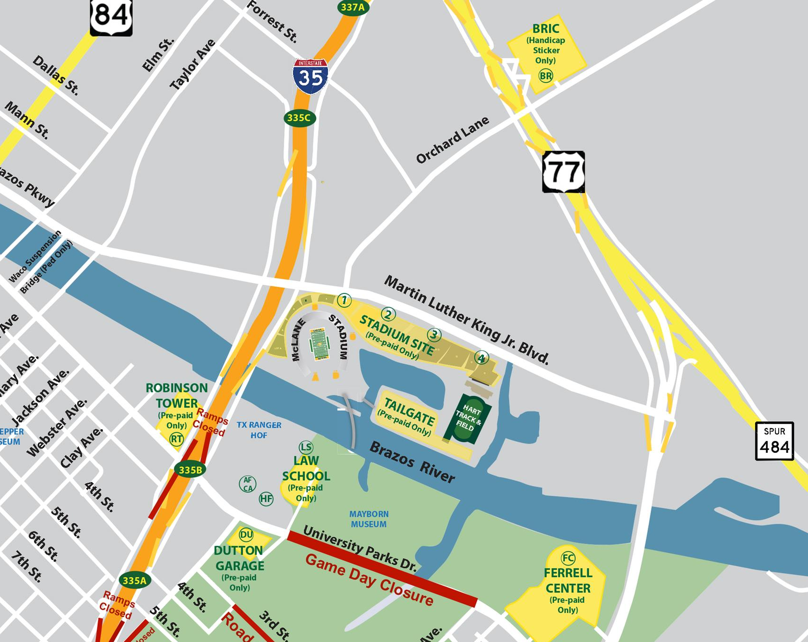
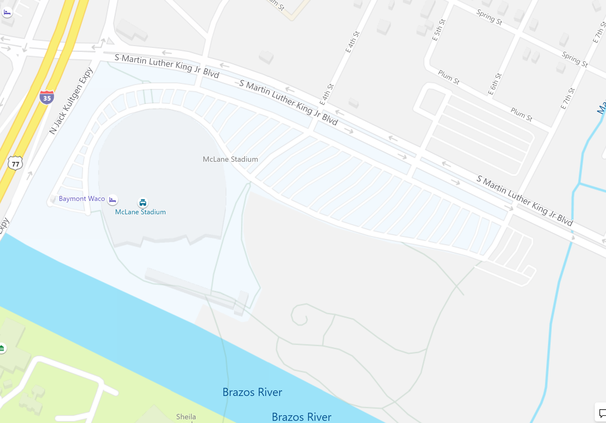
Undeveloped space for massive project
Notes:
Baylor owns 93 acres at the site of the planned stadium, on the north bank of the Brazos River across from Baylor Law School.
-The university has owned most of that land since it made a bid for the George W. Bush presidential library. (Culp, 2012)
- “The only piece of land Baylor needed but lacked was a parcel on South Martin Luther King Jr. Boulevard, which most recently was occupied by Hotel Waco. The school bought the property in the fall of 2011 and demolished the hotel earlier this year.” (Culp, 2012)

Slide 7
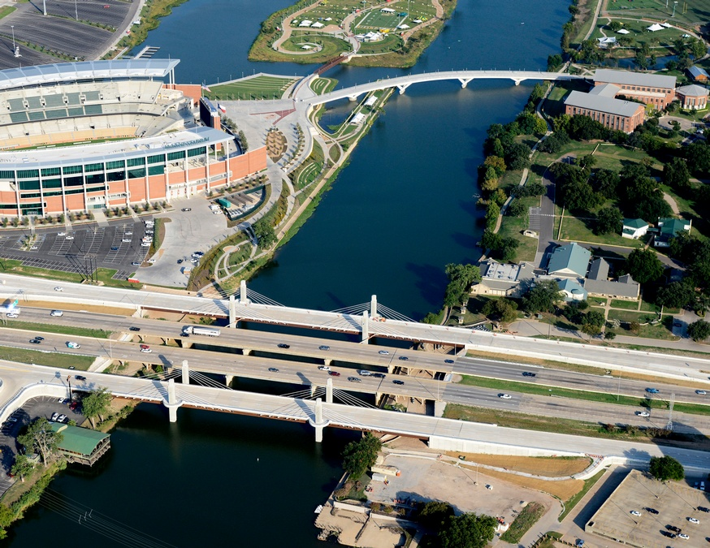
Notes:
Two great points of access from the chosen site
-Land is located at the intersection of the brazos river and interstate 35 (J.B. Smith, 2014)
-walking Bridge leads directly from campus across river to stadium
-Great access to transportation and public access located only a 15 min walk away from downtown waco

Slide 8
New value greatly exceeds expenses
No extra capital land costs
Feasible and Profitable Project
Huge value creation
Majority Private + Minority Public Funding allowed project to be feasible
Notes:
Looking at the feasibility:
This venue had a great outlook because of the value creation and the private funding
Pass off to lucas who will be delving into the timeline, the financing and design aspects

Slide 9
Project Timeline
2011
2012
2012
2014
Proposed Idea to Baylor
Regents approve
Broke Ground on September 15th, 2012
Stadium Completed in time for first game of 2014 season
Notes:
Idea was started in 2011, but did not get approved by regents until 2012 (Smith, 2014)
Completed slightly ahead of schedule on-time for the start of the 2014 season
Shows how fast the timeline moved along

Slide 10
Large capital gift propels project
Baylor already owned the land
$266 Million total
$35 Million from city of Waco (Smith, 2014)
Baylor did not specify the amount of the donation by McLane and his family, but did confirm it was "the largest capital gift in university history." (Baylor University Athletics, 2012)
Notes:
Financing
Baylor already owned the land
$266 Million total
$35 Million from city of Waco (Smith, 2014)
Baylor did not specify the amount of the donation by McLane and his family, but did confirm it was "the largest capital gift in university history." (Baylor University Athletics, 2012)
Previous record donation was $20 Million

Slide 11
Venue Program
Capacity: 45,140
A $20 million shade canopy atop the upper deck shades up to 55% of the seats during the day
Located in the endzone is the 47 foot wide by 107 foot tall HD video/scoreboard
Lagoon to promote Sailgating
Outdoor amphitheater and walking path
Notes:
Stadium Details
Capacity: 45,140
A $20 million shade canopy atop the upper deck shades up to 55% of the seats during the day.
Located in the endzone is the 47 foot wide by 107 foot tall HD video/scoreboard.
Lagoon around stadium to promote ‘sailgating’
Outdoor amphitheater and walking path invite visitors to enjoy the setting year round

Slide 12
A design built for the future
Highway access to nearby major highway I-35
Aesthetic, futuristic design
East-West Orientation
Notes:
Design
Aesthetic, futuristic design
East-West Orientation

Slide 13
Notes:
Open side of field
Can see huge scoreboard
“Sailgater” and tents set up

Slide 14
Notes:
Aerial View
Lagoon
Amphitheater

Slide 15
How McLane functions
Baylor has a wonderful fan base that’s made it largely successful
Average attendance in 2017 was 43,830 (Davis, 2018)
“In 2017, we hosted a total of 798 private events in the Baylor Club,” said Mike Mosel, general manager. (Copeland, 2018)
Notes:
Functionality
Baylor has a wonderful fan base that’s made it largely successful
McLane Stadium has certainly helped as the average attendance in 2017 was 43,830 despite the team’s 1-11 record (Davis, 2018)
“In 2017, we hosted a total of 798 private events in the Baylor Club,” said Mike Mosel, general manager. (Copeland, 2018)

Slide 16
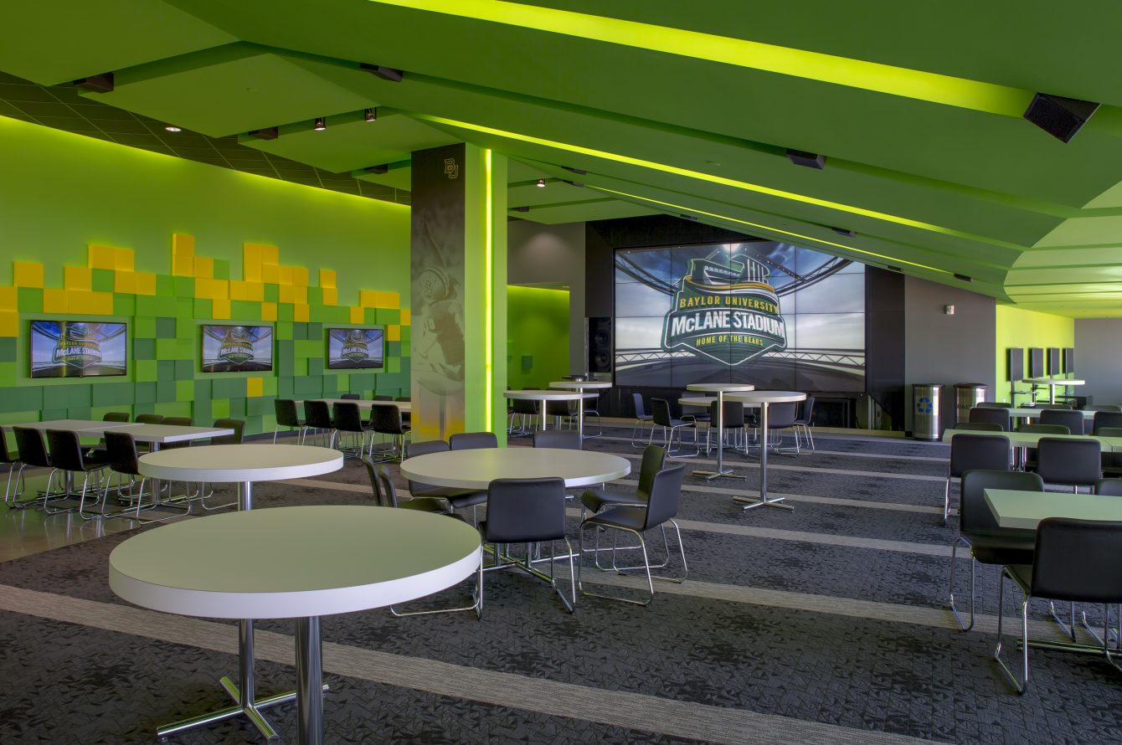
Multi-use event space + Brazos revitalization
-Baylor Club event space
-Premium Seating expansion
-Sailgating
-Surrounding Development
Notes:
Baylor club allows for non-football related event revenue, year-round
39 suites, 74 loge boxes, 1,200 outdoor club seats allows for creation of different revenue streams than Floyd Casey which did not have these amenities
Sailgating for 18 boats creates values in that they sell boating slips for $3,000 a season (“Home - McLane Stadium,” 2015)
Major implications and we see a huge opportunity...Allowed for development of the surrounding area to extend campus
While the university does not directly capture this value, the city of Waco does because it raised the value of land surrounding the area of the river, the city has current plans to revitalize the Brazos river district into an entertainment district like in San Antonio

Slide 17
Conclusion
+
Questions
McLane Stadium has begun to revitalize the downtown Brazos district and serves as a powerful asset to Baylor University and its athletic missions.

