Slide 1
Question 1:
How did the districts change (growth compared to growth rates in the city or county) and how did the entire downtown areas in each city grow (in residents and jobs) compared to the overall growth in the city, county, or MSA?

Slide 2
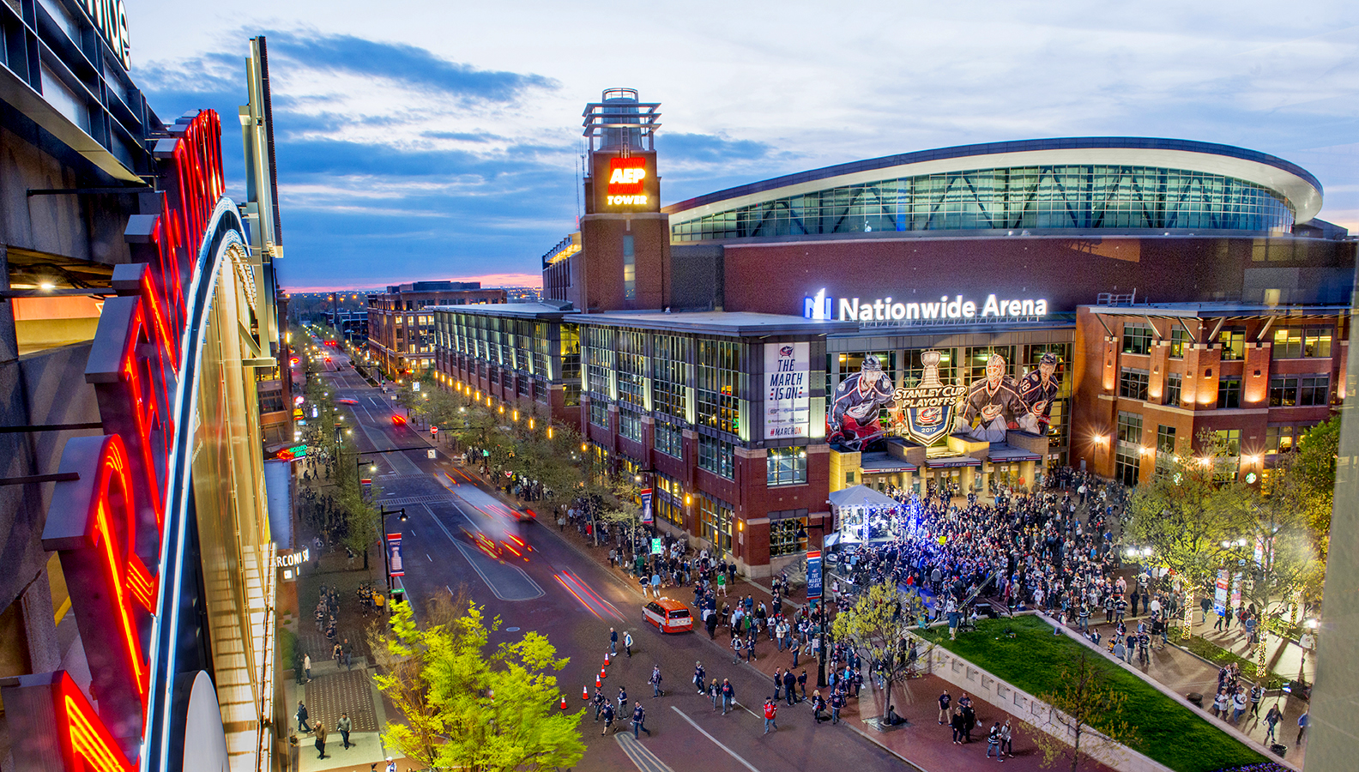
Case 1: Nationwide Arena District-Columbus, OH
Notes:
The purpose of the arena district in Columbus was really to
Re-centralize regional economic activity into their downtown
They measured their success of building the arena and surrounding urban housing, cultural amenities, and retail space by:
Looking towards the growth of population and housing in comparison to Franklin County
Looking towards the growth of primary jobs in the area as compared to Franklin County

Slide 3
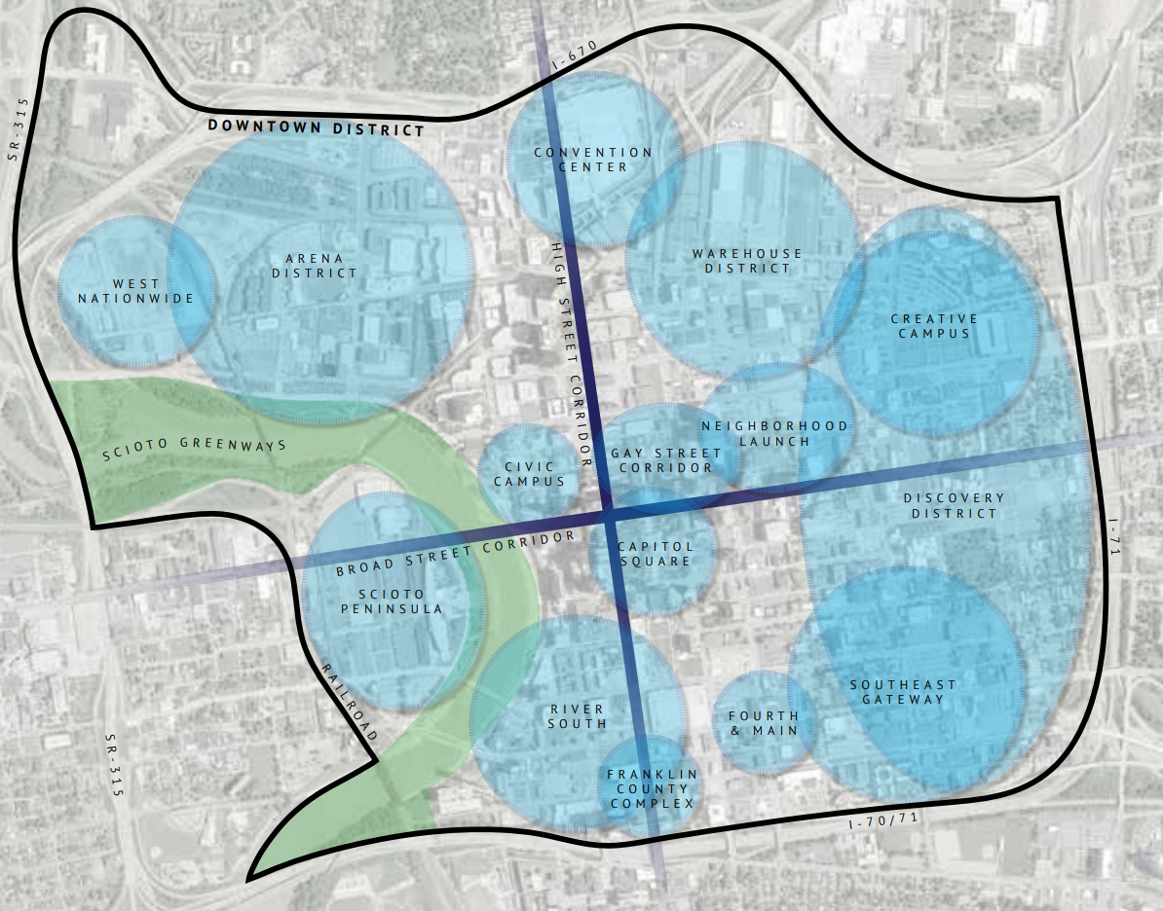
Notes:
Here you can find the location of the Arena District within Downtown Columbus

Slide 4
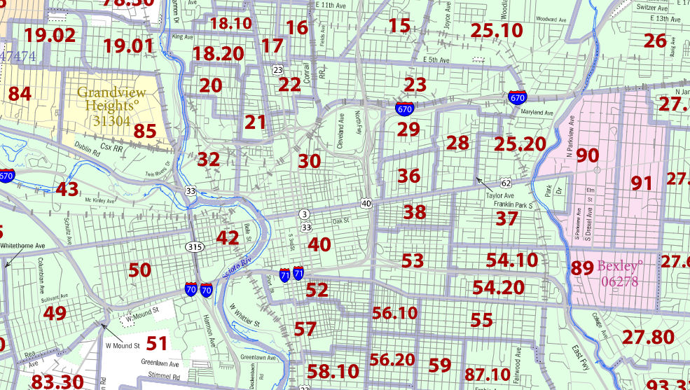
Notes:
Here is the census block map which shows that the arena district is census tract “30”

Slide 5
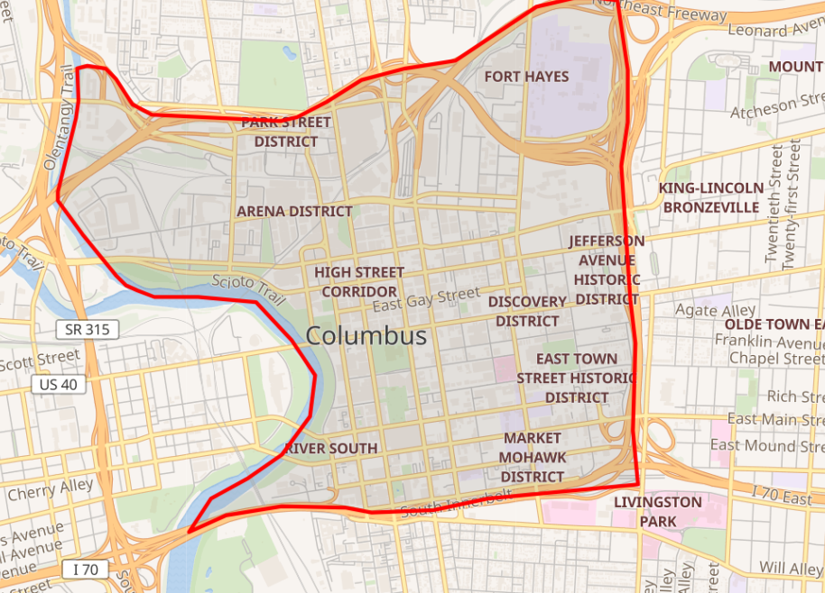
Notes:
This map clearly shows the downtown area that I used for gathering downtown data in order to calculate the growth rates

Slide 6
History/Timeline of the District
1998- broke ground on the district
2000- the Blue Jackets first competed at Nationwide
Notes:
For the purposes of the data, I pulled the population data from Social Explorer Census data and chose to use the years of 2000 and 2010 (2020 not available yet). This accurately reflects the time at which the arena district was being built and finished and still captures the important growth that occurred after completion in 2000.
The Arena District - A Billion-Dollar Belt | Arena District

Slide 7
Primary Concern 1:
Did the growth of the Arena District outpace the growth of the Franklin County, OH?

Slide 8
Total Population and Growth (ACS, 2000, 2010)
Arena District
Franklin County, OH
2000: 2,179
2010: 3,105 (+926)
Total Growth Rate: 42.5%, AAGR: 4.25%
2000: 1,068,978
2010: 1,163,414 (+94,436)
Total Growth Rate: 8.83%, AAGR: 0.88%
4.25%
0.88%
The Arena district grew 5x greater than Franklin County
Notes:
Critical Keys: The arena district succeeded in population growth (4.25% AAGR) by outpacing the growth of Franklin county (.88%) by almost 5x as much.
Importance: Population growth is key to re-centralizing economic activity into the arena district rather than other areas of Franklin County because they have succeeded in making it a place to live, work, and spend money.

Slide 9
Total Housing Units and Growth (ACS, 2000, 2010)
Arena District
Franklin County, OH
2000: 1,003
2010: 1,911 (+684)
Total Growth Rate: 55.75%, AAGR: 5.57%
2000: 471, 016
2010: 527,186 (+56,170)
Total Growth Rate: 11.93%, AAGR: 1.19%
5.57%
1.19%
The Arena district grew 4.5x greater than Franklin County
Notes:
Critical Keys: Once again, the arena district succeeded in housing unit growth (5.57% AAGR) by outpacing the growth of Franklin county (1.19%) by almost 4.5x as much. It is important to note that housing units is closely tied to population growth.
Importance: Housing Units is a variable that measures the success through the growth of residential infrastructure within the district.

Slide 10
Primary Concern 2:
Did downtown Columbus, OH outpace the residents and job growth of Franklin County, OH?

Slide 11
Total Population and Growth (ACS, 2000, 2010)
Downtown Columbus
Franklin County, OH
2000: 28,436
2010: 26,398 (-2,029)
Total Decline Rate: -7.14%, AADR: -0.71%
2000: 1,068,978
2010: 1,163,414 (+94,436)
Total Growth Rate: 8.83%, AAGR: 0.88%
-0.71%
0.88%
Downtown Columbus did not reduce de-centralization trends
Notes:
Critical Keys: Downtown Columbus declined in population growth (-.71% AAGR) as opposed to the growth of Franklin county (.88%).
Importance: This is a critical point because it shows that while the arena district itself grew at a greater rate than Franklin county, the entire downtown area did not. This shows that outside of the arena district, Columbus is dealing with de-centralization from the downtown area into the suburbs of Columbus.

Slide 12
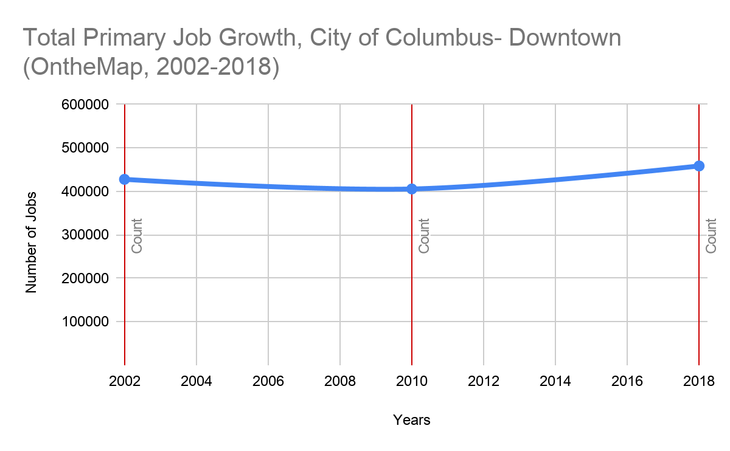
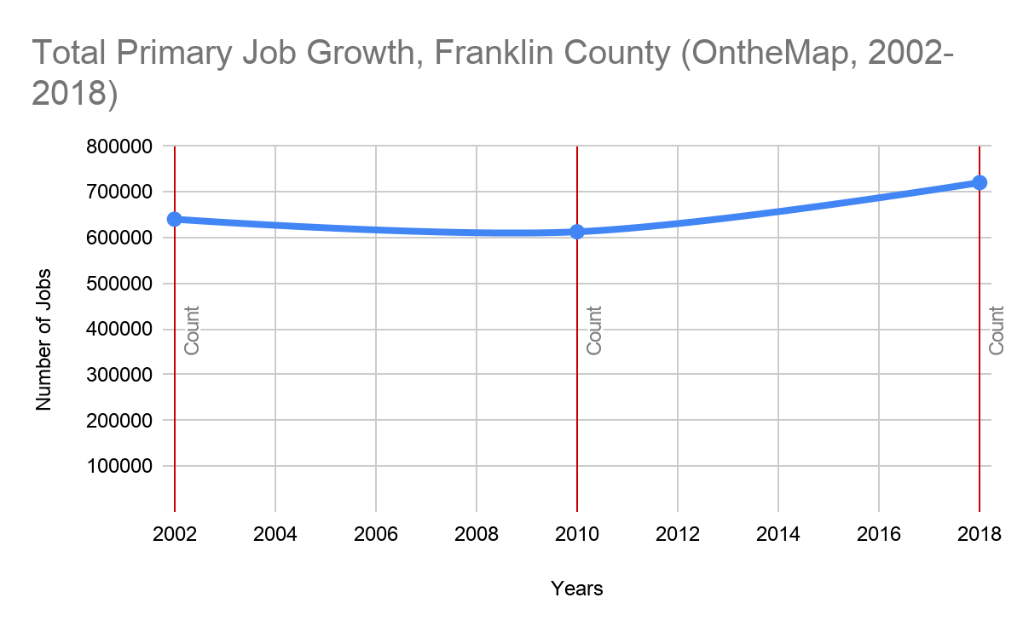
Total Primary Jobs/Growth (OnTheMap, 2002-2018)
Downtown Columbus
Franklin County, OH
2000: 427,773
2018: 458,560 (+30,787)
Total Growth Rate: 7.20%, AAGR: 0.45%
2000: 840,424
2018: 987,192 (+146,768)
Total Growth Rate: 17.46%, AAGR: 1.09%
0.45%
1.09%
Notes:
Critical Keys: Downtown Columbus had minor primary job growth (.45% AAGR), which lacked behind the growth of the entire county which grew almost 2 times greater (1.09% AAGR).
Importance: This once again shows that in terms of jobs, there seems to be a decentralization trend occurring in Columbus and the greater Columbus MSA. Because of this data, that places all the more importance on the arena district to re-centralize activity back into downtown Columbus.

Slide 13
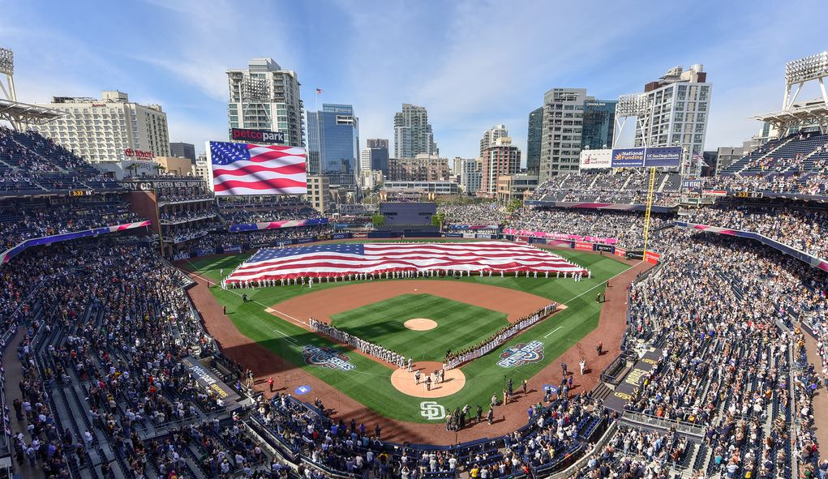
Case 2: San Diego Ballpark District-San Diego, CA
Notes:
The purpose of the arena district in Columbus was really to
Retard the trend of sprawling by centralizing population into residential areas
They measured their success of building the ballpark and surrounding urban housing and cultural amenities by:
Looking towards the growth of population in comparison to San Diego County
Examining job growth in downtown San Diego (which includes the district surrounding the ballpark district) as compared to San Diego County

Slide 14
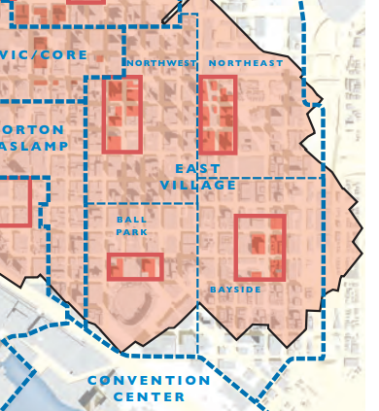
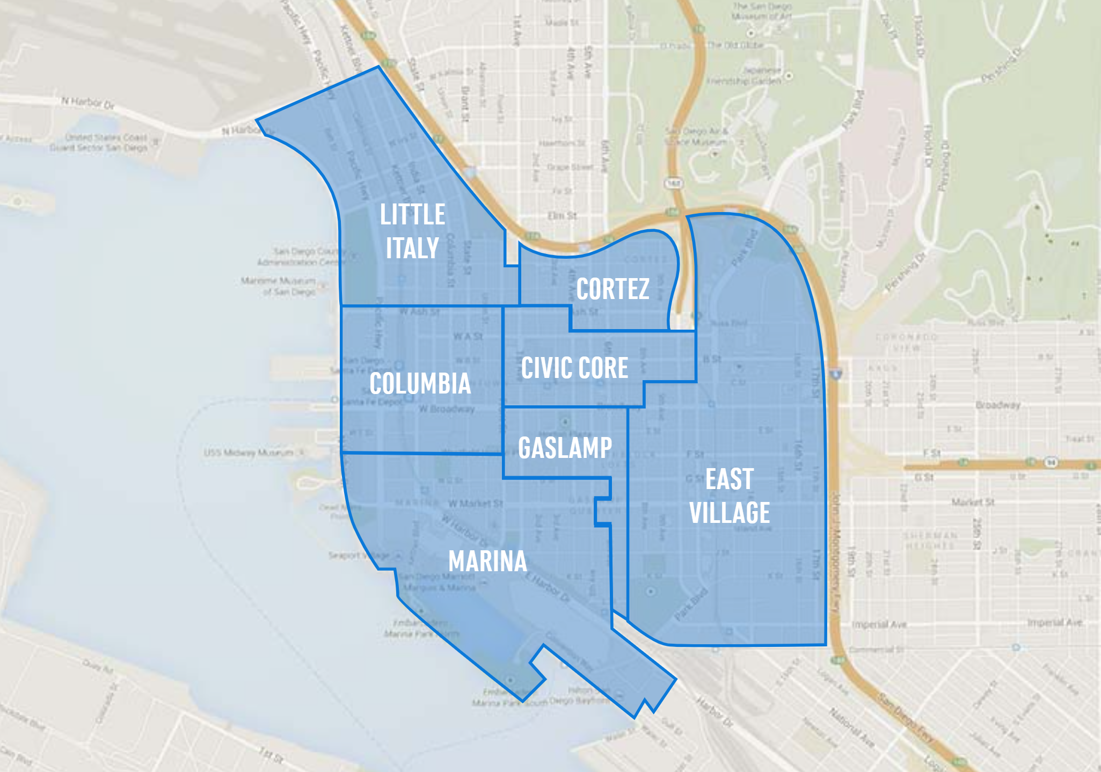
Notes:
Within San Diego there are many different sectors. East Village is shown in the picture on the left. Within East Village, there are four other districts, one of which is the BallPark district.

Slide 15
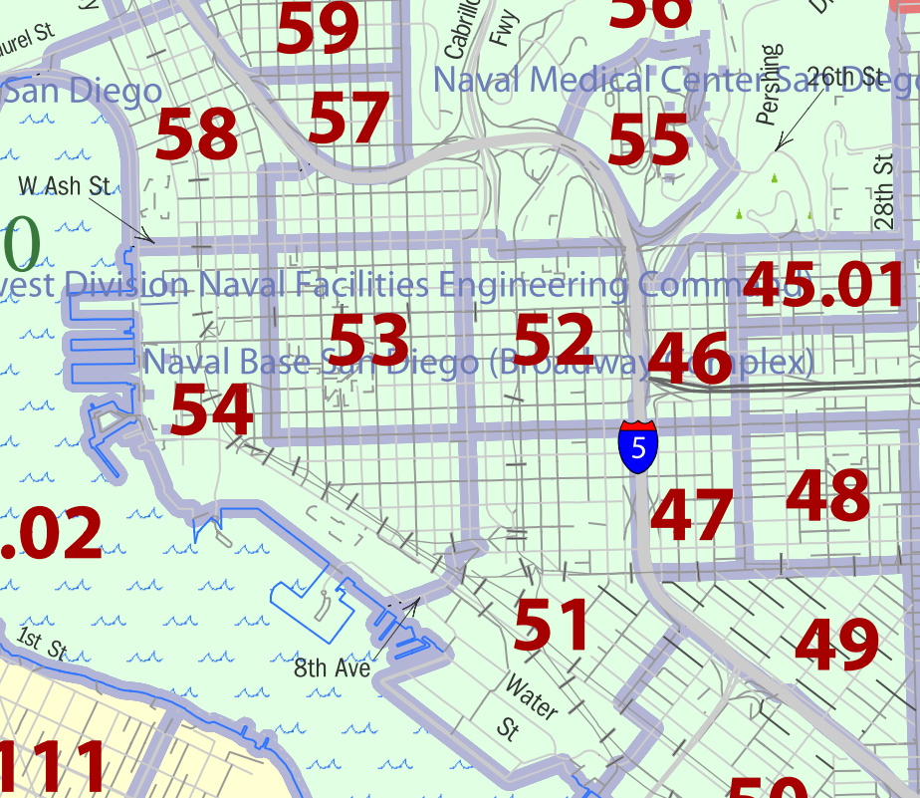
Notes:
Here is the census block map of San Diego which shows that the ballpark district is census tract “51”

Slide 16
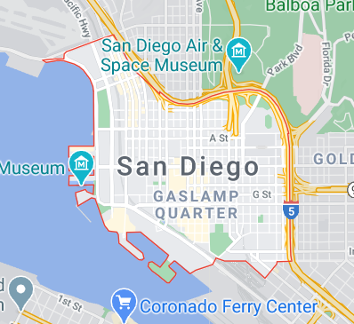
Notes:
This map clearly shows the downtown area that I used for gathering downtown data in order to calculate the growth rates

Slide 17
History/Timeline of the District
1998- Ballpark District was legally established
2004- Petco Park was completed and Padres began to play there
Notes:
For the purposes of the data, I pulled the population data from Social Explorer Census data and chose to use the years of 2000 and 2010. This accurately reflects the time at which the ballpark district was being built and finished and still captures the important growth that occurred after completion in 2004.
dbagr.PDF (sandiego.gov)
PETCO Park | Clark Construction

Slide 18
Primary Concern 1:
Did the growth of the Ballpark District outpace the growth of San Diego County, CA?

Slide 19
Total Population and Growth (ACS, 2000, 2010)
Ballpark District
San Diego County, CA
2000: 3,360
2010: 7,140 (+3,780)
Total Growth Rate: 112.5%, AAGR: 11.25%
2000: 2,813,833
2010: 3,095,313 (+281,480)
Total Growth Rate: 10.0%, AAGR: 1.0%
11.25%
1.0%
The Ballpark district grew nearly 11x greater than San Diego County
Notes:
Critical Keys: The ballpark district succeeded greatly in population growth (11.25% AAGR) by outpacing the growth of SD county (1.0%) by almost 11x as much.
Importance: Population growth is key to reducing the sprawl (the overall goal of the city of San Diego through this district creation). It is clear from this data that San Diego did an amazing job of creating the ballpark district focused on reducing the sprawl of residency within San Diego. This is why it outpaced the county in population growth by such a large margin.

Slide 20
Total Housing Units and Growth (ACS, 2000, 2010)
Ballpark District
San Diego County, CA
2000: 814
2010: 3,494 (+2,680)
Total Growth Rate: 32.92%, AAGR: 32.92%
2000: 1,040,149
2010: 1,164,786 (+124,637)
Total Growth Rate: 11.98%, AAGR: 1.20%
32.92%
1.20%
The Ballpark district grew 27x greater than San Diego County
Notes:
Critical Keys: Once again, the ballpark district succeeded in housing unit growth (32.92% AAGR) by outpacing the growth of SD county (1.20%). It is important to note that housing units is closely tied to population growth.
Importance: Much like in the Columbus case, this shows the residential infrastructure available for the ballpark district was growing at an astounding rate as compared to the entire county. This brings great attraction to the ballpark district and thus helps to mitigate sprawl.

Slide 21
Primary Concern 2:
Did downtown San Diego outpace the residence and jobs growth of the entire San Diego-Chula Vista-Carlsbad MSA?

Slide 22
Total Population and Growth (ACS, 2000, 2010)
Downtown San Diego
San Diego MSA/ County*
2000: 16,128
2010: 28,530 (+12,402)
Total Growth Rate: 76.90%, AAGR: 7.69%
2000: 2,813,833
2010: 3,095,313 (+281,480)
Total Growth Rate: 10.0%, AAGR: 1.0%
7.69%
1.0%
Downtown San Diego grew nearly 7.5x greater than San Diego County
Notes:
*The geographic area served by the San Diego MSA is also the same geographic area that is served by San Diego County, this is why they are both listed
Critical Keys: Downtown SD succeeded in population growth (7.69% AAGR) by outpacing the growth of SD county (1%) by almost 7.5x as much.
Importance: This data is critical to understanding the scale of success that San Diego had in creating the ballpark district that greatly impacted the population growth of downtown SD, thus reaching their goal of keeping the activity inside of the city and not allowing for decentralization.

Slide 23
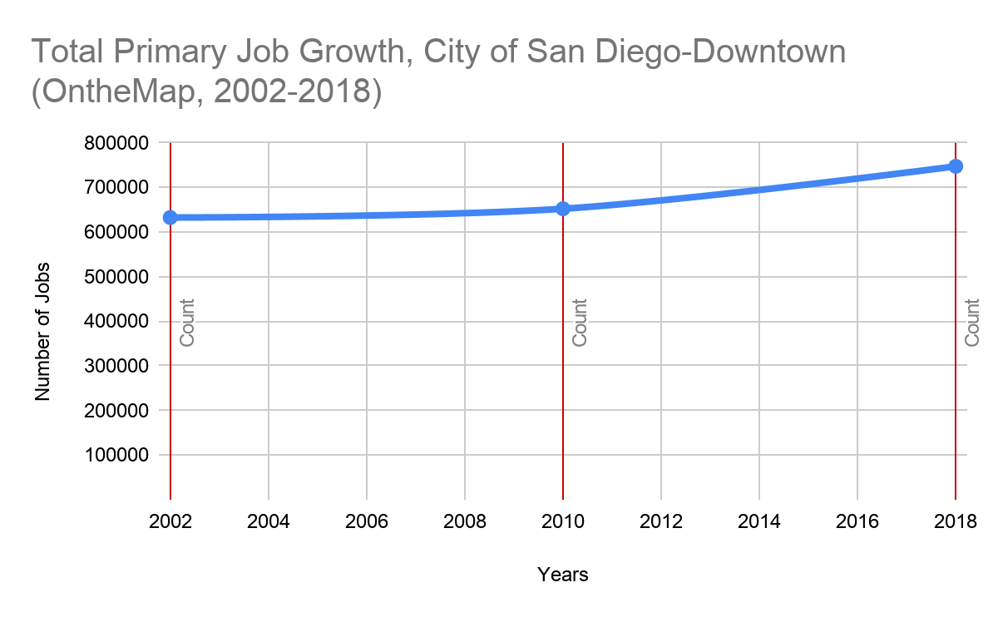
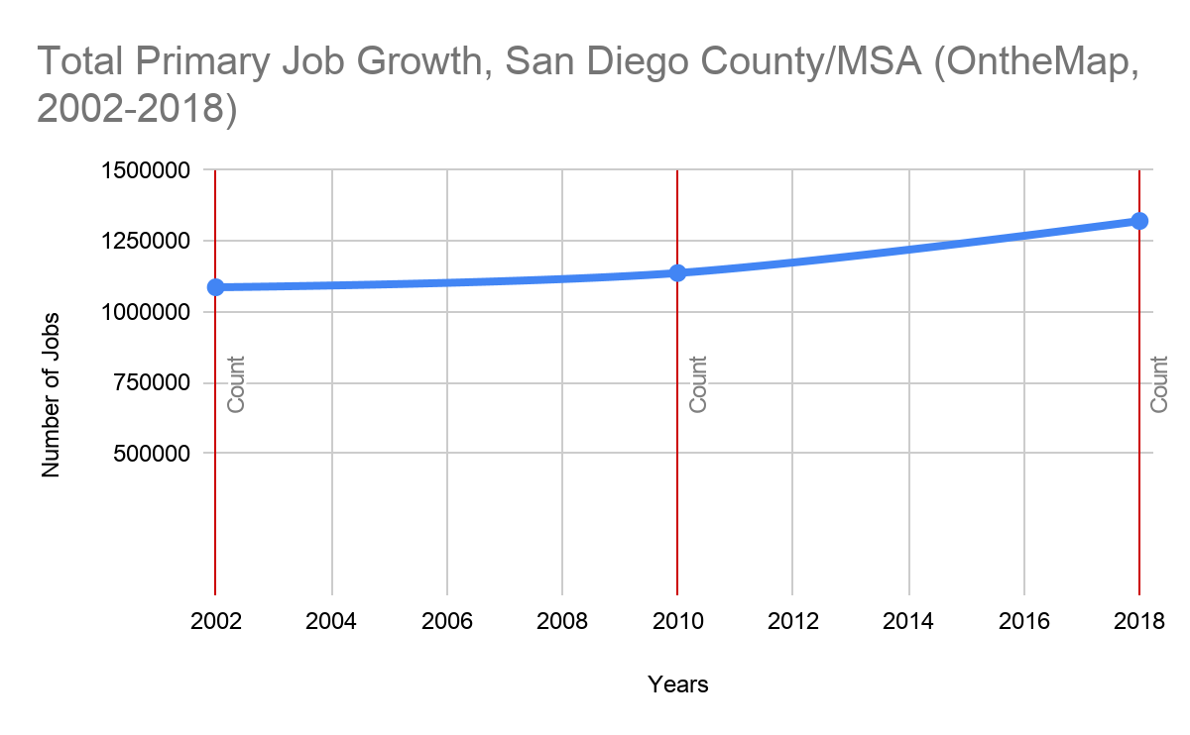
Total Primary Jobs/Growth (OnTheMap, 2002-2018)
Downtown San Diego
San Diego MSA/County*
2000: 632,771
2018: 747,538 (+114,767)
Total Growth Rate: 18.14%, AAGR: 1.13%
2000: 1,086,998
2018: 1,321,011 (+234,013)
Total Growth Rate: 21.53%, AAGR: 1.35%
1.13%
1.35%
Notes:
Critical Keys: Within primary jobs, Downtown SD (1.13 AAGR) slightly fell behind the SD County growth (1.35% AAGR).
Importance: Because job growth was not anticipated directly in the ballpark district, but rather in the surrounding districts(overall downtown), this helps us to understand the impact of the ballpark district on job growth downtown. Because downtown had average growth, this shows that the ballpark district did have an impact in the surrounding districts. Because the AAGR for both are very similar, this does not pose a great threat to sprawling in San DIego.

Slide 24
Evidence Reasoning
Columbus Arena District
Evidence:
The Arena district grew 4.5x greater in population than Franklin County
The Arena district grew 5x greater in housing units than Franklin County
Downtown Columbus declined in population growth (-.71% AAGR) as opposed to the growth of the Columbus MSA (.88%)
Downtown Columbus had minor primary job growth (.45% AAGR), which lacked behind the growth of the entire MSA which grew almost 2 times greater (1.09% AAGR)

Slide 25
Evidence Reasoning
San Diego Ballpark District
Evidence:
The Ballpark district grew nearly 11x greater in population than San Diego County
The Ballpark district grew 27x greater in housing units than San Diego County
Downtown San Diego grew nearly 7.5x greater than San Diego County
Within primary jobs, Downtown SD (1.13% AAGR) slightly fell behind the SD County growth (1.35% AAGR).

Slide 26
Conclusion: What was the overall success of the 2 districts based on their growth in residents and jobs?
San Diego Ballpark District:
Columbus Arena District:
Goal: Retard sprawling within San Diego, primarily through residential development
Goal: Re-centralize economic activity
Takeaway: The Arena District succeeded in bringing population/ residential growth into the district, however downtown Columbus still showed de-centralization trends compared to the rest of the county.
Takeaway: The Ballpark District grew rapidly in population and housing. It also helped to propel the surrounding districts into greater population growth, thus giving the downtown a significant growth advantage over the MSA. There was also average growth in jobs in the downtown. All of these point to San Diego succeeding in their goal for the Ballpark district.

Slide 27
KIN 513 Portion of Question #1
For KINES 513 Students: (a) Did the downtown areas become the location of higher wage jobs at a faster rate compared to changes elsewhere in the region? (b) Is there a greater concentration of higher paying jobs in the downtown areas compared to elsewhere in the regions? (c) Did the median household income levels in the downtown areas grow at a faster rate when compared to median income growth in other parts of the region?
Sidney Johnson

Slide 28
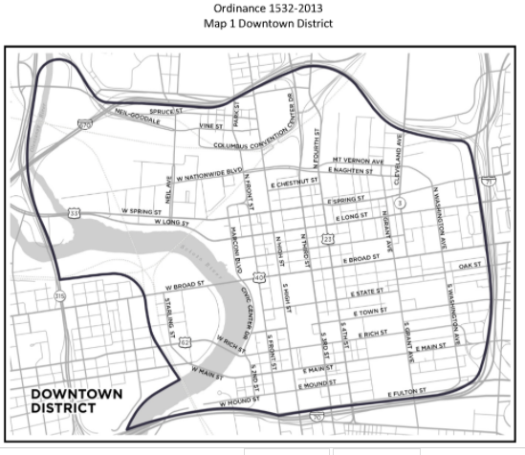
Columbus, OH Downtown Area
Source: Chapter 3359 - DOWNTOWN DISTRICT | Code of Ordinances | Columbus, OH
Census Tracts 30, 32 and 40

Slide 29
Question 1a:
Columbus, OH
Downtown Area 2002, 2010
Growth Rate- Higher Wage Jobs
Top Chart- 2002
Bottom Chart- 2010
Rate of Growth of Higher Wage Jobs is (1456-726)/726= 100.6%
Notes:
In the Columbus Downtown Area, the Rate of Growth of HIgher Wage Jobs was 100.6% between 2002 and 2010
https://www.socialexplorer.com/tables/LEHD2010/R12791339

Slide 30
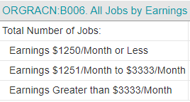
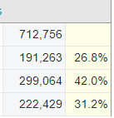
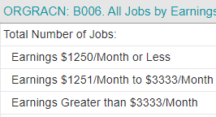
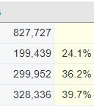
Question 1a:
Columbus, OH
MSA 2002, 2010
Growth Rate- Higher Wage Jobs
Top Chart- 2002
Bottom Chart- 2010
Rate of Growth of Higher Wage Jobs is (328,336-222,429)/222,429= 47.6%
Notes:
This slide and the preceding slide show that the rate of growth of higher wage jobs was greater in the Downtown Area of Columbus, than in the region (MSA) over the period of 2002-2010. The MSA higher-wage jobs grew at 47.6%, while the same higher wage jobs grew at 100.6% in the downtown area. Per Census.gov, the region (MSA) includes the following counties: Delaware, Fairfield, Franklin, Hocking, Licking, Madison, Morrow, Perry, Pickaway and Union

Slide 31
Question 1b: Columbus, OH % of higher wage jobs
Downtown Area
Notes:
As a point in time analysis, the 2015-2019 ACS shows a high percentage of jobs in high-earning categories (financial operations, professional occupations) and Median Household Income in the Downtown Area of $59,804.
The 2015 LEHD shows 55.7% of households in the downtown area earning more than $3,333 per month
Source: https://www.socialexplorer.com/tables/ACS2019_5yr/R12791166
https://www.socialexplorer.com/tables/LEHD2015/R12791174

Slide 32
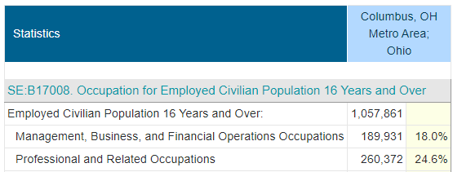
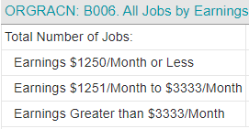
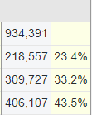
Question 1b: Columbus, OH % of Higher Wage Jobs
(Region (MSA))
Notes:
This slide and the preceding slide clearly show that there are a greater percentage of higher-wage jobs in the downtown area of Columbus compared to the Columbus region (MSA). There are a higher percentage of jobs downtown in high-earning categories (financial operations, professional occupations) -- 65.5% to 42.6%. Also, a much higher % of jobs earn more than $3,333 per month -- 55.7% to 43.5%
Per Census.gov, the region (MSA) includes the following counties: Delaware, Fairfield, Franklin, Hocking, Licking, Madison, Morrow, Perry, Pickaway and Union
https://www.socialexplorer.com/tables/ACS2019_5yr/R12791204
https://www.socialexplorer.com/tables/LEHD2015/R12791237

Slide 33
Question 1a: San Diego Downtown Growth Rate of High Wage Jobs
Notes:
2002 is shown at the top and 2010 is shown at the bottom
The rate of growth for high-wage jobs from 2002-2010 in the downtown area is (4,681-1,607)/1607= 191.3%.
https://www.socialexplorer.com/tables/LEHD2002/R12791501
https://www.socialexplorer.com/tables/LEHD2010/R12791517

Slide 34
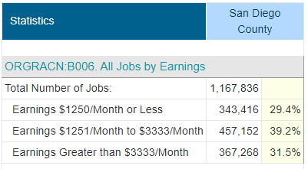
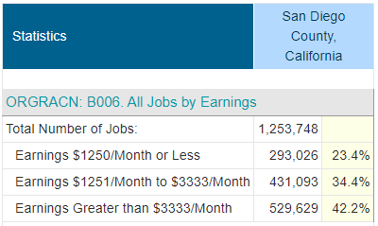
Question 1a: San Diego County (Region) Growth Rate of High Wage Jobs
Rate of Growth of High Wage Jobs for San Diego County (Region) from 2002-2010:
=(529,629-367268)/367268
= 44.2%
From 2002-2010, The Rate of Growth of High Wage Job was much higher for DOWNTOWN San Diego, than it was for San Diego County [191% vs. 44%
Notes:
2002 is shown at the top and 2010 on the bottom. This
https://www.socialexplorer.com/tables/LEHD2002/R12791508
https://www.socialexplorer.com/tables/LEHD2010/R12791526

Slide 35
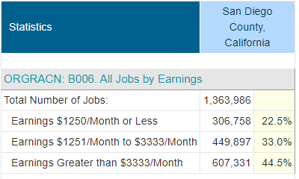
Question 1b : San Diego Downtown Area vs. County
Percent of High Wage Jobs
Notes:
This slide shows that San Diego’s downtown area has a higher percentage of high-earning jobs than for the region (San Diego County). 54% compared to 44.5% of jobs earn more than $3,333 per month
San Diego Downtown Area consists of census tracts 51, 52, 53, 54 and 58
https://www.socialexplorer.com/tables/LEHD2015/R12791471

Slide 36
Question #1c: Growth Rate of Median Household Income Downtown Area San Diego, CA
Notes:
2005 shown at top and 2015 shown at the bottom:
ACS Data
Growth Rate for Downtown= ($56,871-$46,106)/$46,106 = $23.3%

Slide 37
Question #1c: Growth Rate of Median Household Income San Diego County , CA
Notes:
2005 shown at top and 2015 shown at the bottom:
ACS Data
https://www.socialexplorer.com/tables/ACS2009_5yr/R12791574
\
Growth Rate for San Diego County= ($64,309-$62,901)/$62,901 = $0.6%
The Median Income for the Downtown area has outpaced the County 23.3% to 0.6%

Slide 38
Problem#2
The Edmonton Oilers began play in their new venue in 2016 and the Pittsburgh Penguins moved into a new venue in 2010. Relying on data that are easily accessible,
how much of the future increments [in] each team’s value would you attribute to the venue?
The Calgary Flames and the City of Calgary are building a new venue. What increment in the team’s valuation would you predict when the team begins play in the new venue?

Slide 39
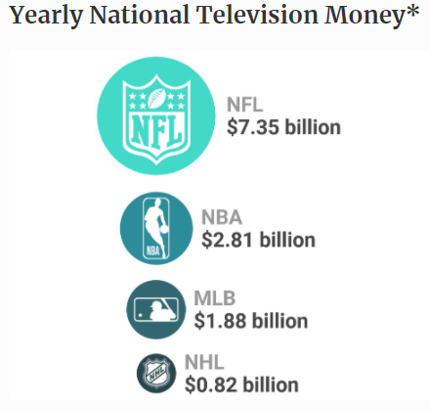
Steps in Calculating Stadium Valuation Growth
Separate league share revenue (National Television Money, etc.) generation from local revenue generation
Subtract league share revenue from total franchise valuation

Slide 40
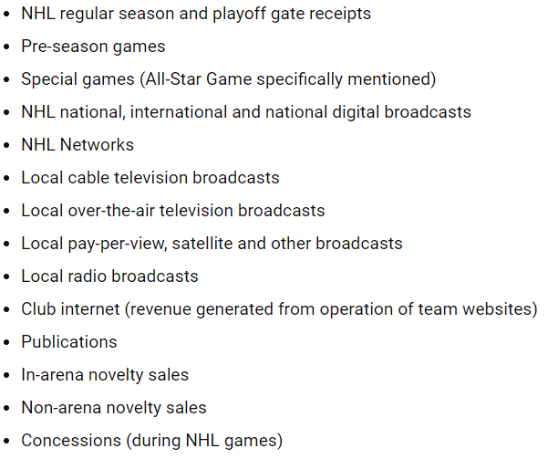
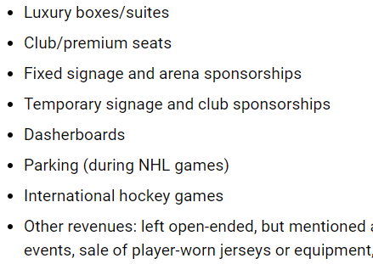
What is Hockey-Related Revenue (HRR)?
Section 50.1(a) of the National Hockey League’s Collective Bargaining Agreement
HRR is shared amongst the league teams
Notes:
https://flamesnation.ca/2020/04/24/cba-school-article-50-team-payroll-range-system/

Slide 41
Edmonton Oilers

Slide 42
Difficult to Isolate Stadium Impact in Valuation
Complications in separating Overall Value Growth from Stadium Value
“Revenues tend to go up 20 to 50 per cent in the first year in a new building”
https://edmontonjournal.com/sports/hockey/nhl/cult-of-hockey/new-forbes-rankings-show-katz-doing-well-with-oilers-despite-slight-revenue-dip/
New Television Contract with NBC beginning in 2012-2013 increased value of all teams substantially
https://sports.yahoo.com/blogs/nhl-puck-daddy/nhl-nbc-rights-fees-even-lockout-cancels-2012-171130920--nhl.html

Slide 43
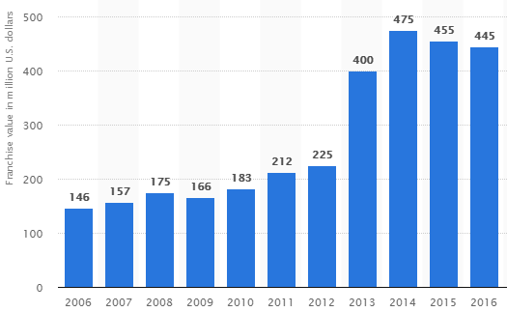
Edmonton Value Growth 2006-2016 prior to opening of Rogers Place
Negative Growth Rate 2014-2016 of -6.3% [avg. 3.2% per year]
Largest Value Growth between 2012&2013 [77.8%]
New TV contract
Arena announcement
Notes:
The value of the Edmonton Oilers franchise nearly doubled before the 2012-2013 season. Value of Edmonton Oilers franchise shoots up to $400 million, Forbes reports
Edmonton had a negative growth rate in the Final two seasons before opening the new arena.

Slide 44
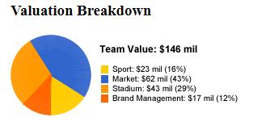
Edmonton Oilers
2006 Stadium Value
2006 Stadium Value of $43M (one of the oldest facilities in the NHL)
2006 Stadium Value was 29.5% of Total Team Value
https://images.forbes.com/lists/2006/31/biz_06nhl_Edmonton-Oilers_314229.html

Slide 45
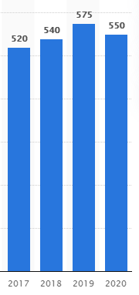
Edmonton Oilers Franchise Value 2017-2020 After Opening of Rogers Place
New Stadium opened at beginning of 2016-2017 season
Franchise value grew 16.9% in first year at Rogers Place [$445M in 2015-16 to $520M]
Value Growth Rate of 10.6% from 2017-2019 (avg. 5.3% per year).
Loss in 2020 attributable to COVID-19 pandemic
• Edmonton Oilers revenue 2005-2020

Slide 46
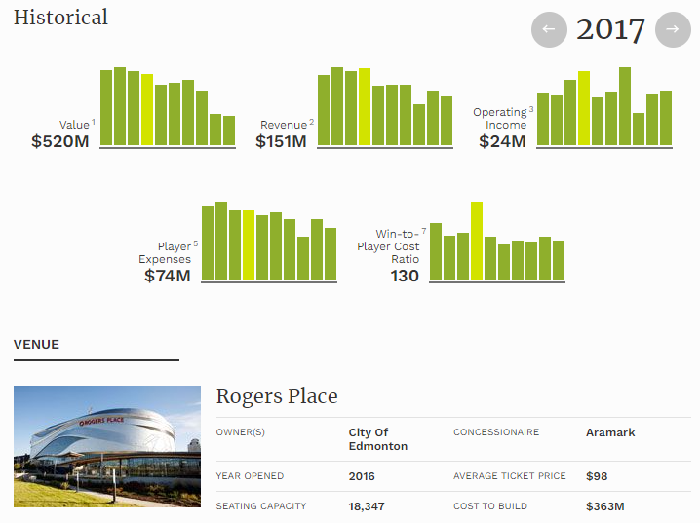
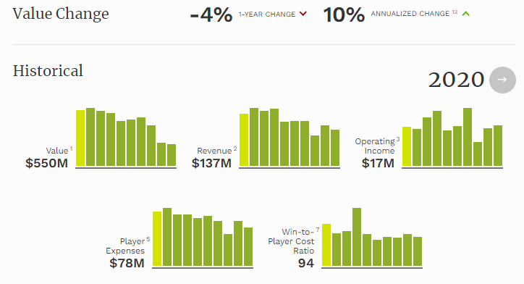

Slide 47
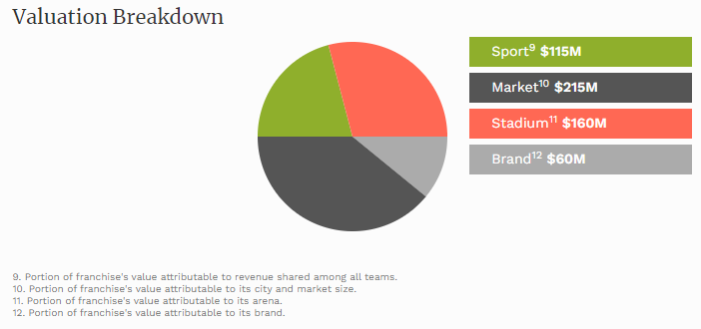
Edmonton Oilers 2020 Stadium Value
Per Forbes, Stadium is worth $160M in 2020
29% of $550M franchise value
https://www.forbes.com/teams/edmonton-oilers/?sh=3080dcb91629

Slide 48
Pittsburgh Penguins

Slide 49
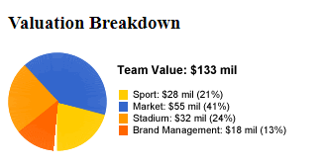
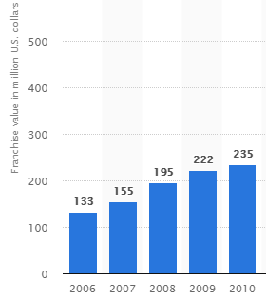
Pittsburgh Penguins-
Franchise Values 2006-2010 prior to opening of Consol Energy Center (now PPG Paints)
Value Growth Rate of 76.7% [19.2% per year] from 2006-2010
2006 Stadium Value = $32M
2006 Stadium Value was 24.1% of Team Value
At the time, Mellon Stadium was the oldest venue in the NHL. Very few luxury suites and poor lease
https://www.statista.com/statistics/194977/nhl-franchise-value-of-the-pittsburgh-penguins-since-2006/
Notes:
2006 Stadium Value (Forbes)
2006-2010 Team Values

Slide 50
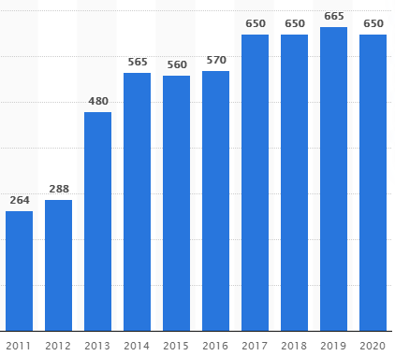
Pittsburgh Penguins
Franchise Values 2010-2020 after Opening of new stadium
Value Growth Rate of 12.3% first year in new stadium [2009-10 $235M, 2010-11 $264M]
Biggest jump of 66.7% between 2012 and 2013 seasons
(National TV Contract)
2013-2019:
Value Growth Rate of 38.5% [6.4% avg. per year]
Source:
Pittsburgh Penguins on the Forbes The Business of Hockey List
https://www.statista.com/statistics/194977/nhl-franchise-value-of-the-pittsburgh-penguins-since-2006/

Slide 51
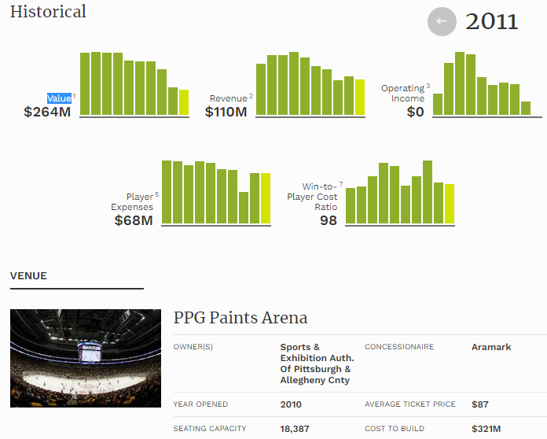
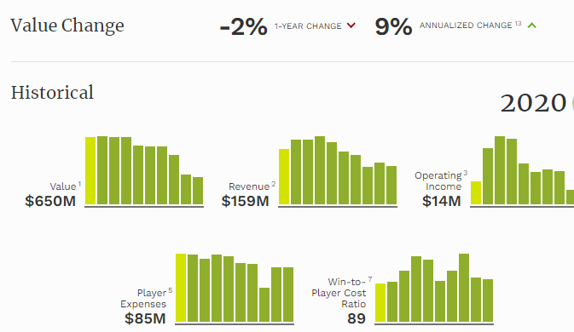

Slide 52
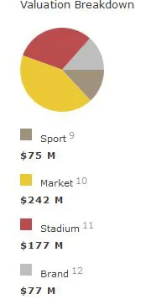
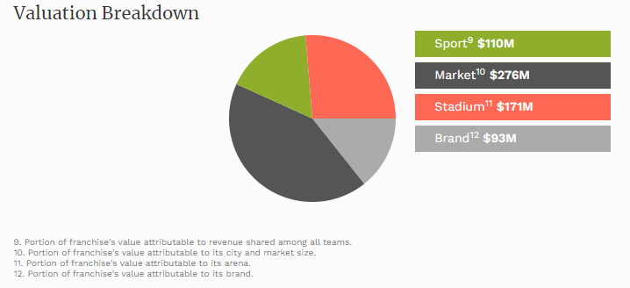
Stadium Value as a Percentage of Total Team Value
2016 stadium value=$177M
Stadium Value%= 31.1%
https://www.pensburgh.com/2016/11/30/13794530/forbes-values-penguins-at-570-million
2020 Stadium Value=$171M
Stadium Value%=26.3%
https://www.forbes.com/teams/pittsburgh-penguins/?sh=54c4135f4cca
Notes:
2016 is shown on the left and 2020 is shown on the right

Slide 53
Summary for Question 2:
For the Pittsburgh Penguins, the value growth rate when moving to the new stadium was substantial, but the growth was intertwined the introduction of new television contracts in the U.S. (2012) and Canada (2013).
The value of the stadium as a percentage of total value in 2006 before the move in 2010 was 24%. After the move, the percentage ballooned to 31% in 2016 and fell again to 26 in 2020%.
For the Edmonton Oilers, the stadium value as a percentage of total value has remained steady at 29% in 2006 before the move and 2020 after the move.
The new ownership group in Calgary can expect the new stadium value to account for approximately 30% of the initial valuation in their first year at the stadium.

Slide 54
Summary for Question 2 (cont.) Increment Expected when Moving to New Arena
The Pittsburgh Pirates had an increase in value 12% in their first year of play in their new area.
The Edmonton Oilers had an increase of 17% in theirs.
Calgary can expect an increase in ticket sales and merchandise in its first year that will increase their average earnings between 15 and 20 percent in their first year of operation in the new arena.

Slide 55
Question 3

Slide 56
Jerry Bruckheimer and David Bonderman paid the National Hockey League (NHL) $650 million for the league’s 32nd franchise. The new team will play in Seattle, where the newly renovated arena will open for the 2021-22 season. There are rumors that the arena will also serve as a home to a franchise from the National Basketball Association (NBA) in the near future.
Q1: Under the assumption that the rumors are false, and there will not be an NBA team in the market, evaluate whether the NHL franchise will produce enough revenues to sustain a market value of at least $650 million. What would you project the valuation of the team will be after a year in the new arena?

Slide 57
Seattle-Tacoma-Bellevue MSA (Social Explorer, ACS 2019)
Demographics
Population: 3,871,323
50.1% Male, 49.9 % Female
Percentage of Population Age 18-44: 39.5%
Percentage of Population with Highest Educational Attainment Bachelor’s Degree: 43%
Percentage of Households Earning At Least $75,000: 56.7%
Percentage of Population in Labor Force: 68.5%
Seattle DMA: 1,854,810 TV Households (2019)

Slide 58
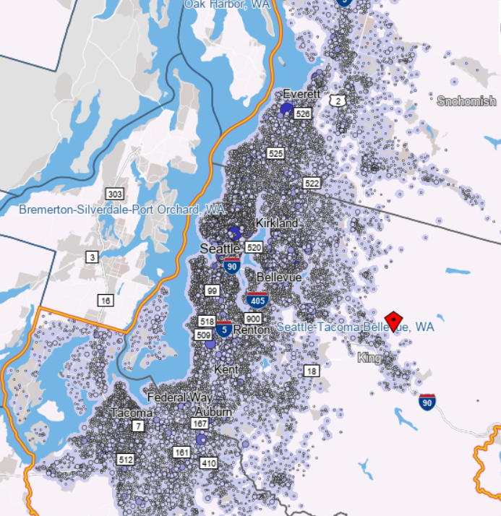
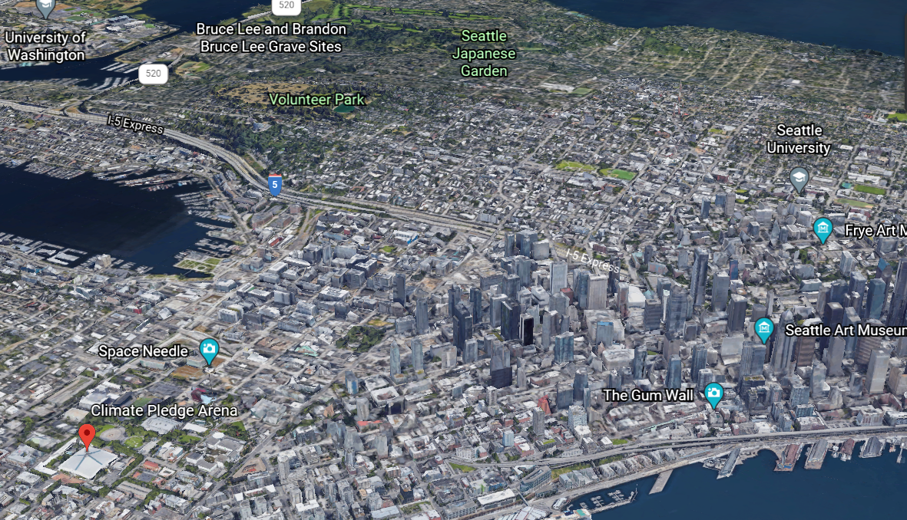
Seattle MSA
Notes:
Jobs are concentrated in downtown Seattle, Climate Pledge arena is located near the jobs downtown and near the Space Needle.
OnTheMap, Google Earth

Slide 59
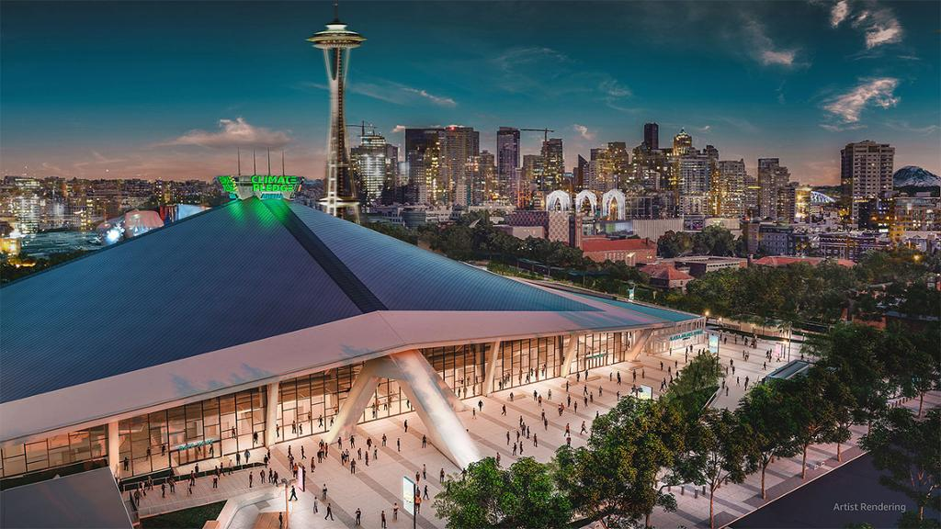
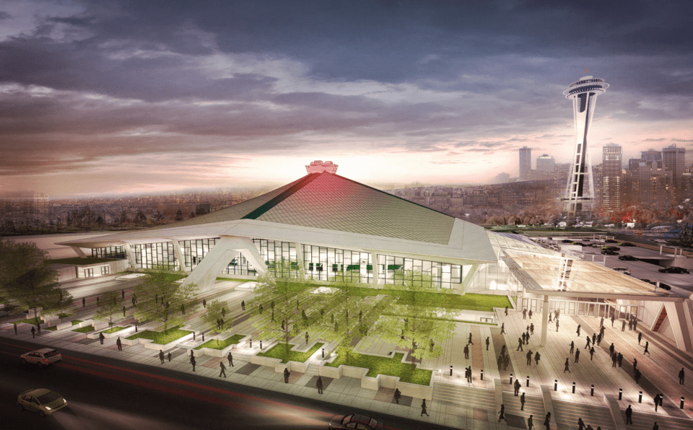
Climate Pledge Arena: Home of the Seattle Kraken
Will add 41 NHL home games plus playoffs to the market every year
Capacity of 17,100 fans for hockey games
701,100 more tickets added to market off games
Entertainment events add to that total
Notes:
Climate Pledge Arena has a unique design that will attract fans and tourists to its new renovation. It is powered entirely by renewable energy creating a connection with a region that cares about the environment.

Slide 60
Seattle’s Ticket Demand
Seattle Franchises/Sports Teams:
Seattle Seahawks - NFL - Total Tickets: 549,920
Seattle Mariners - MLB - Total Tickets: 3,845,880
Seattle Storm - WNBA - Total Tickets: 307,800
Seattle Sounders - MLS - Total Tickets: 641,274
Washington Huskies - NCAA Football - Total Tickets: 350,000
Washington Huskies - NCAA Basketball - Total Tickets: 200,000
Seattle U - NCAA - Total Tickets: 20,000
Seattle Kraken - NHL - 701,100
Supply & Demand:
Total Tickets Available Major Pro Sports/NCAA: 7,000,000
Per Capita Sales Required: 1.8
Notes:
The Seattle Market is not overly stressed by supply of sports tickets even with the addition of the Seattle Kraken supply.

Slide 61
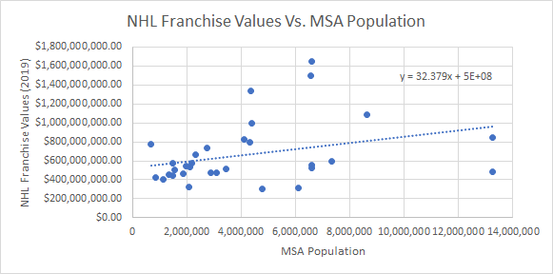
NHL Franchise Values
Notes:
2019 Franchise Values from Forbes: https://www.thescore.com/nhl/news/1905303
MSA Population Data from Social Explorer and Statista: https://www.statista.com/statistics/443749/canada-population-by-metropolitan-area/

Slide 62
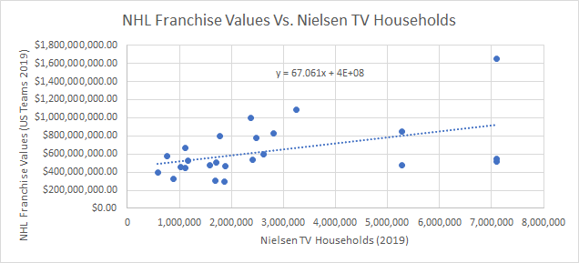
NHL Franchise Values
Notes:
2019 Franchise Values from Forbes: https://www.thescore.com/nhl/news/1905303
2019 Nielsen Data: https://mediatracks.com/resources/nielsen-dma-rankings-2019/

Slide 63
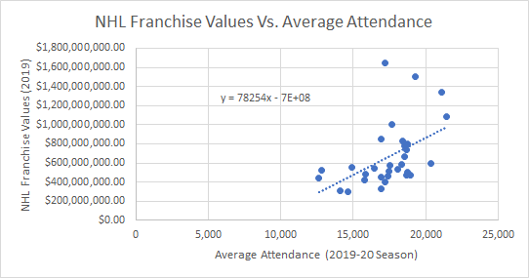
NHL Franchise Values
Notes:
2019 Franchise Values from Forbes: https://www.thescore.com/nhl/news/1905303
2019-20 Attendance Data from ESPN: https://www.espn.com/nhl/attendance/_/year/2020

Slide 64
Regressions
Franchise Value vs MSA Population
Y = 32.379x + 5*10^8
If Y = $650,000,000 , X = 4,632,632 People
Franchise Value vs Attendance
Y = 78,254x - 7*10^8
If Y = $650,000,000 , X = 17,252 Fans per Game
Franchise Value vs Nielsen TV Households
Y = 67.061x + 4*10^8
If Y = $650,000,000 , X = 3,727,949 TV Households
Notes:
Based on the Scatter Plots, these figures would plot them at a value of $650,000,000. The Seattle MSA is within a million people of this estimate and has about that capacity. Nielsen and Population data are also skewed by the New York and Los Angeles franchises respectively.

Slide 65
Comparable MSA’s
Seattle
Expansion Fee: $650 Million
MSA Population: 3,871,323
Nielsen TV Households: 1, 854,810
Climate Pledge Capacity: 17,100
% of Households with Income Greater than $75,000: 56.7%
Pittsburgh
Franchise Value: $665 Million
MSA Population: 2,331,447
Nielsen TV Households: 1,108,780
Average Attendance: 18,537
% of Households with Income Greater than $75,000: 42.2 %
Tampa
Franchise Value: $470,000,000
MSA Population: 3,097,859
Nielsen TV Households: 1,875,420
Average Attendance: 18,922
% of Households with Income Greater than $75,000: 36.7%
Las Vegas
Franchise Value: $580 Million
MSA Population: 2,182,004
Nielsen TV Households: 766,500
Average Attendance: 18,310
% of Households with Income Greater than $75,000: 41.3%
Initial Expansion Fee: $531 Million (2019 $)
2019 Forbes/Nielsen Values

Slide 66
Comparable MSA’s: Forbes 2020 Valuations
Seattle
Sport: $100-120 Million
Stadium: Newly Renovated, Clean Energy
Market: Excitement for a new team
Brand: Similar to Vegas as Expansion
Cost to Build: $1 Billion
Average Ticket: High earnings, willingness to pay
Pittsburgh
Sport: $110 Million
Stadium: $171 Million
Market: $276 Million
Brand: $93 Million
Cost to Build Arena: $321 Million
Average Ticket: $87
Tampa
Sport: $120 Million
Stadium: $133 Million
Market: $165 Million
Brand: $53 Million
Cost to Build: $139 Million
Average Ticket: $64
Las Vegas
Sport: $98 Million
Stadium: $150 Million
Market: $238 Million
Brand: $84 Million
Cost to Build: $375 Million
Average Ticket: $102
Notes:
2020 Forbes Valuation Data:
Tampa: https://www.forbes.com/teams/tampa-bay-lightning/?sh=3923c83b3385
Vegas: https://www.forbes.com/teams/vegas-golden-knights/?sh=4763c7424c2b
Pittsburgh: https://www.forbes.com/teams/pittsburgh-penguins/?sh=72d327454cca
Climate Pledge Cost: https://climatepledgearena.com/arena-info/

Slide 67
Seattle’s Projected Value
The Seattle Kraken will exceed the value of their $650 Million expansion fee. The Seattle market is not overly saturated with tickets and there is demand for Kraken tickets as the franchise has already sold out of season tickets.
Seattle is a larger market than Pittsburgh and will be able to charge higher average ticket prices with such a valuable arena. Seattle compares to Tampa in population and media statistics but will have a more valuable market and arena. Over 56% of households in the Seattle MSA earn over $75,000 meaning that the region is built to handle added ticket demand.
Similar to Las Vegas’ ability to surpass their expansion fee, Seattle will be able to surpass a franchise valuation of $650 Million and arrive closer to $700 Million with the Climate Pledge Arena.

Slide 68
Q2: The owners of the Houston Rockets has touted the greater Houston market as the next one for an NHL franchise. If you worked for the NHL, what would you project as an appropriate expansion fee for a franchise in that market?

Slide 69
Houston MSA
Demographics
Population: 6,884,138
49.6% Male, 50.4 % Female
Percentage of Population Age 18-44: 38.6%
Percentage of Population with Highest Educational Attainment Bachelor’s Degree: 32.8%
Percentage of Households Earning At Least $75,000: 45.8%
Percentage of Population in Labor Force: 66.7%
Nielsen TV Households: 2,423,360 TV Households (2019)

Slide 70
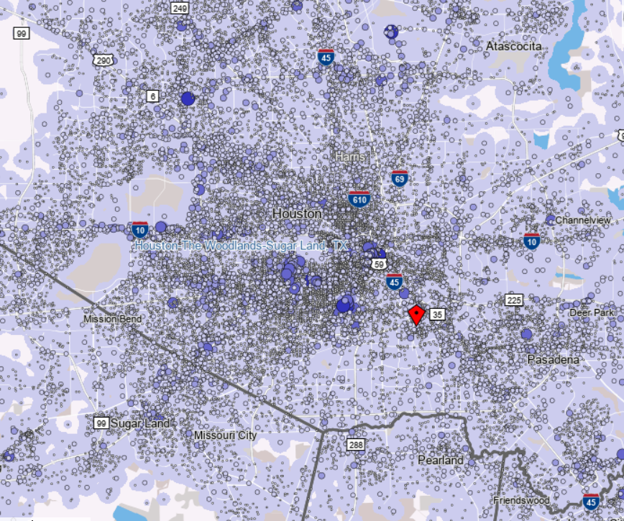
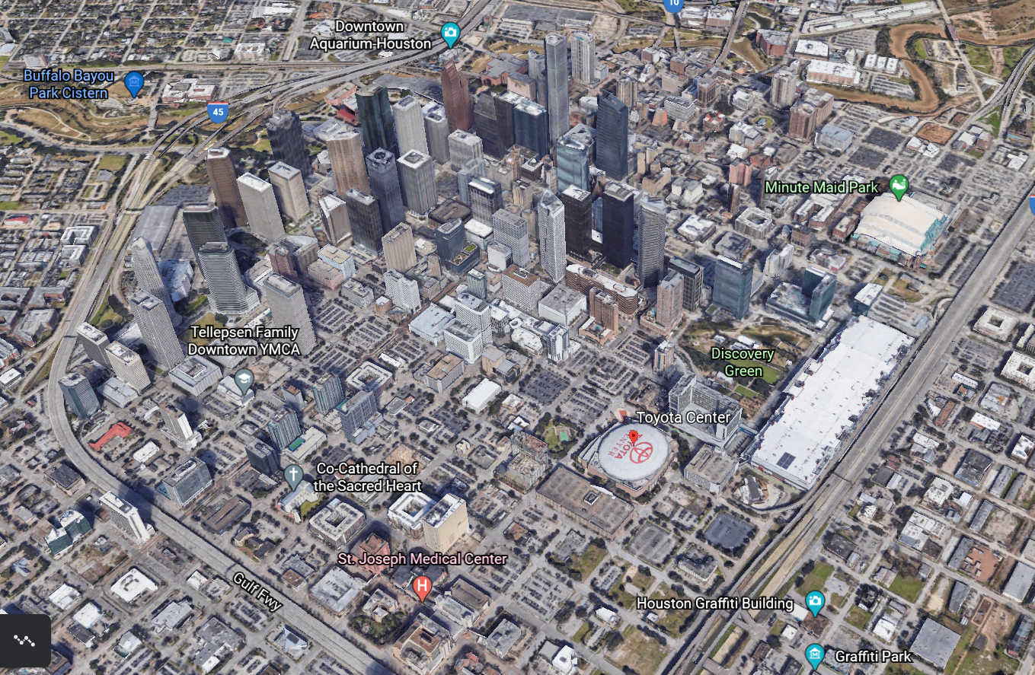
Houston MSA - Location

Slide 71
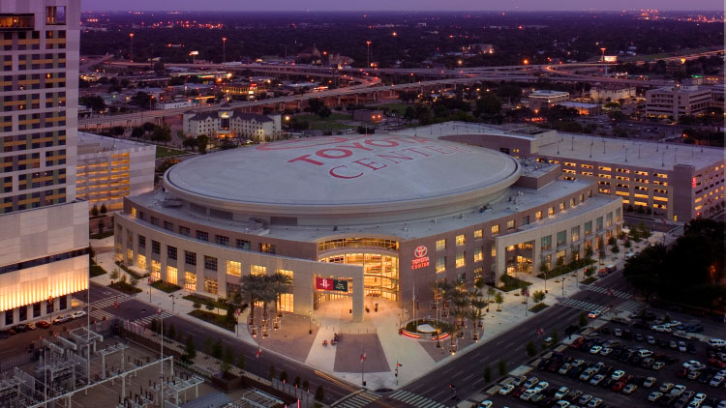
Toyota Center - Placemaking

Slide 72
Houston & Seattle
Seattle
Expansion Fee: $650 Million
MSA Population: 3,871,323
Nielsen TV Households: 1, 854,810
Climate Pledge Capacity: 17,100
% of Households with Income Greater than $75,000: 56.7%
Houston
Houston Rockets 8th most Valuable NBA Team at $2.5 Billion
MSA Population: 6,884,138
Nielsen TV Households: 2,423,360
Toyota Center Capacity: 18,055
% of Households with Income Greater than $75,000: 45.8%
Notes:
Houston Rockets Valuation: https://www.forbes.com/nba-valuations/list/

Slide 73
Houston’s Ticket Demand
Major Houston Franchises/Sports Team
Houston Texans - NFL - 577,760
Houston Rockets - NBA - 740,255
Houston Astros - MLB - 3,334,608
Houston Dynamo - MLS - 374,663
Houston Cougars - NCAA Basketball - 142,000
Houston Cougars - NCAA Football - 200,000
Rice Owls - NCAA Basketball - 104,160
Rice Owls - NCAA Football - 235,000
Houston Dash - NWSL - 84,000
Rodeo - 2,000,000
Supply & Demand:
Total Tickets Available: 8,000,000
Per Capita Sales Required: 1.16

Slide 74
Dallas Stars Forbes 2020 Valuation
MSA Population: 7,320,663
Nielsen TV Households: 2,622,070
Franchise Valuation: $575 Million
Sport: $108 Million
Market: $249 Million
Stadium: $145 Million
Brand: $73 Million
Cost to Build Arena: $420 Million
Average Ticket: $60
Notes:
Dallas Valuation: https://www.forbes.com/teams/dallas-stars/?sh=137dea775fdd

Slide 75
NHL Media Deals
Newly rumored $400 Million per year deal with ESPN
$500 Million deal with Rogers in Canada
Local TV deals
NHL Franchises will share $900 Million per year from these two media contracts alone when the ESPN deal begins. Adding Seattle changes each team’s cut from $29 Million per year to $28.125 Million. Adding a 33rd franchise would cut each team to $27.273 Million as well as take away from a team like Dallas’ local media deal.
Notes:
Media Deal Sources
https://www.pensionplanpuppets.com/2020/7/11/21318449/nhl-accounting-in-a-pandemic-season-divvying-up-debt-instead-of-dollars-escrow-salary-cap
https://awfulannouncing.com/espn/winners-and-losers-of-the-nhls-tv-deal-with-espn.html
https://www.latimes.com/entertainment-arts/business/story/2021-03-10/nhl-returns-to-espn-with-a-seven-year-deal-with-four-stanley-cup-finals

Slide 76
Regressions
Franchise Value vs MSA Population
Y = 32.379x + 5*10^8
If X = 6,884,138 , Y = $722,901,504
Franchise Value vs Attendance
Y = 78,254x - 7*10^8
If X = 18,055, Y = $712,875,970
Franchise Value vs Nielsen TV Households
Y = 67.061x + 4*10^8
If X = 2,423,360, Y = 562,512,945
Notes:
Based on the Scatter Plots from the Seattle question, Houston will be a valuable franchise. Nielsen and Population data are also skewed by the Los Angeles franchises.

Slide 77
Houston Expected Expansion Fee
Houston would face a steep expansion fee with the large population, media market, ready arena, and valued standings in other leagues such as the NBA. The Stars stand as the 12th most valuable team in the NHL and knowing that Houston would encroach on their territory in Texas, especially in media rights, the expansion fee would have to help cover any losses to other franchises. Each team would also be sacrificing home games on their schedule by adding another franchise into the scheduling format, which causes varied levels of lost individual team revenue.
The Seattle expansion fee was raised $120 Million from the fee Las Vegas paid when adjusted for inflation, I would project a similar increase for Houston to join which could stand anywhere from $725-750 Million. This expansion fee would cost around the 8-10 range of most valuable NHL franchises, which equates with Houston’s standing as a major market in professional sports and the United States.

